Slide 1
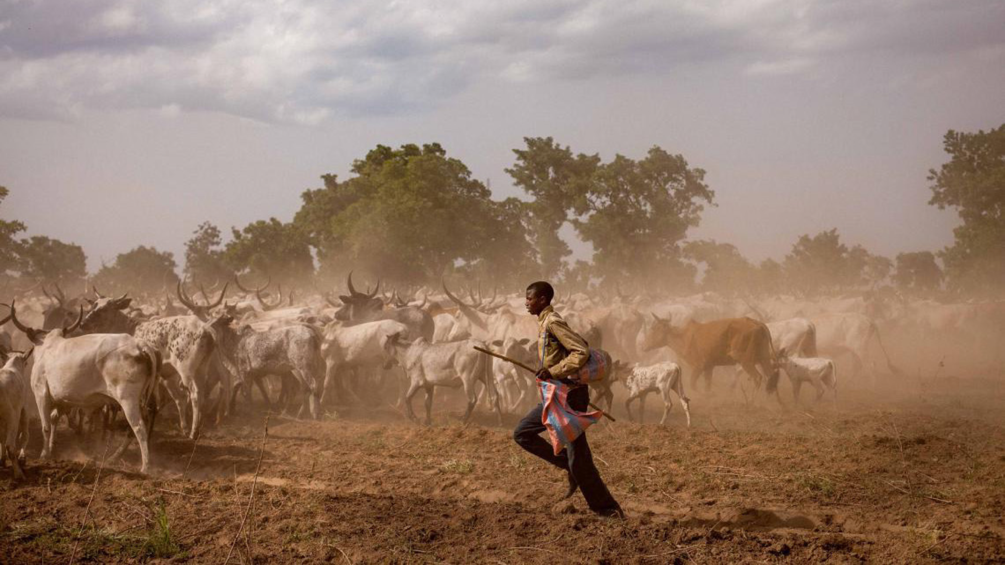


Roadmap for IYRP 2026
IYRP Global Alliance
Global Secretariat
Updated Sept 2025

Slide 2
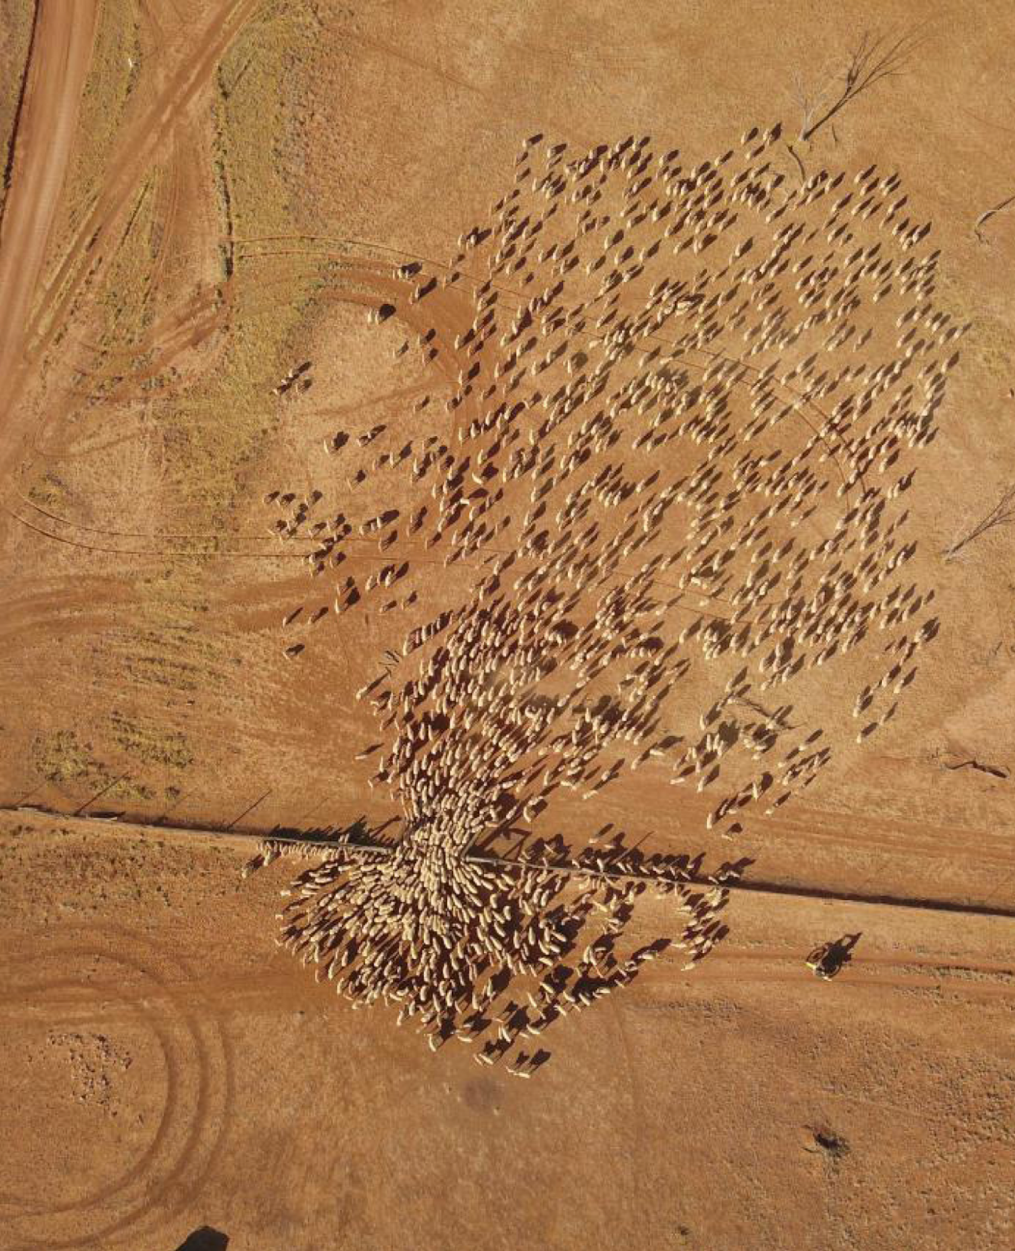
Outline of the presentation
Why do we need an International Year for Rangelands and Pastoralists?
Short history and structure of the IYRP Global Alliance
Global Action Plan for IYRP 2026
Road map 2025-2026
Beyond 2026
© Wendy Sheehan
Notes:
This presentation is intended to be used by any member of the IYRP International Support Group during presentations, or it can be printed and handed out at pastoralist gatherings. French and Spanish versions are available.

Slide 3
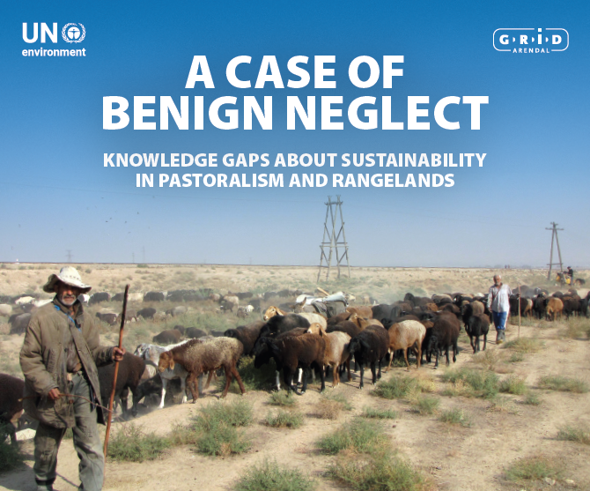
Why an IYRP 2026?
Reveal important contributions of rangelands & pastoralists for food security, the economy and the environment
Break myths and misunderstandings about rangelands and pastoralists and amplify the voices of pastoralists
Fill knowledge gaps with more participatory research
Promote informed, science-based policies and legislation throughout the world
Increase sustainable and ethical funding and investment in rangelands and for pastoralists
UNEP Gap Analysis Report:
Notes:
The IYRP is not just to celebrate, but also to raise awareness, increase action, and bring greater attention to the challenges faced by pastoralists for sustainability and stewardship of rangelands. The ‘Benign Neglect’ report prepared by UNEP in 2019 identified many gaps in our knowledge of these systems and led to a resolution at the fourth meeting of the United Nations Environment Assembly for greater policy and investment focus on rangelands and for pastoralists.
[https://www.unenvironment.org/resources/report/case-benign-neglect-knowledge-gaps-about-sustainability-pastoralism-and-rangelands]
During the campaign for designation of IYRP in 2015-2021, there was a significant increase in activities being undertaken by members of the IYRP International Support Group (now renamed the IYRP Global Alliance), such as the Rangeland Atlas, the World Pastoralist Map, outreach to events such as the World Food Summit, the SDG-High Level Political Forum, and the Conference of Parties of UNCBD, UNCCD, UNFCCC, etc. Since the designation in 2022 of IYRP2026, these actions have increase significantly.
Please see: https://iyrp.info/iyrp-achievements-and-upcoming-events

Slide 4
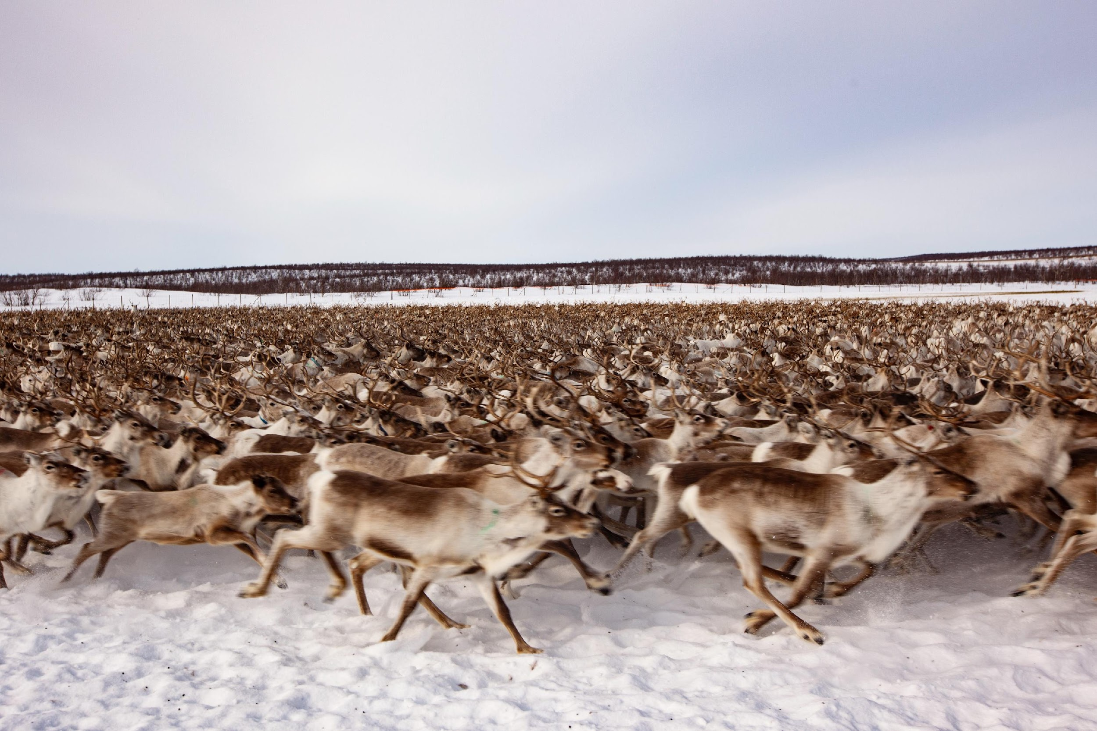
Getting to sustainability
Pastoralism is the Future!
Film on IYRP YouTube
Rangelands support livelihoods of 500 million people and another 2 billion people along the value chain
Pastoralist livestock products have high-value protein and are rich in nutrients
Carbon sinks can be significant in rangeland/pastoral systems
Rangelands are global biodiversity hotspots and habitats for numerous endangered species and offer valuable grazing land for both livestock & wildlife
Rangelands cover approximately half of the Earth’s land surface
© Lawrence Hislop
Notes:
Why are rangelands and pastoralists important?
WATCH THIS!
https://www.youtube.com/watch?v=DeqITzac9Ac

Slide 5
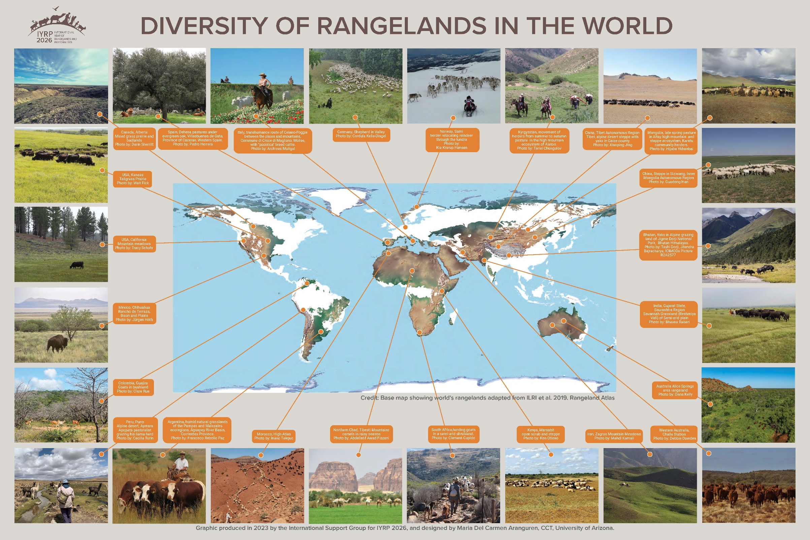
© Kalyan Varma
Notes:
IYRP aims to raise awareness of the importance of rangelands to the global economy so as to dispel the myth that they are all "wastelands", and to stop them from being indiscriminately changed to other uses. Mongolia’s successful submission to the UN General Assembly defines rangelands as “lands on which the indigenous vegetation is predominantly grasses, forbs or shrubs that are or can be grazed, and which are used as a natural ecosystem for raising grazing livestock and wildlife”. This poster shows the amazing diversity of rangelands. Some rangelands (such as in Europe) do not appear on the base map because of mapping scale issues. Researchers continue to collect data to expand and deepen our knowledge of rangelands in the world.

Slide 6
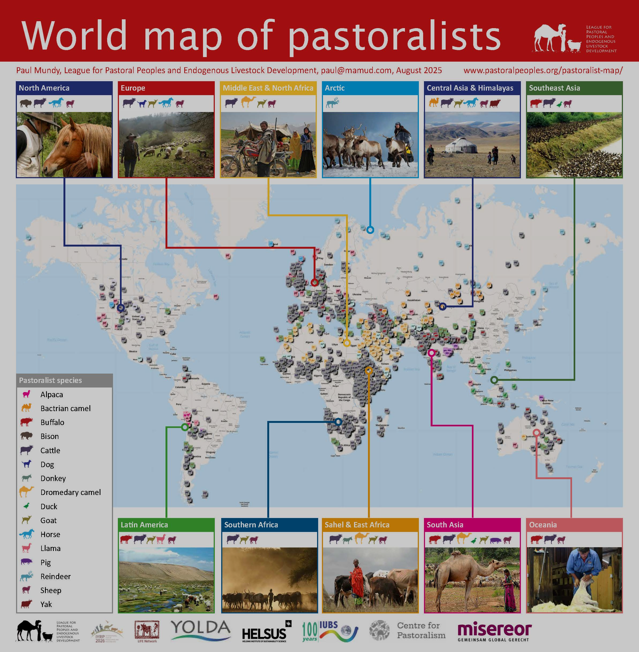
© Kalyan Varma
Notes:
Similarly, IYRP aims to raise awareness of the importance of pastoralism around the world.
There are many forms of pastoralism in the world. Mongolia’s submission to the UN General Assembly defines pastoralists as “people who raise livestock or semi-domesticated animals on rangelands, including ranchers, nomads and transhumant herders”. While these definitions are not yet universally accepted, they have been embraced by the wide coalition of IYRP Alliance members as adequate for global inclusivity.
The League for Pastoral Peoples continues to improve the global map and invites pastoralist communities to contact them to be registered on the map.
(http://www.pastoralpeoples.org/wp-content/uploads/2023/07/Pastoralist-map-poster-7.23-print.pdf)

Slide 7
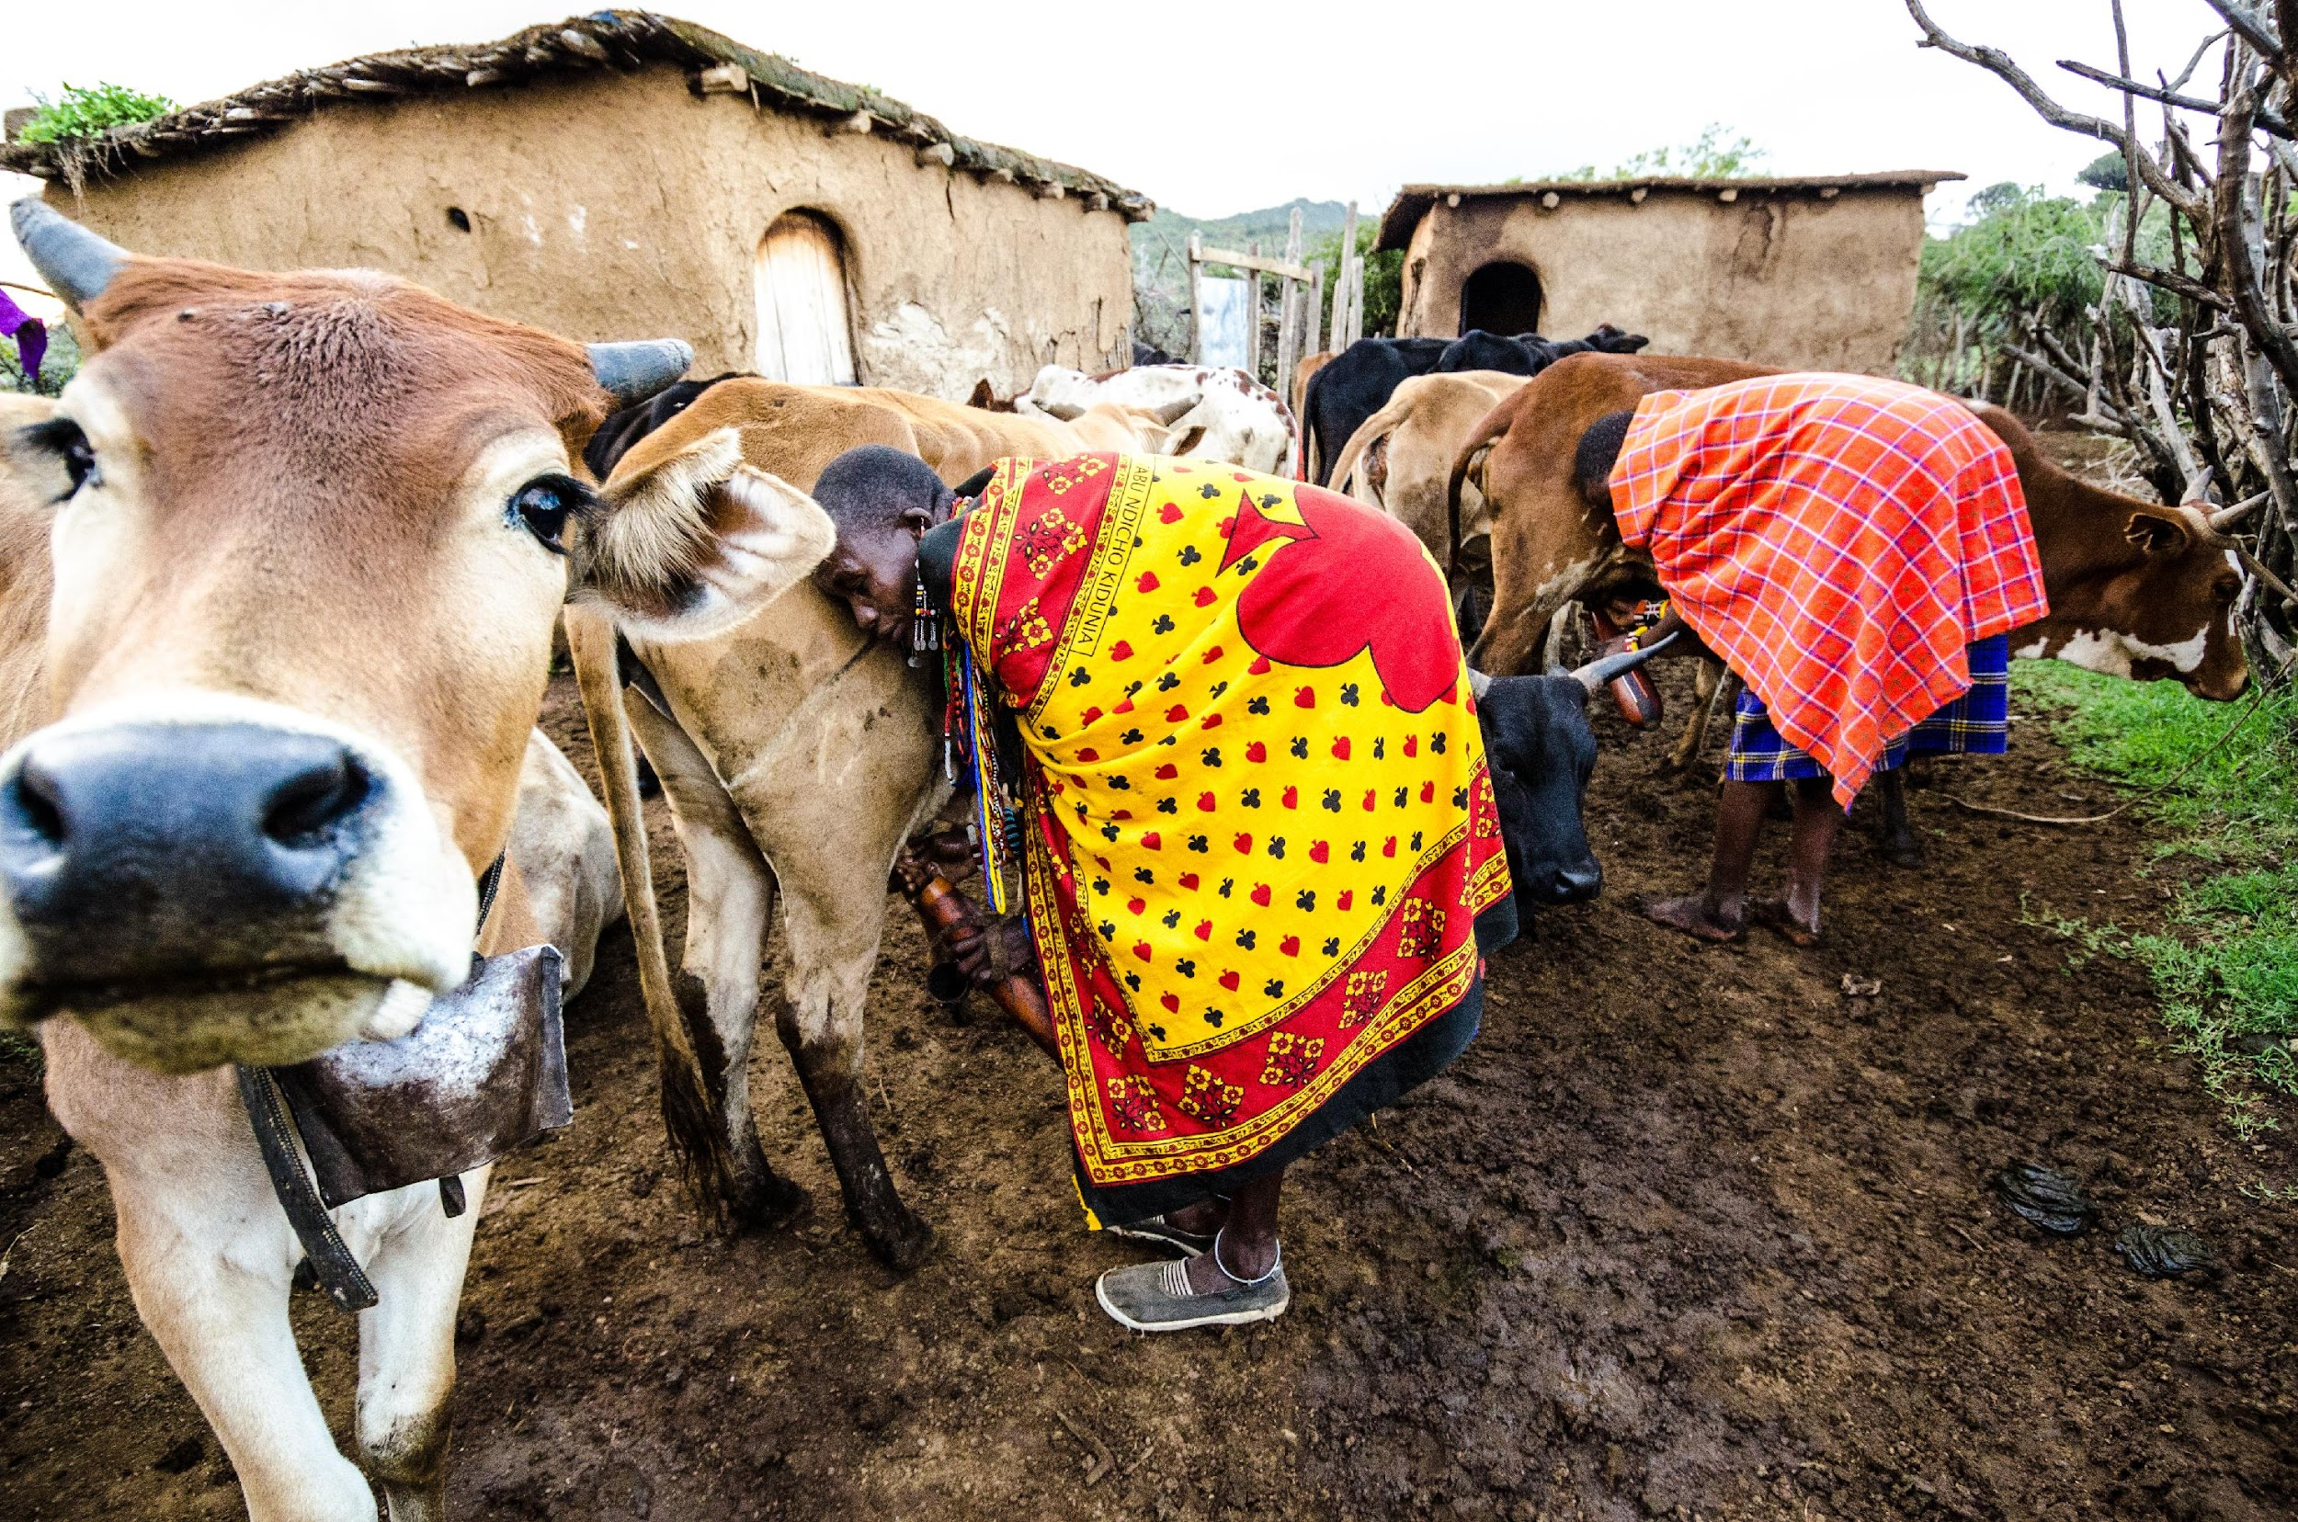
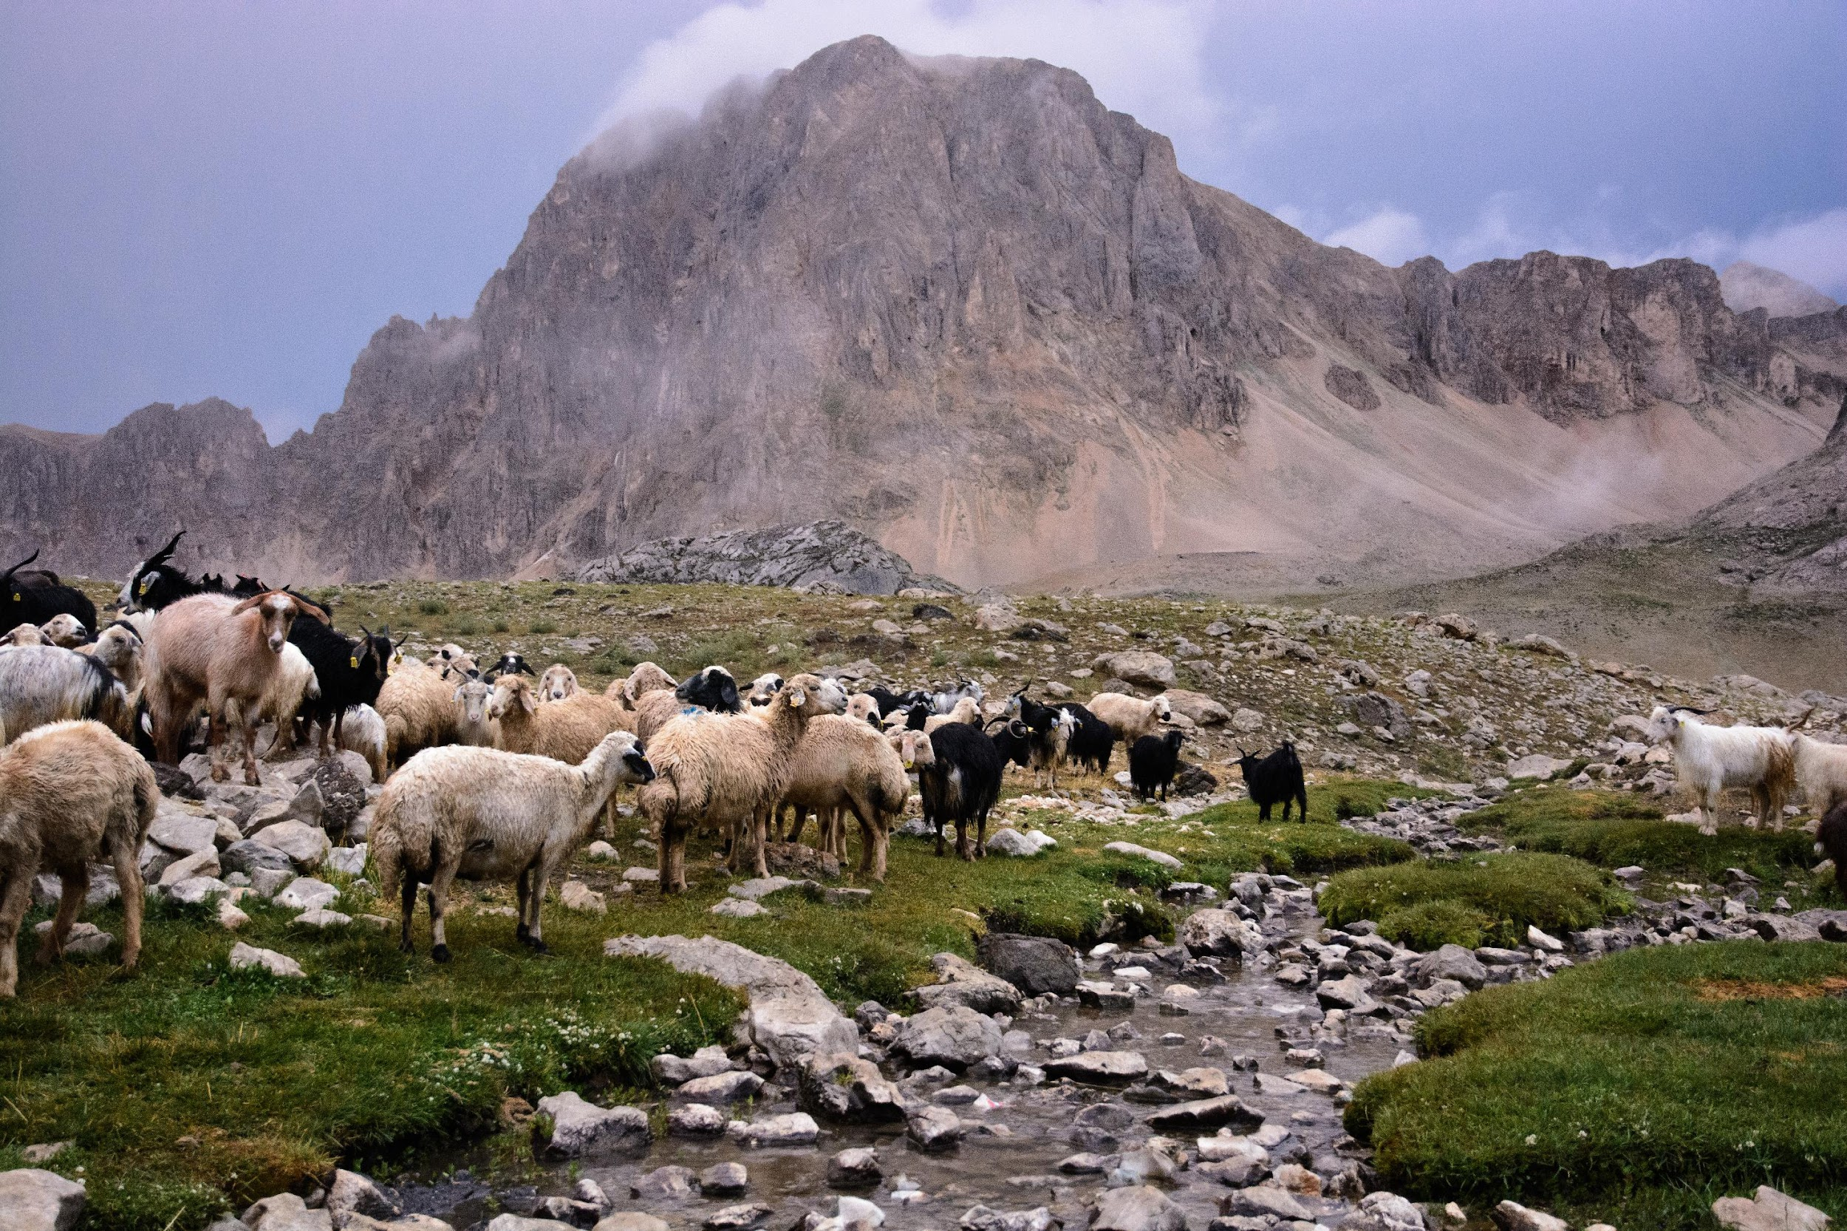
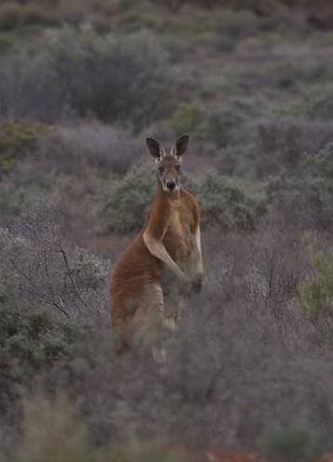
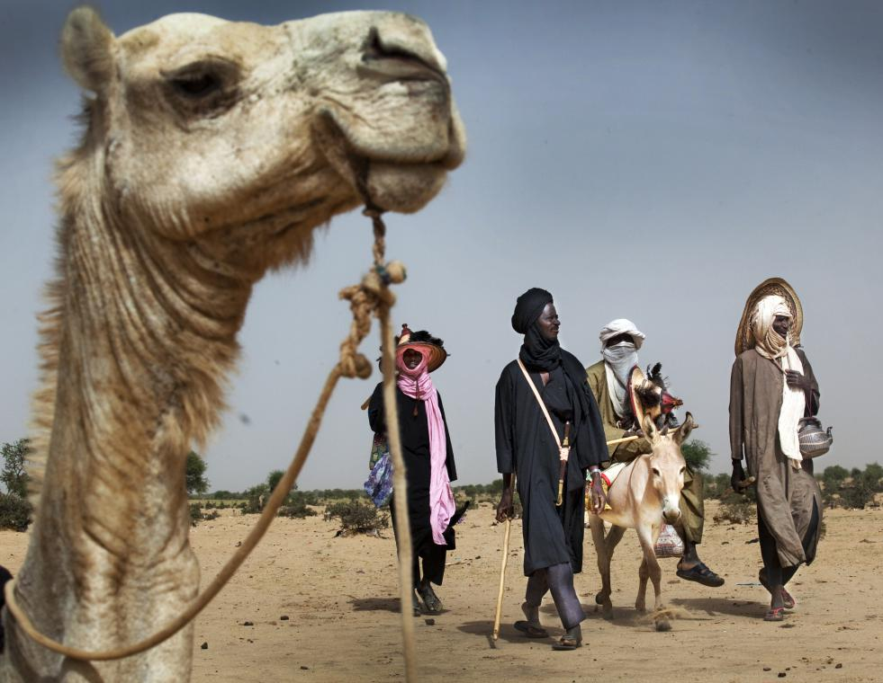
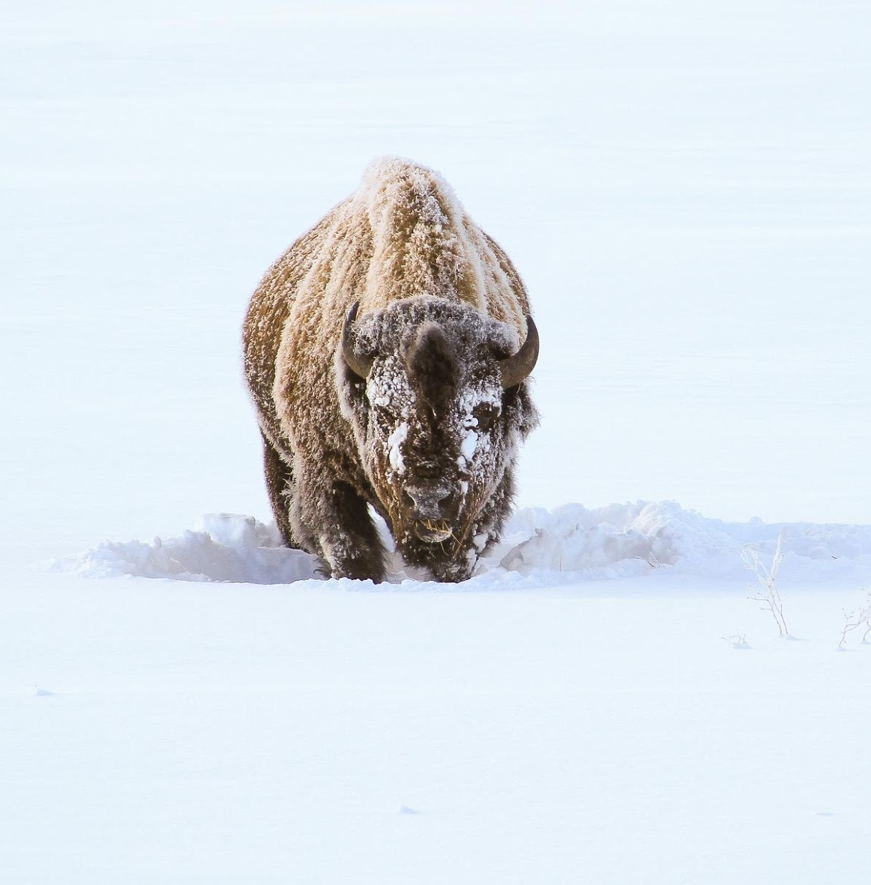
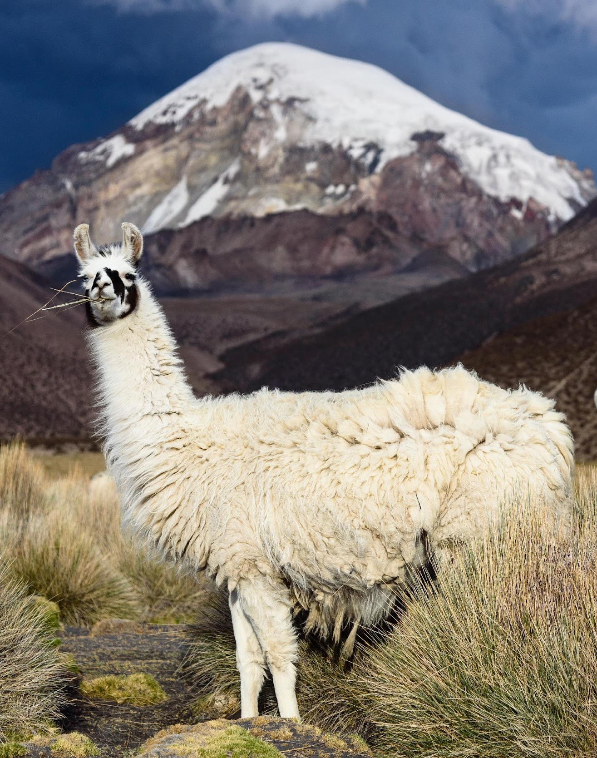
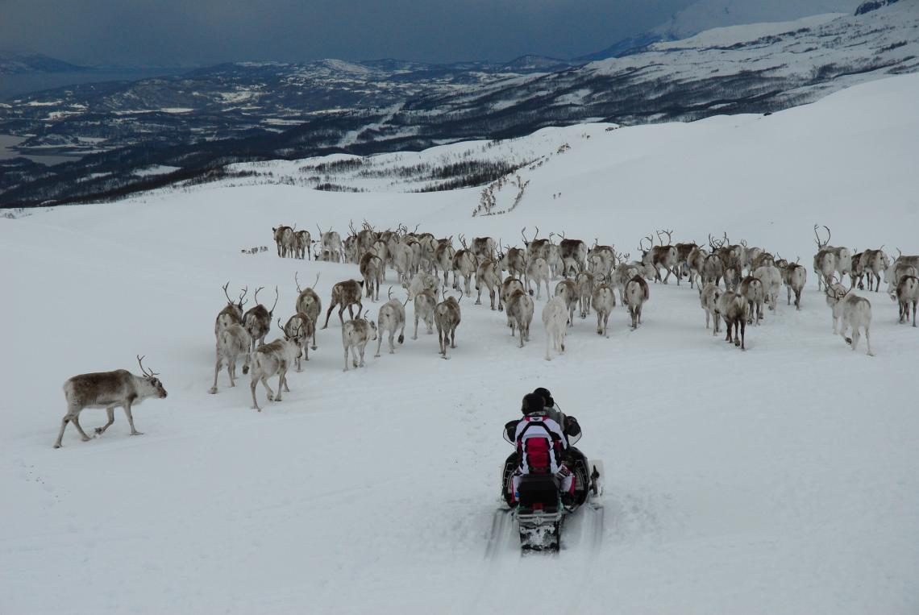
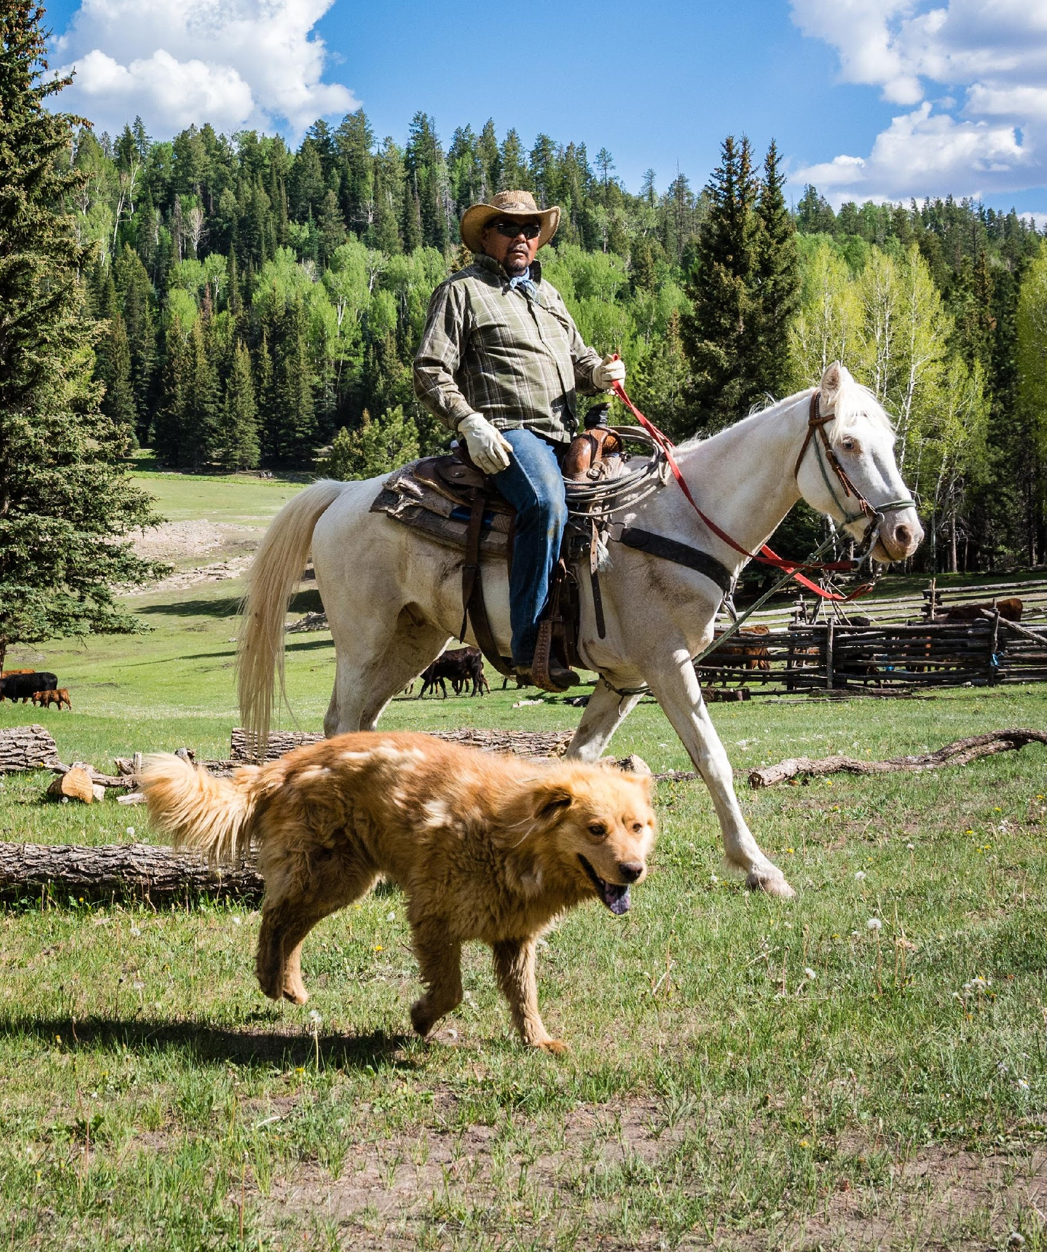
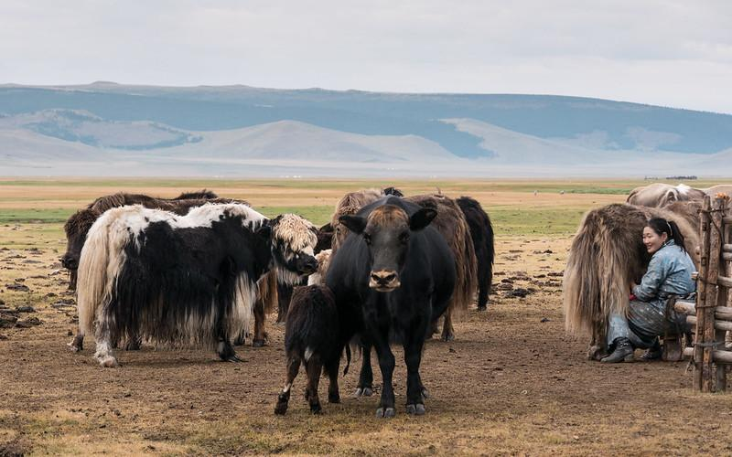
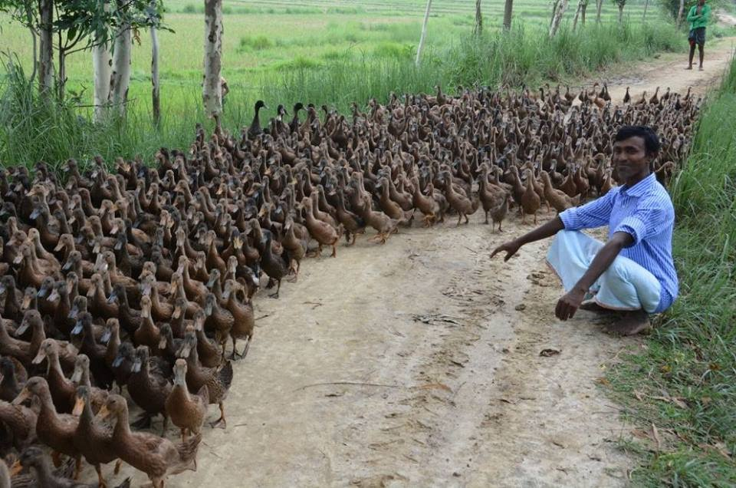
Diversity of animals on rangelands
Camels and donkey Niger
© Tim Dirven
Sheep & goats Turkey
© Michael Benanav
Bison USA © David Restivo
Maasai cattle Kenya
© Michael Benanav
Wildlife Australia
© Caroline Jones
Cow dog and horse Navajo Nation
© Michael Benanav
Reindeer Norway
© Kia Krarup Hansen
Duck India
© Mr. Vinodh
Llamas Bolivia
© Michael Benanav
Yak Mongolia © Rita Willaert
© Kalyan Varma
Notes:
Pastoralists raise an amazing diversity of animals on rangelands, both domesticated and wild. Movement of animals (rotational grazing between paddocks, transhumance, herding through long distance corridors, etc.) is an essential feature of pastoralism that is necessitated by the native ecosystem and conditions of rangelands. Agro-pastoralists integrate animal raising with their crops, such as the herding of large flocks of ducks between rice paddies in India.

Slide 8
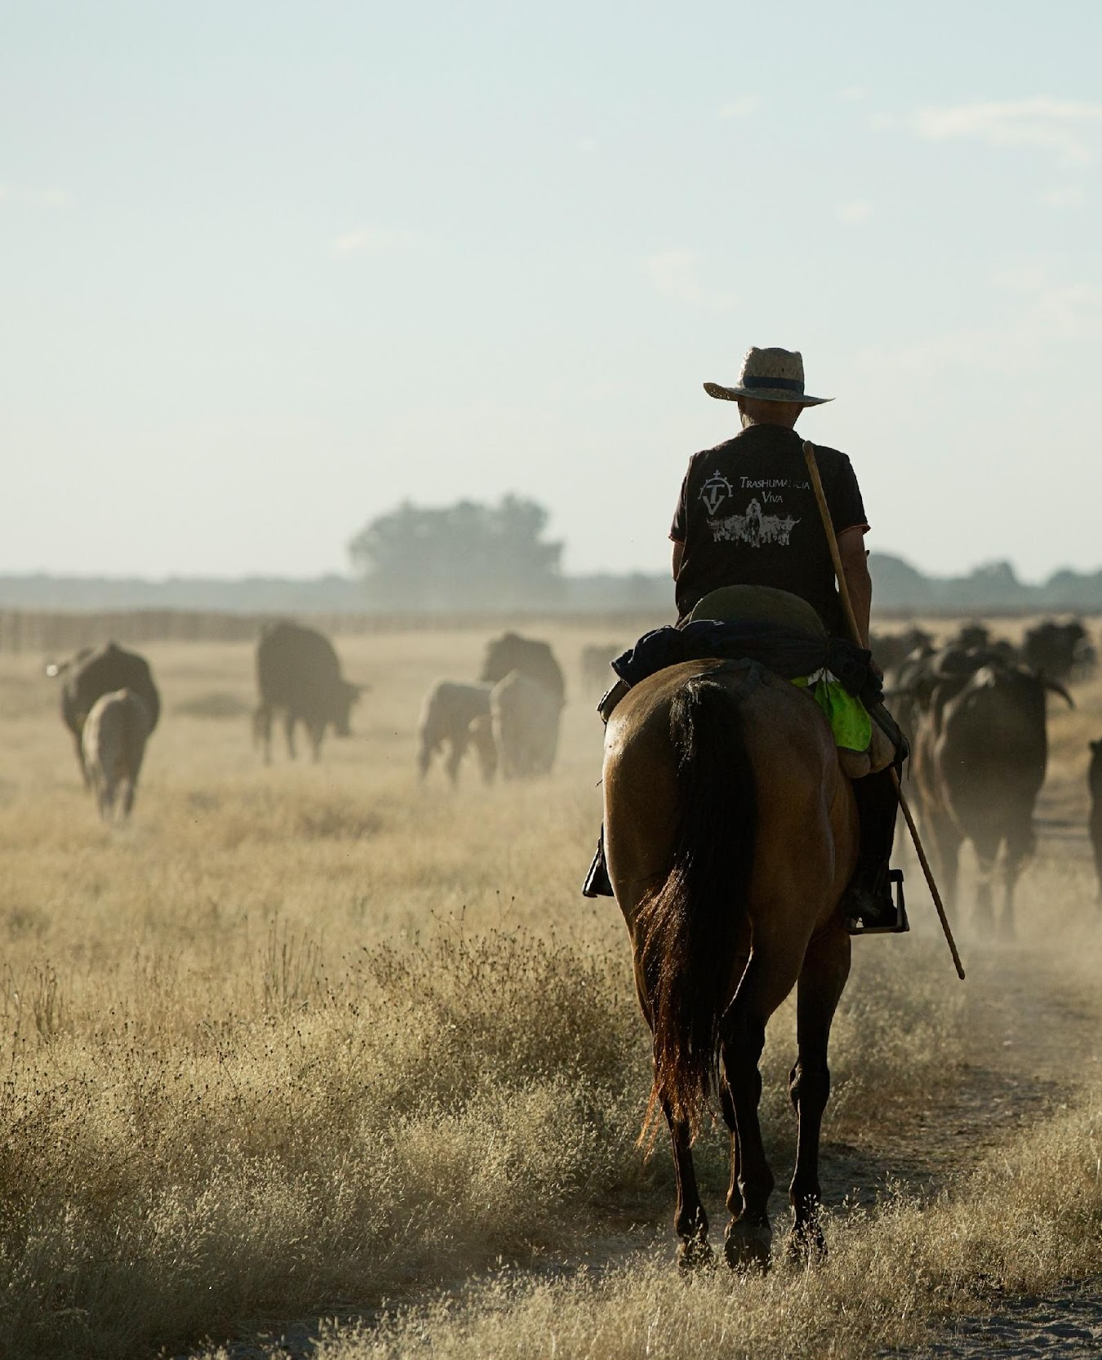
Short history of the IYRP 2026
International Rangeland Congress 2008
IYRP Support Group established in 2016
In 2022, UN General Assembly declares 2026 as IYRP
FAO as Lead UN agency
IYRP Global Alliance – renamed 2024
© Antolin Avuzela
Notes:
The Process for official designation of IYRP involved the following milestones:
International Rangeland Congress 2008 recognized “… ensuring worldwide societal recognition of the enduring value of natural grasslands”
IYRP Support Group established in 2016
In 2022, UN General Assembly declares 2026 as IYRP, led by Government of Mongolia and with 102 countries supporting it
FAO designated as Lead UN agency
In 2024, the IYRP Support Group was renamed as the IYRP Global Alliance
Today it has more than 550 active partners and organizations
This includes pastoralist organizations, civil society, academia and research, business community – from national to regional to global levels

Slide 9
Structure of the IYRP coalition
General IYRP e-list
~975 addresses primarily for info distribution
International Support Group (ISG)
~550 active partners, Friends of IYRP, including GCG members & Global Alliance
Global Alliance
Co-chairs, coordinators of Comms Team & Working Groups, website & listserv managers
Global Coordinating Group (GCG)
~50 members (Global Alliance, RISG chairs & reps from key support partners; Govt of Mongolia, FAO, ICARDA, ILC, ILRI, IUCN, UNEP, WAMIP)
Global Communications Team
Working Groups (WG)
Regional Support Groups (RISG)
Notes:
The IYRP Global Alliance is a voluntary coalition and network of member organizations working to raise global awareness and support for sustainable pastoralism and healthy rangelands. Formed to highlight the global significance of these ecosystems and communities, the Alliance played a central role in advocating for the successful adoption of the United Nations General Assembly resolution proclaiming 2026 as the International Year of Rangelands and Pastoralists. The Global Alliance promotes investment, policy engagement, and knowledge sharing to elevate the contributions of rangelands and pastoralists to food security, environmental health, cultural heritage, and climate action. It coordinates regional support groups and thematic working groups on issues such as land degradation, climate change, and Indigenous knowledge, while representing the voices of pastoralists and scientists in global forums. Through these efforts, the Alliance fosters collaboration and action to protect and sustainably manage rangelands worldwide.

Slide 10
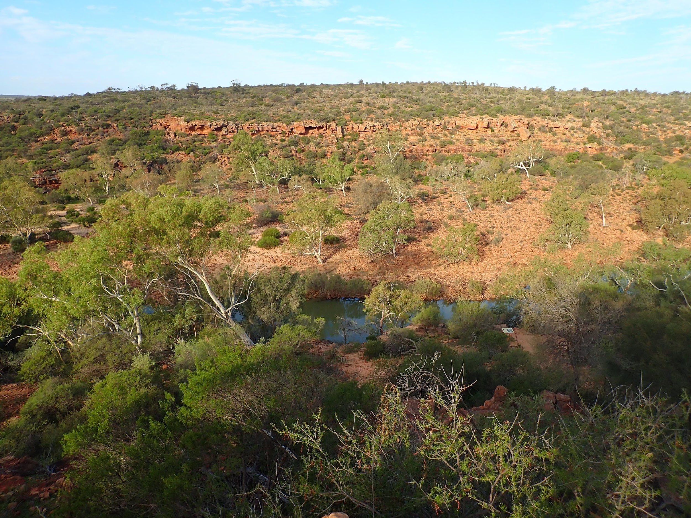
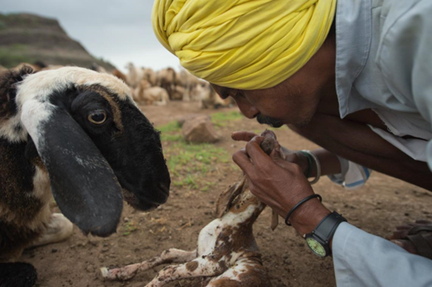
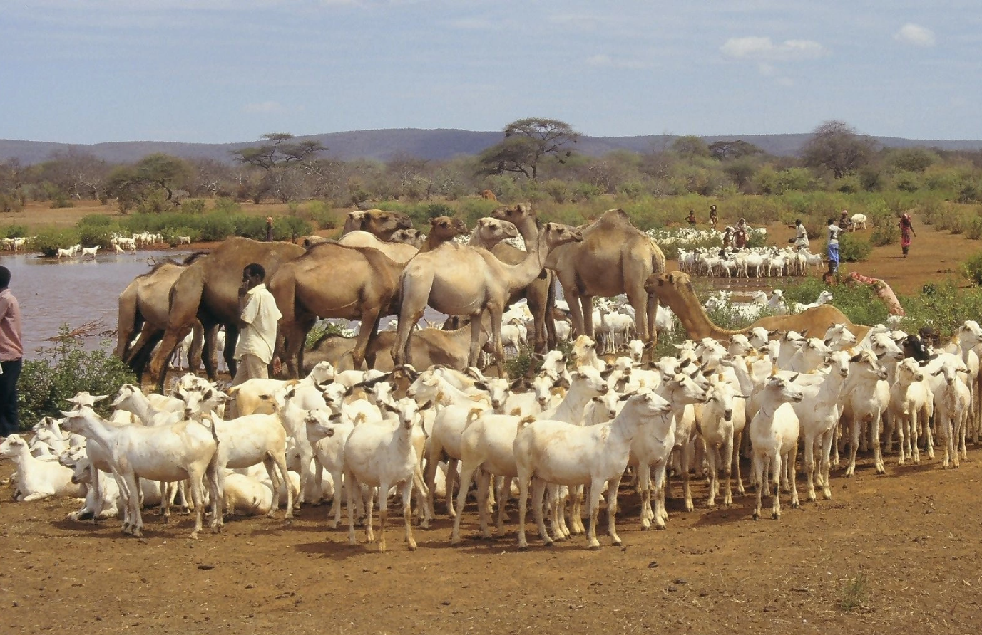
Regional IYRP Support Groups (RISGs)
Arctic
East Asia
South Asia
Central Asia & Mongolia
Australasia
North Africa & Middle East
Eastern & Southern Africa
West & Central Africa
Europe
North America
South America
Impact at local level:
Promoting pastoralist organizations & their activities
Rangelands
@ Lauren Svejcar
Pastoralists
Animals
@ Kalyan Varma
@ Wolfgang Bayer
Notes:
The role of the RISGs is to focus on their regions to raise awareness, foster cooperation, and lead communication efforts on IYRP. Notable achievements of the RISGs include: raising awareness about the total economic value of pastoralism in Eastern Africa (CELEP 2021); the conference on pastoralism and rangeland restoration in Burkina Faso in 2019; yearly Pastoralism Awards in South Asia, Central Asia and Mongolia; the Camel Festival in the Gobi desert, Mongolia in 2021; World Reindeer Herders events at the World Food Forum in Rome 2022; declaring transhumance as a World Intangible Cultural Heritage by UNESCO in Dec 2023 based on several European applications; raising indigenous voices at the International Rangeland Congress in Australia 2025; raising awareness about Yak rearing in the Asia Highlands; yearly ‘Campfire’ conversations with youth and indigenous peoples at meetings of the Society for Range Management in the USA; and an Andean Pastoralist Gathering in August 2025.

Slide 11
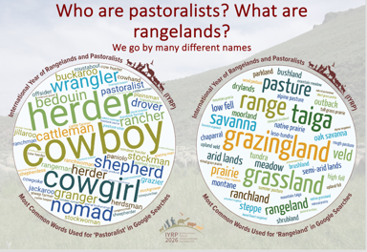
IYRP Global Action Plan 2025-2026
Strategy 1: Multi-stakeholder Coalition Building
Strategy 2: Knowledge Generation
Strategy 3: Celebration & Awareness Raising
Strategy 4: Policy Advocacy over the next decade
Strategy 5: Appropriate Investment for rangelands and pastoralists
IYRP Global Action Plan 2025-2026
https://iyrp.info/iyrp-2026-global-action-plan
Notes:
The IYRP Global Action Plan was developed by the Global Coordinating Group of the IYRP Global Alliance, with the objectives of raising awareness and building pastoralist coalitions in the short term, and advocating for greater knowledge generation, policy improvement and appropriate investment in the long term.

Slide 12
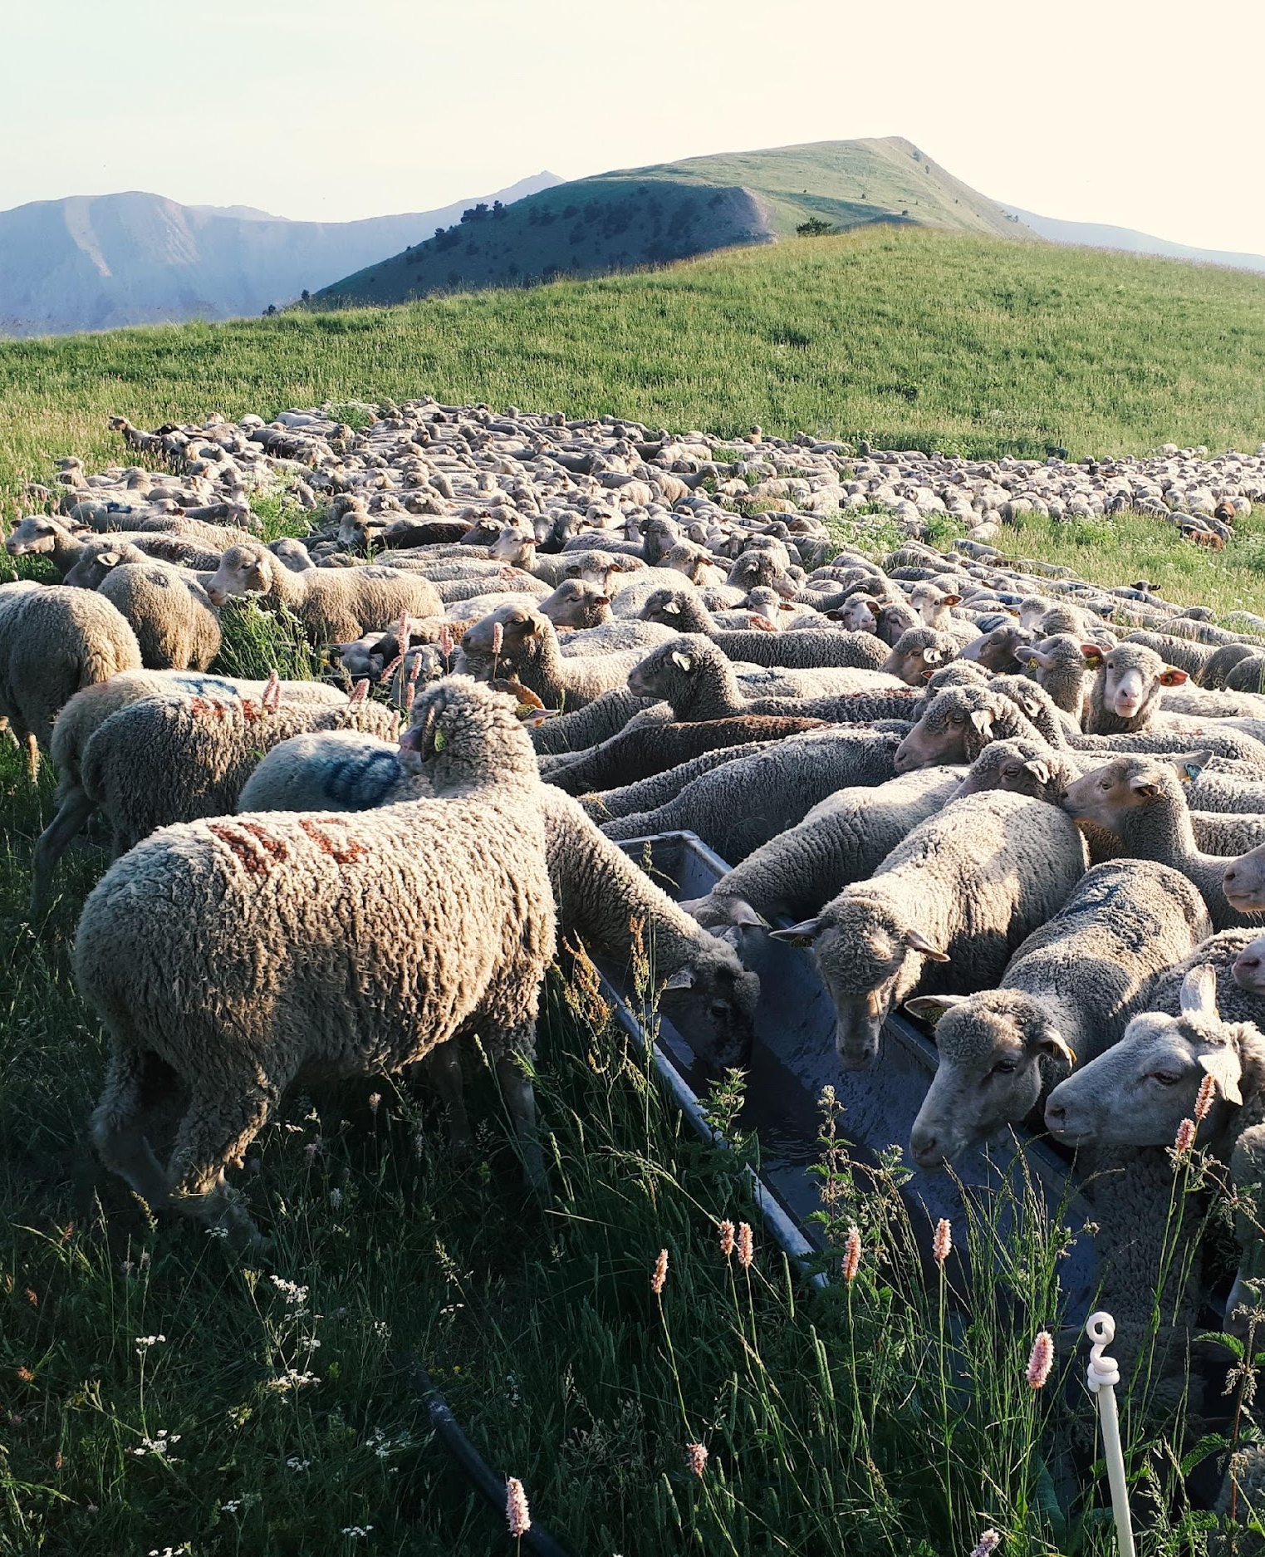
Knowledge generation through thematic Working Groups
Objectives of Working Groups:
Greater awareness in science & society about how rangelands & pastoralists contribute to food security, economy, environment & cultural heritage
Foster changes in national, regional & global policies
Increase sustainable & ethical investment in rangelands & pastoralist livelihoods
Tasks of Working Groups:
Collate and analyse existing research results (science review)
Stimulate and engage in participatory research to fill gaps and explore opportunities
Science- and experience-based advocacy with key messages for the public, international bodies, local communities, etc.
© Jacky Collieux
Notes:
The IYRP Global Alliance Working Groups bring together eminent scientists, practitioners and pastoralist experts. Their immediate aim is to prioritize the key issues that need urgent attention, such as the true value of rangelands and pastoralism to GDP, or the rapid pace of conversion of rangelands. They also highlight areas where further research and evidence gathering needs to happen.

Slide 13
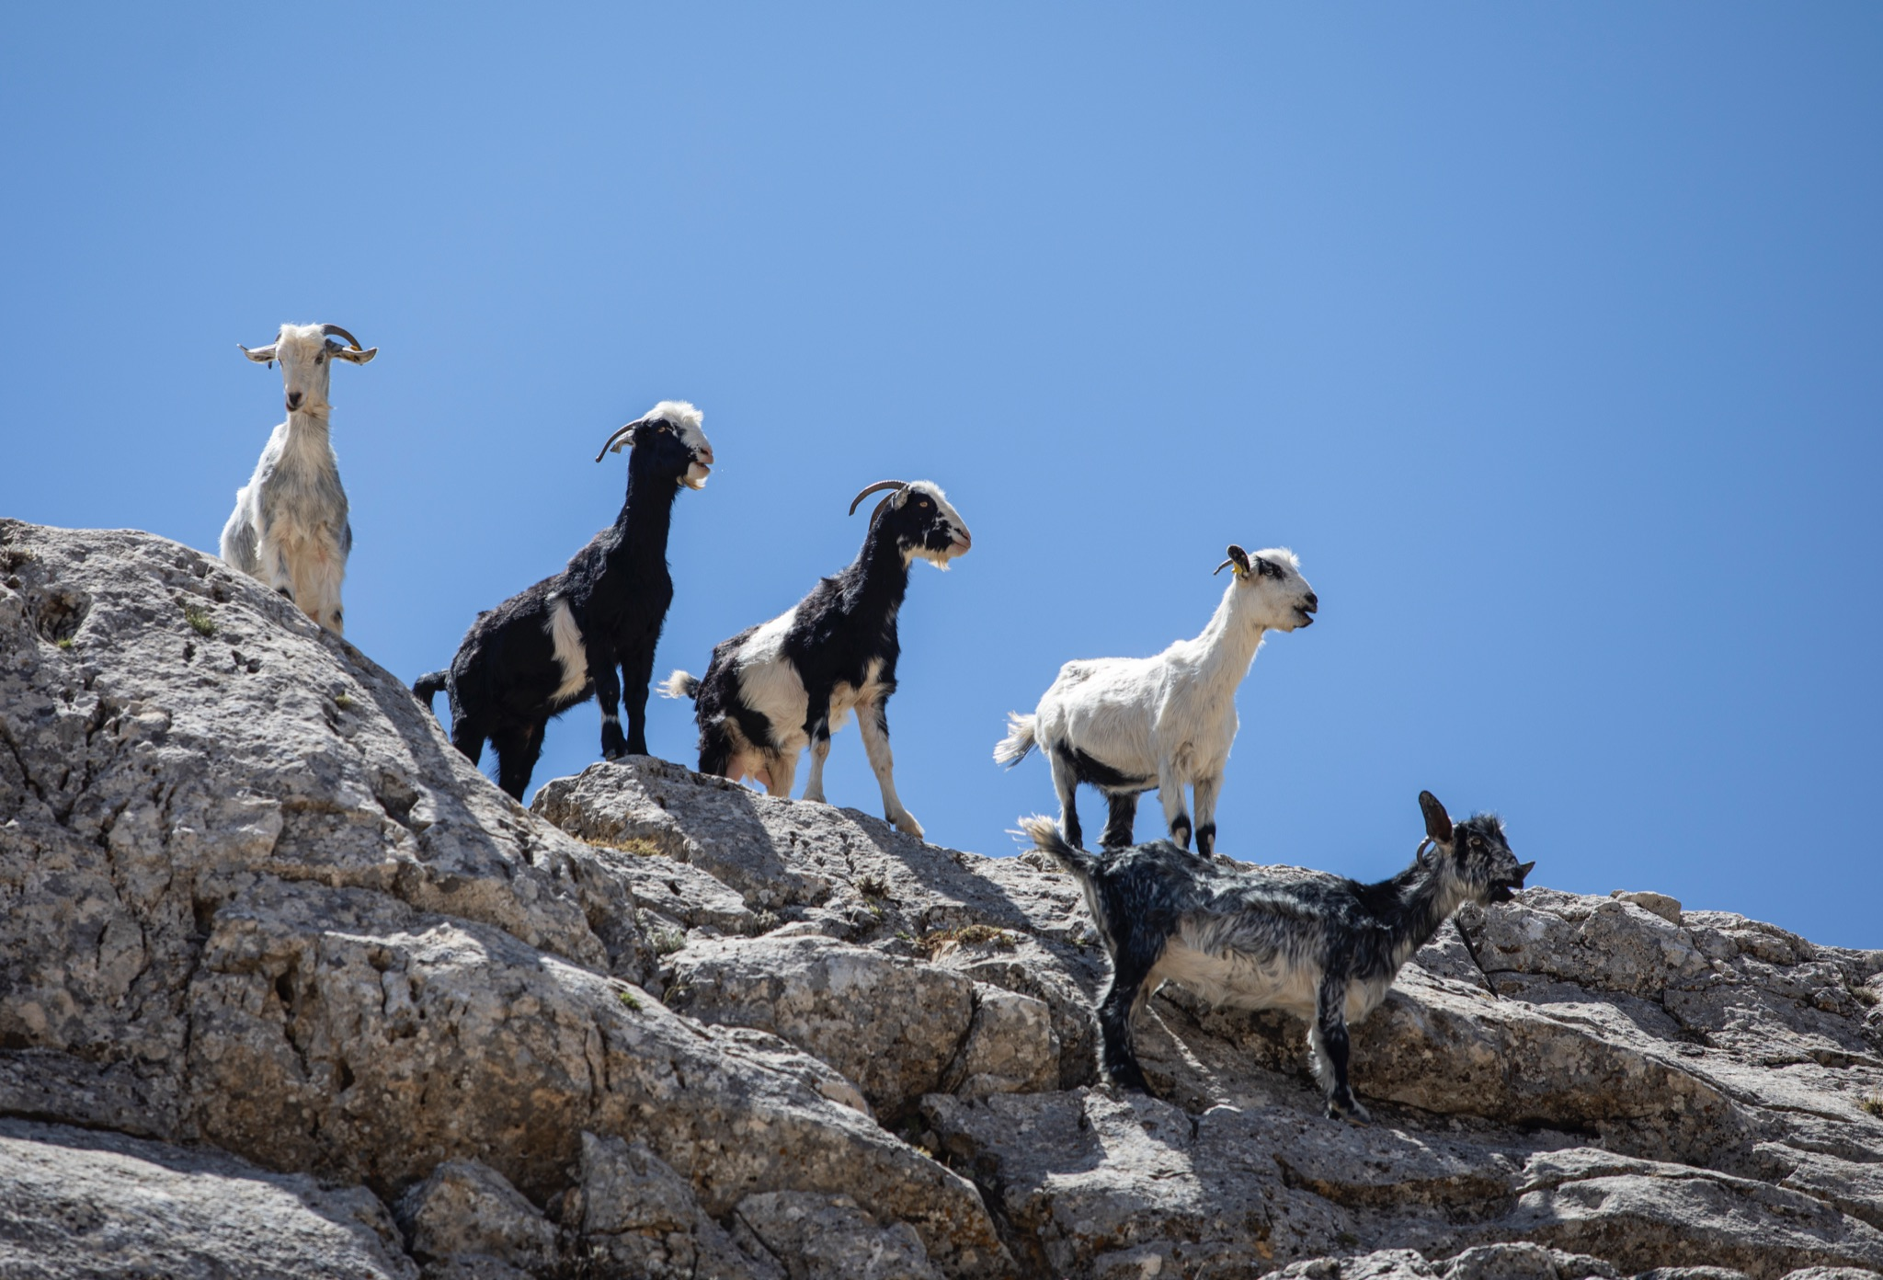
Current Working Groups
Afforestation in Rangelands
Pastoralism & Gender
Pastoralism & Water
Rangelands & Land Degradation Neutrality
Rangelands & Biodiversity
Economics of Pastoralism
Pastoralist Youth
Pastoralism and land rights
Pastoralism and climate change
Carbon markets
Pastoralist Fibre
© Cem Türkel
Notes:
The Working Groups have been working since 2023 to develop the latest evidence and science that now underpins the key messages that the Global Action Plan has adopted. These will also form the basis of the communications campaign to be launched January 2026.

Slide 14
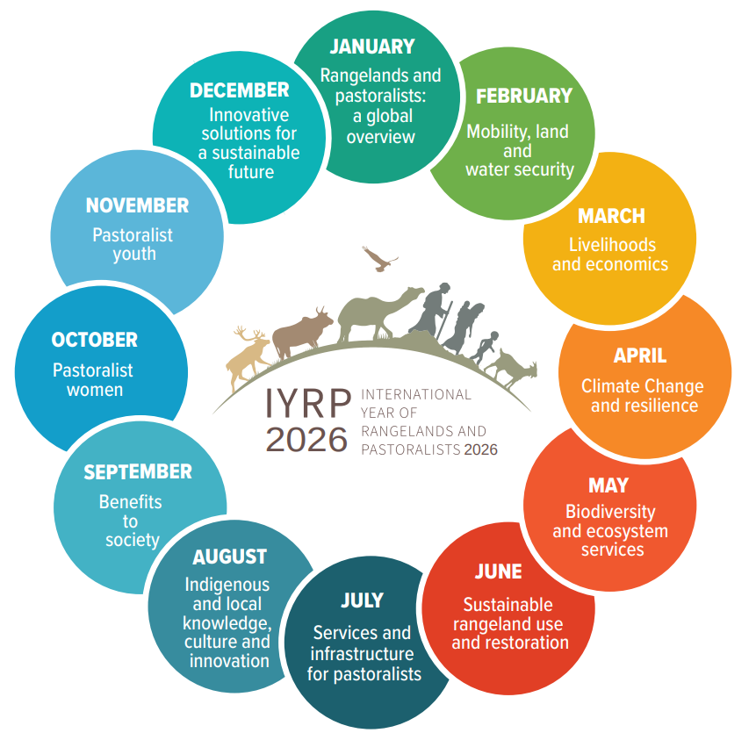
Raise awareness through
12 global themes ~ one for each month of 2026
Also showcasing:
One animal per month
One pastoralist community per month
Key messages based on findings of IYRP Working Groups
Each RISG interprets & implements these themes to address regional needs & priorities
Notes:
The 12 global themes were initially developed in 2017 and updated in 2024. They pay homage to the many critical issues pertaining to rangelands and pastoralists today, within an integrated framework consistent with the SDGs (Sustainable Development Goals), and as defined by the IYRP Working Groups. They are assigned to the months where there are relevant International Days so as to produce greater synergies in awareness raising. However, each region will also have national holidays, and pastoralist events throughout the year, and therefore the 12 themes can be highlighted as relevant.
In addition to the 12 themes, we will also showcase one pastoralist animal per month, and one pastoralist region per month.

Slide 15
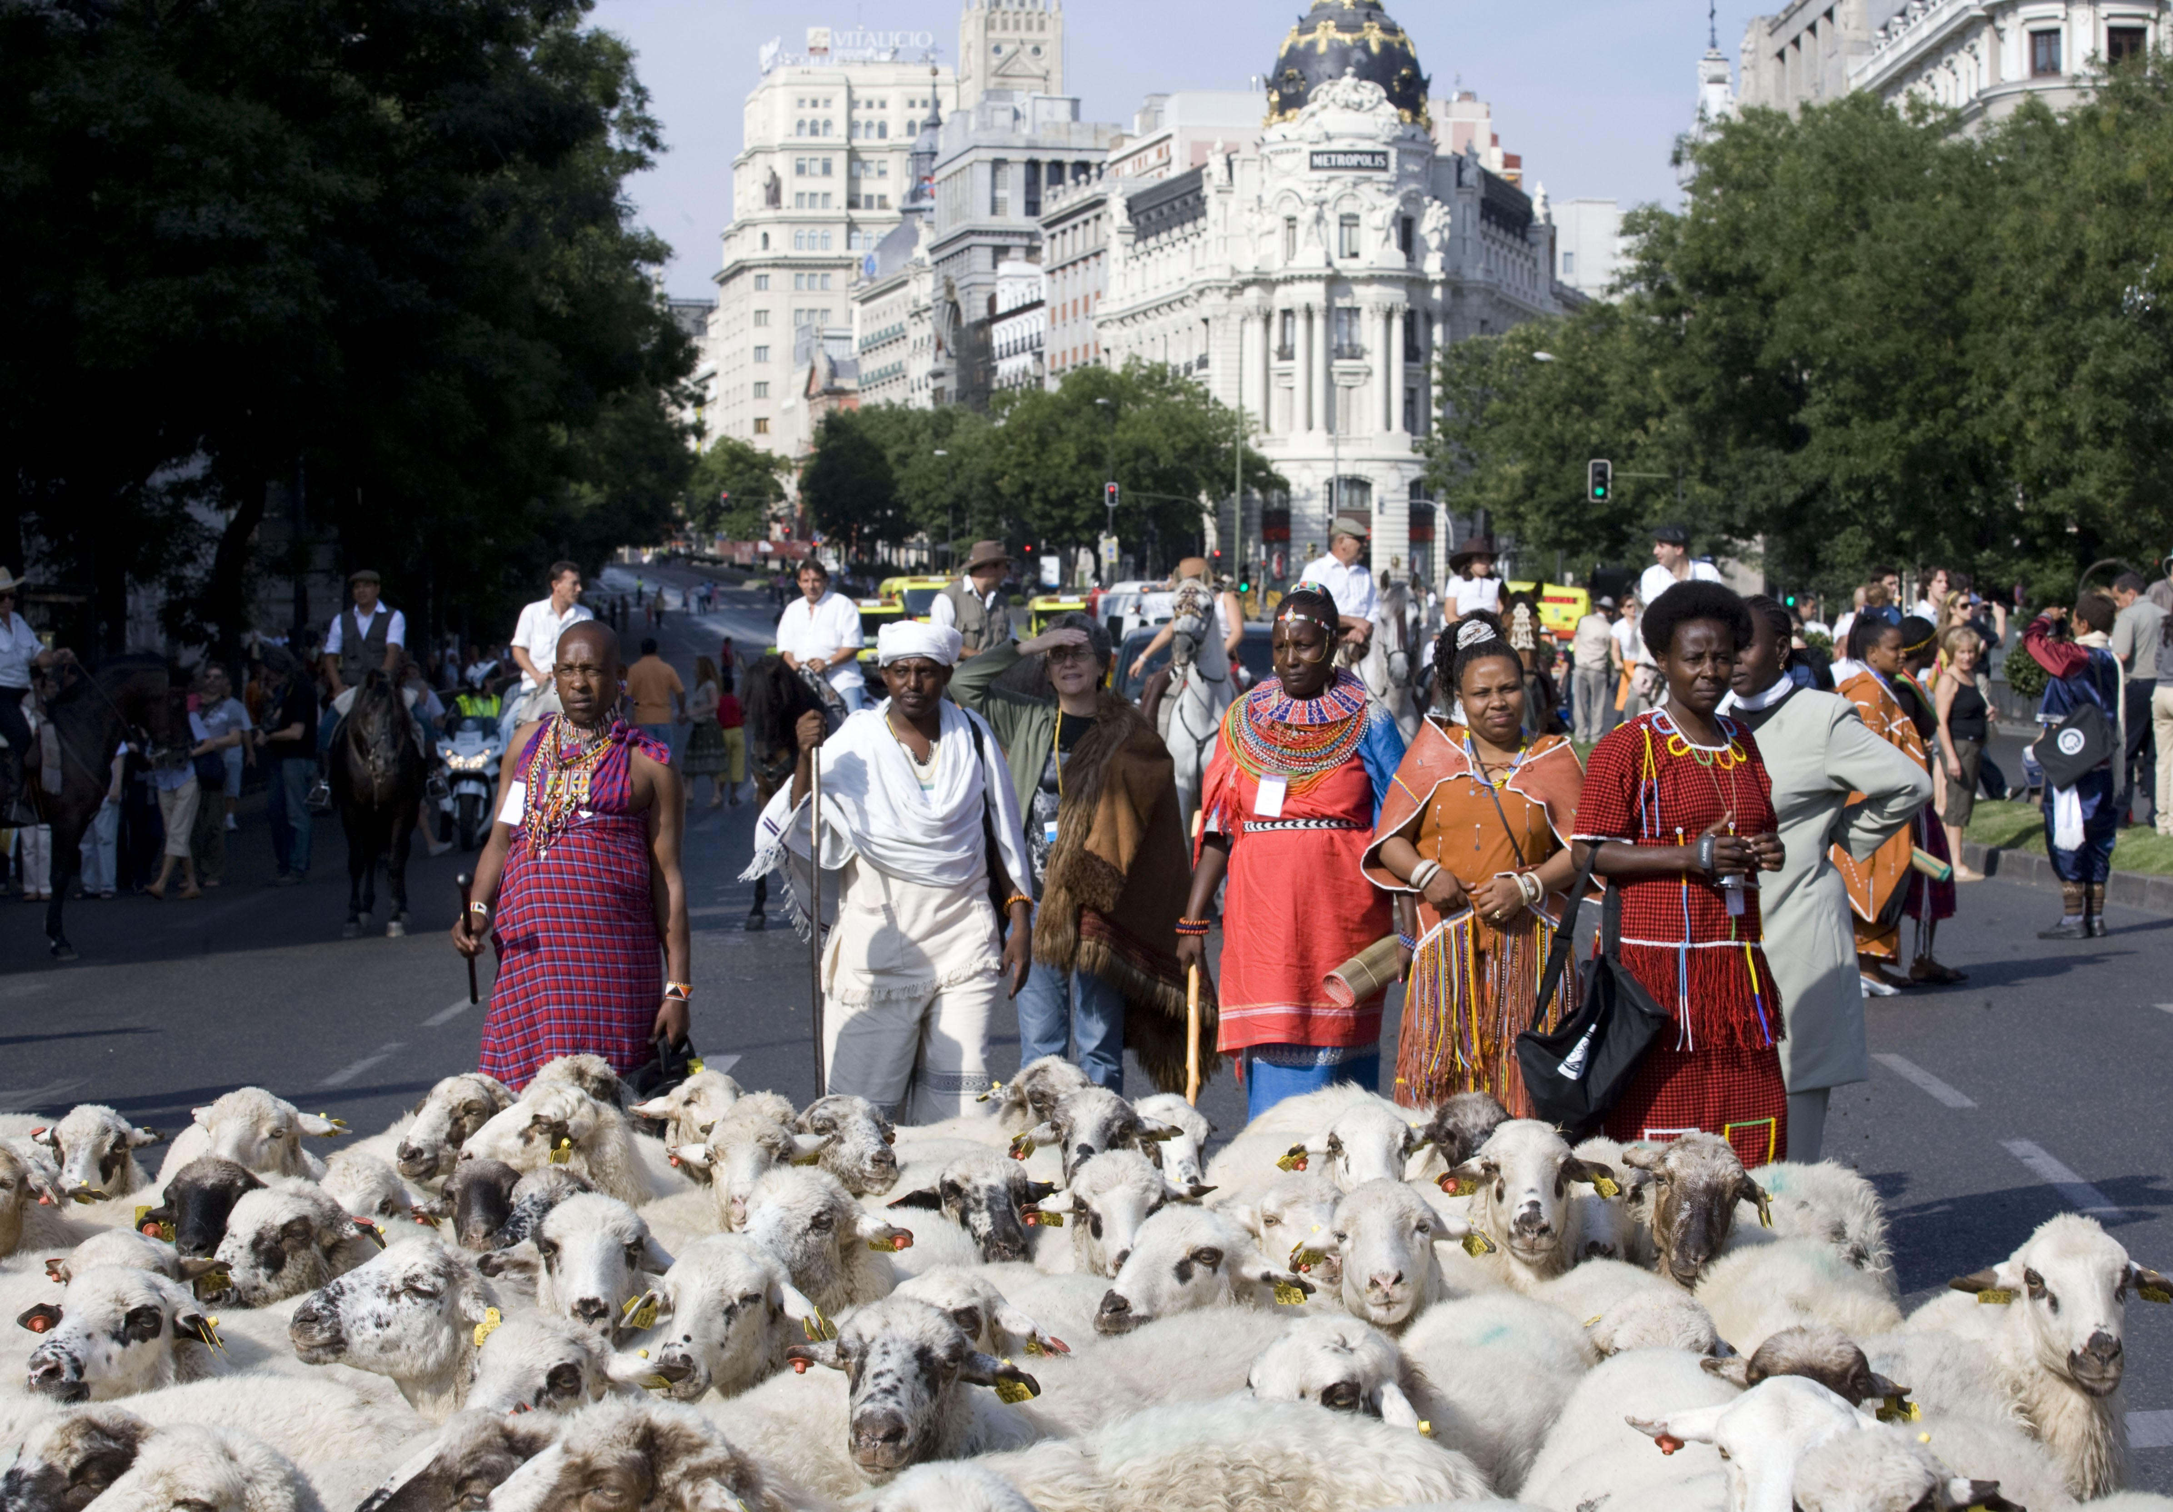
Celebrate and raise awareness at all levels
Local/National examples:
Naadam, Mongolian traditional festival of pastoralists, June every year
Transhumance: when thousands of sheep walk through Madrid – Oct every year
Annual Aadi Kidai Pongal Festival, organized by the Tamil Nadu Federation of Pastoral Peoples Sangams (TFPPS)
Regional examples:
West Africa (agro)pastoralism conference – November 2024 in Senegal
Southern Africa 60th Annual Grassland Society Conf. – July 2025 South Africa
Regional and global Gatherings of Pastoralists: events focused on herders and cultures, youth and women
Global examples:
Sámi Mobile Food Lab at World Food Forum -
International Rangeland Congress IRC 2025 – Adelaide, Australia; June 2025
Global Landscape Forum/ Rangelands - June 2026 in Kenya
© TyN
Transhumance celebrations, Madrid 2007
Notes:
Awareness of the value of rangelands and the stewardship of these lands by pastoralists needs to be raised higher and higher. The general public who might think that meat is bad for the planet, or the policy maker that might think that pastoralism is an outmoded form of production, or the young pastoralist who might see no future, all need to take a second look.
There are many positive actions being taken by pastoralists and their supporting civil society and local government officials to increase awareness and dispel myths. There is so much to celebrate.

Slide 16
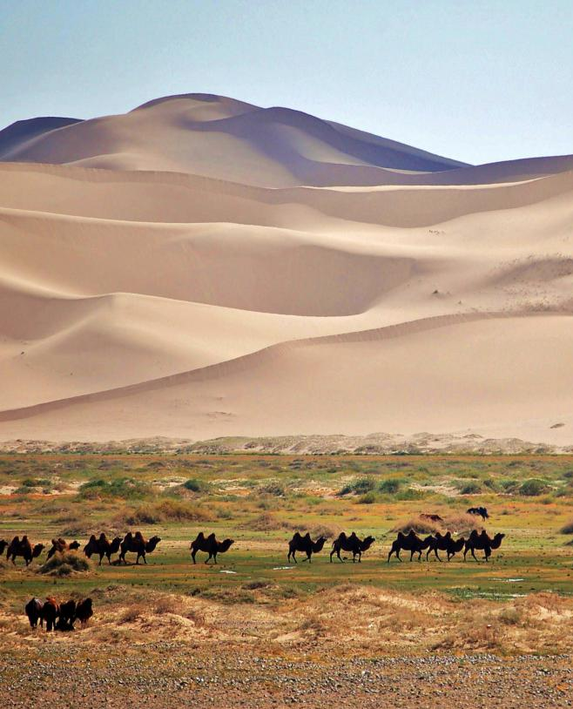
Advocacy for global
policy change
AMCEN (African Ministerial Conference on the Environment) 2017
UN Environment Assembly, UNEA-4 (March 2019),
UNCCD COP 16 (December 2024),
CMS COP 15 (March 2026), Campo Grande, Brazil
© Marc Foggin
Notes:
Since 2017, IYRP Global Alliance has been advocating for policy change at all levels. This has resonated in many countries, including the 62 countries that co-sponsored the IYRP proposal at the UN General Assembly. It has resulted in several important policy decisions, including:
AMCEN (African Ministerial Conference on the Environment) 2017, called for the UN General Assembly to designate the IYRP
UN Environment Assembly, UNEA-4 (March 2019), passed a resolution on sustainable rangelands and pastoralists
UNCCD COP 16 (December 2024), adopted the first ever resolution on rangelands and pastoralists
CMS established a special Working Group on Pastoralism under its Scientific Council, and the CMS COP 15 (March 2026), Campo Grande, Brazil will review the Report of this Working Group
For more information on what IYRP Global Alliance is organizing at these Conference of Parties, please email to: iyrp@iyrp.info

Slide 17
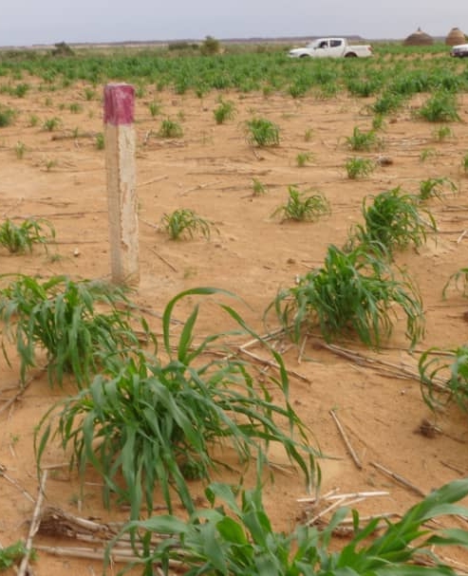
Equitable investments in
rangelands and for pastoralists
Leverage more investment and funding for:
    Pastoralist development programs
  Rangeland restoration
  Protection from conversion
Ensure compliance with ethical and equitable standards
© H Abarchi
Notes:
IYRP Global Alliance calls for :
Partnering with countries to leverage investments in sustainable rangelands and pastoralist development
Promoting established standards (e.g. VGGT, FPIC) and advocate for development of new standards, in particular the Rangelands Certification Standard of the Rangeland Stewardship Council
Working with national and international development partners, multilateral finance institutions and others to adopt standards and good practices and increase the ambition of projects and programmes on rangelands and pastoralists
Applying for more financing from global environmental funds, such as GEF, GCF, Adaptation Fund, etc. for rangeland and pastoralism projects

Slide 18
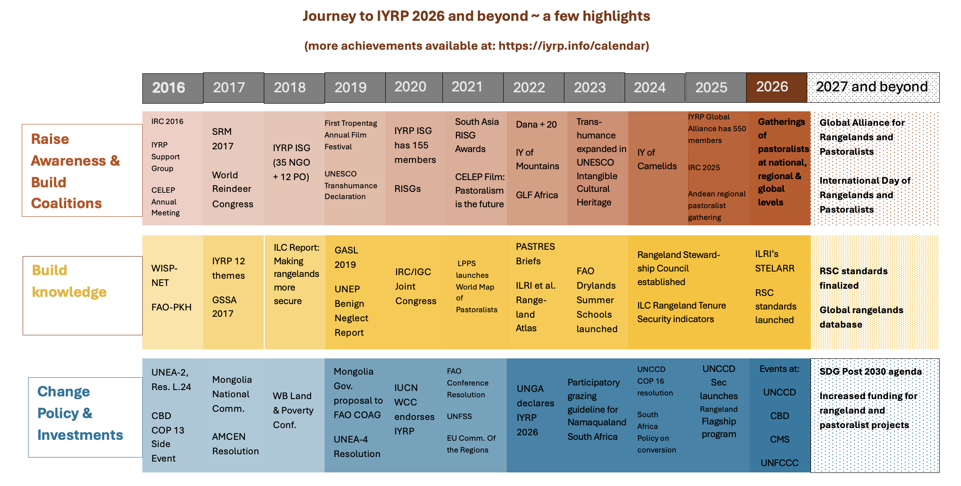
Notes:
The momentum has been building up in the last 10 years for transformational change, as awareness has been raising, coalitions are being built, new knowledge is being generated, and policy is changing at the global, regional and national levels. Ethical investment in rangeland health and sustainable pastoralism is slowly starting to appear and will be strengthened further as more knowledge is generated, and transparency and accountability is instilled in public and commercial activities. This Graphic only shows some notable highlights - there are so many more achievements that can be noted. The IYRP Global Alliance aims to continue these achievements into the next decade.
Abbreviations: AMCEN (African Ministerial Conference on the Environment), CBD (Convention on Biological Diversity), CELEP (Coalition of European Lobbies for Eastern African Pastoralism), CMS (Convention on Migratory Species), Dana+20 (Global Pastoralist Gathering at Dana, Jordan), FAO COAG (Food and Agriculture Organization of the UN- Committee on Agriculture), FAO-PKH (Food and Agriculture Organization of the UN- Pastoralist Knowledge Hub), GASL (Global Agenda for Sustainable Livestock), GLF (Global Landscape Forum), GSSA (Grassland Society of South Africa), ILC (International Land Coalition), ILRI’s STELARR (International Livestock Research Institute’s project STELARR), IRC (International Rangeland Congress), IUCN WCC (International Union for Conservation of Nature, World Conservation Congress), IY of Mountains (International Year of Mountains), IYRP ISG (International Year of Rangelands and Pastoralists International Support Group), LPPS (League for Pastoral Peoples), NGO (non-governmental organizations), PO (Pastoralist Organizations), PASTRES (Pastoralism, Uncertainty and Resilience program of Institute of Development Studies, UK), RISG (Regional IYRP Support Groups), RSC (Rangeland Stewardship Council), SDG (Sustainable Development Goals), SRM (Society for Range Management), UNCCD (UN Convention to Combat Desertification and Drought), UNFCCC (UN Framework Convention on Climate Change), UNEA (UN Environment Assembly), UNESCO (UN Educational, Scientific and Cultural Organization), UNFSS (UN Food Systems Summit), UNGA (UN General Assembly), WISP-NET (World Initiative for Sustainable Pastoralism- Network), WB (World Bank).

Slide 19
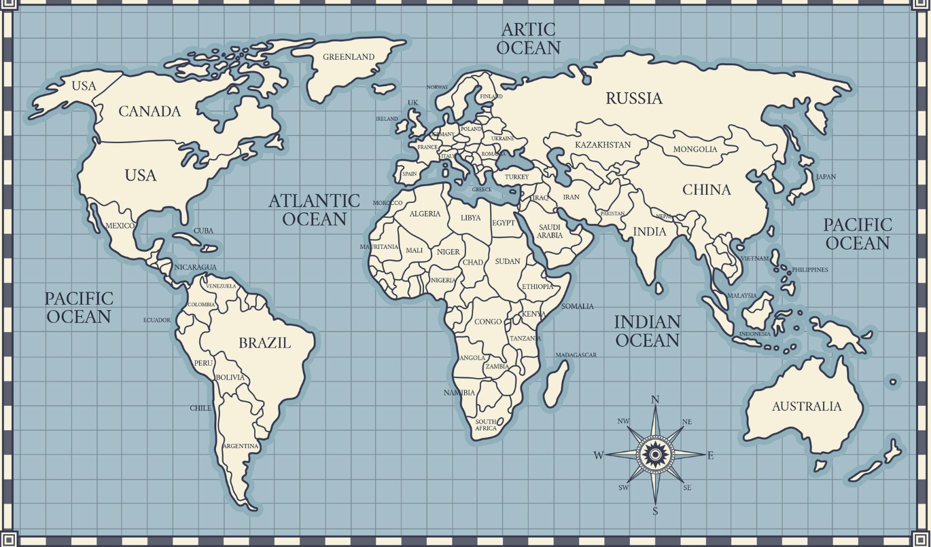

IYRP Pastoralist Gatherings 2025-2026
Arctic gathering,
Mongolia, 08/26
Global Youth gathering,
Spain, 05/26
Mongolia National Forum, 09/25
North America Women’s gatherings (CA, USA, 02+03 2026
MENA Women’s gathering, Tunisia, 01/26
Global Women’s gathering,
Nepal, 06/26
Global gathering,
Mongolia, 08/26
East Africa Youth gathering,
Uganda, 11/25
West & Central Africa gathering,
Senegal, 05/26
South Asia Women’s gathering, India, 12/25
Horn of Africa Women’s gathering,
Kenya, 11/25
Andean gathering,
Bolivia, 08/25
Africa Women’s gathering, Uganda, 12/25
Australia gatherings,
WA + NSW, 09/26
South America gathering
Peru, 06/26
Notes:
Information collected as of September 2025 shows that there will be 12 regional gatherings of pastoralists and 3 global gatherings of pastoralists during 2025 and 2026. The final global gathering will occur in Mongolia on the margins of the UNCCD COP 17. These gatherings are expected to help amplify the voices of pastoralists from around the world.

Slide 20
Road Map 2025-2026: key global points
July 2025: FAO establishes official IYRP Steering Committee
July 2025 to May 2026: Regional pastoralist, women’s and youth women gatherings
    Each will give inputs to the Global Pastoralist Gathering in Mongolia August 2026
December 2025: FAO officially launches the IYRP
January 2026: Start of celebrations and launch of first monthly theme of IYRP
    Social media, webinars, film festivals and YouTube videos for every month of 2026
June 2026: Global Landscape Forum/Rangelands in Kenya
August 2026: Global Pastoralist Gatherings and other activities at UNCCD COP 17 in Mongolia
October 2026: Global Alliance Gathering at CBD COP 17 in Armenia
December 2026: Closing ceremony of IYRP 2026 and final reporting
Notes:
There are many events being planned by the IYRP Global Alliance members in 2025 and 2026. This slide only shows some of the global events. Much more can be seen on the IYRP Global Alliance website’s Calendar of Events (https://iyrp.info/achievements) and well as FAO’s website (soon to be operational).

Slide 21
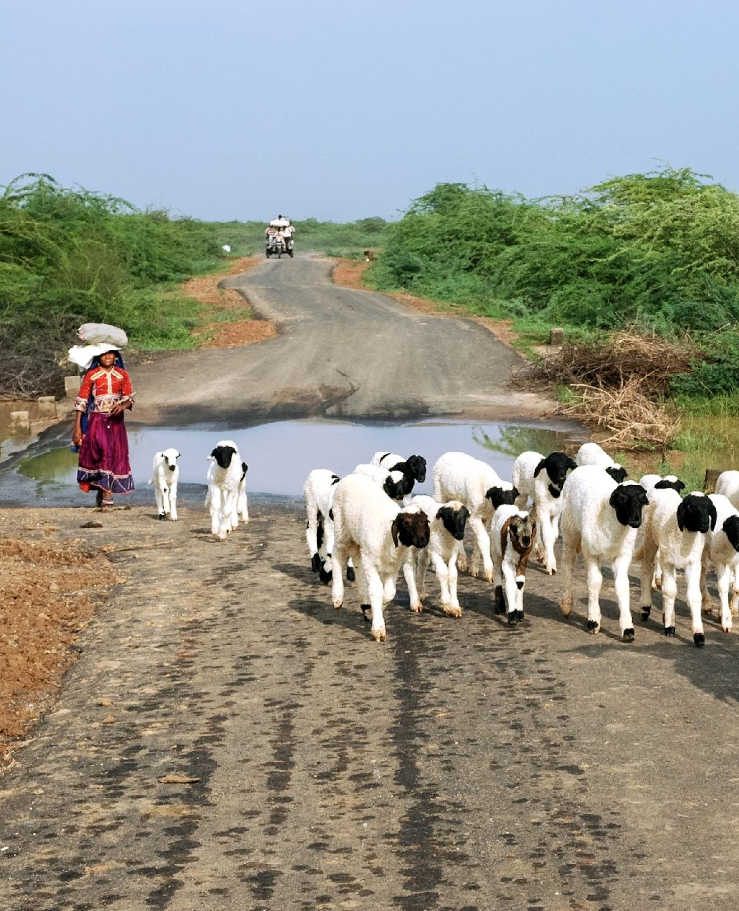
Beyond 2026: calling for a decade of action
Changes in national, regional, global policies promoting the protection and sustainability of rangelands and pastoralists, fair and equitable benefits and upliftment
Creation of a Pastoralist Caucus at UNCCD
Strengthening of the Rangelands and Pastoralists Global Alliance
Rangeland Stewardship Council and standards for certification of pastoralist products
Lobbying for an International Day of Rangelands and Pastoralists
Increased funding and investment for pastoralist-led programmes
Global data base of rangelands and pastoralists
© Michael Benanav
Notes:
While a lot has been achieved so far, there is much more that can be done. We expect concrete actions in 2026 such as strengthening of pastoralist organizations through gatherings aimed at coalition building, policy resolutions at UNCCD and other fora that are expected to translate into national policies, and the launch of the effort to develop the Rangeland Stewardship Council (similar to the Marine Stewardship Council). But more is expected in the coming years and decade, including advocacy for an International Day of Rangelands and Pastoralists, and a global data base on rangelands and pastoralists. The IYRP Global Alliance is as strong as the actions of its members.

Slide 22
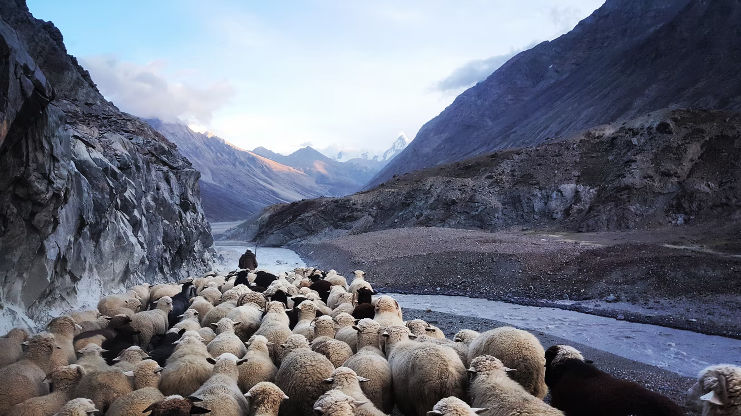
Join us for the IYRP! https://iyrp.info/ iyrp2026@gmail.com
@Steven Lasry
Notes:
Join us in this global movement to elevate the voices from and of rangelands and pastoralists in 2026 and BEYOND!

