Slide 1
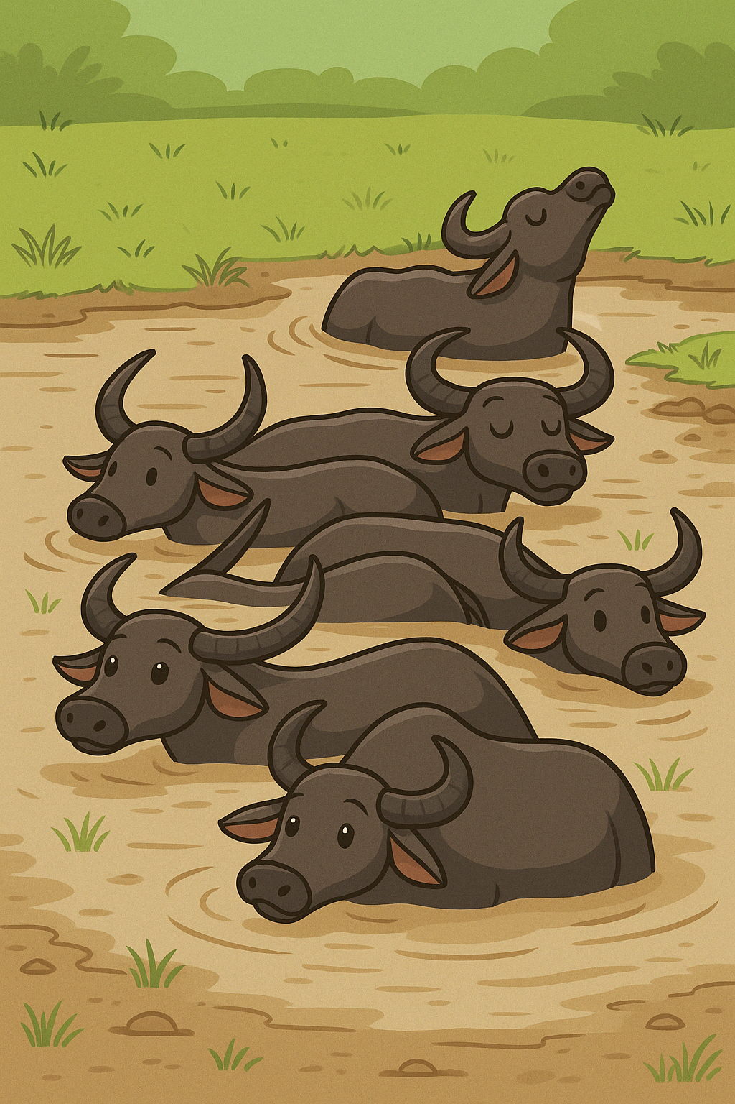
My Work Book
My work book
My name is _________________
I live in________________
_____________________
I am __________ years old
Date : My sign

Slide 2

Grasses in my Dera
_____________________
_______________________
________________________
_________________________
___________________________
_________________________
___________________________

Slide 3
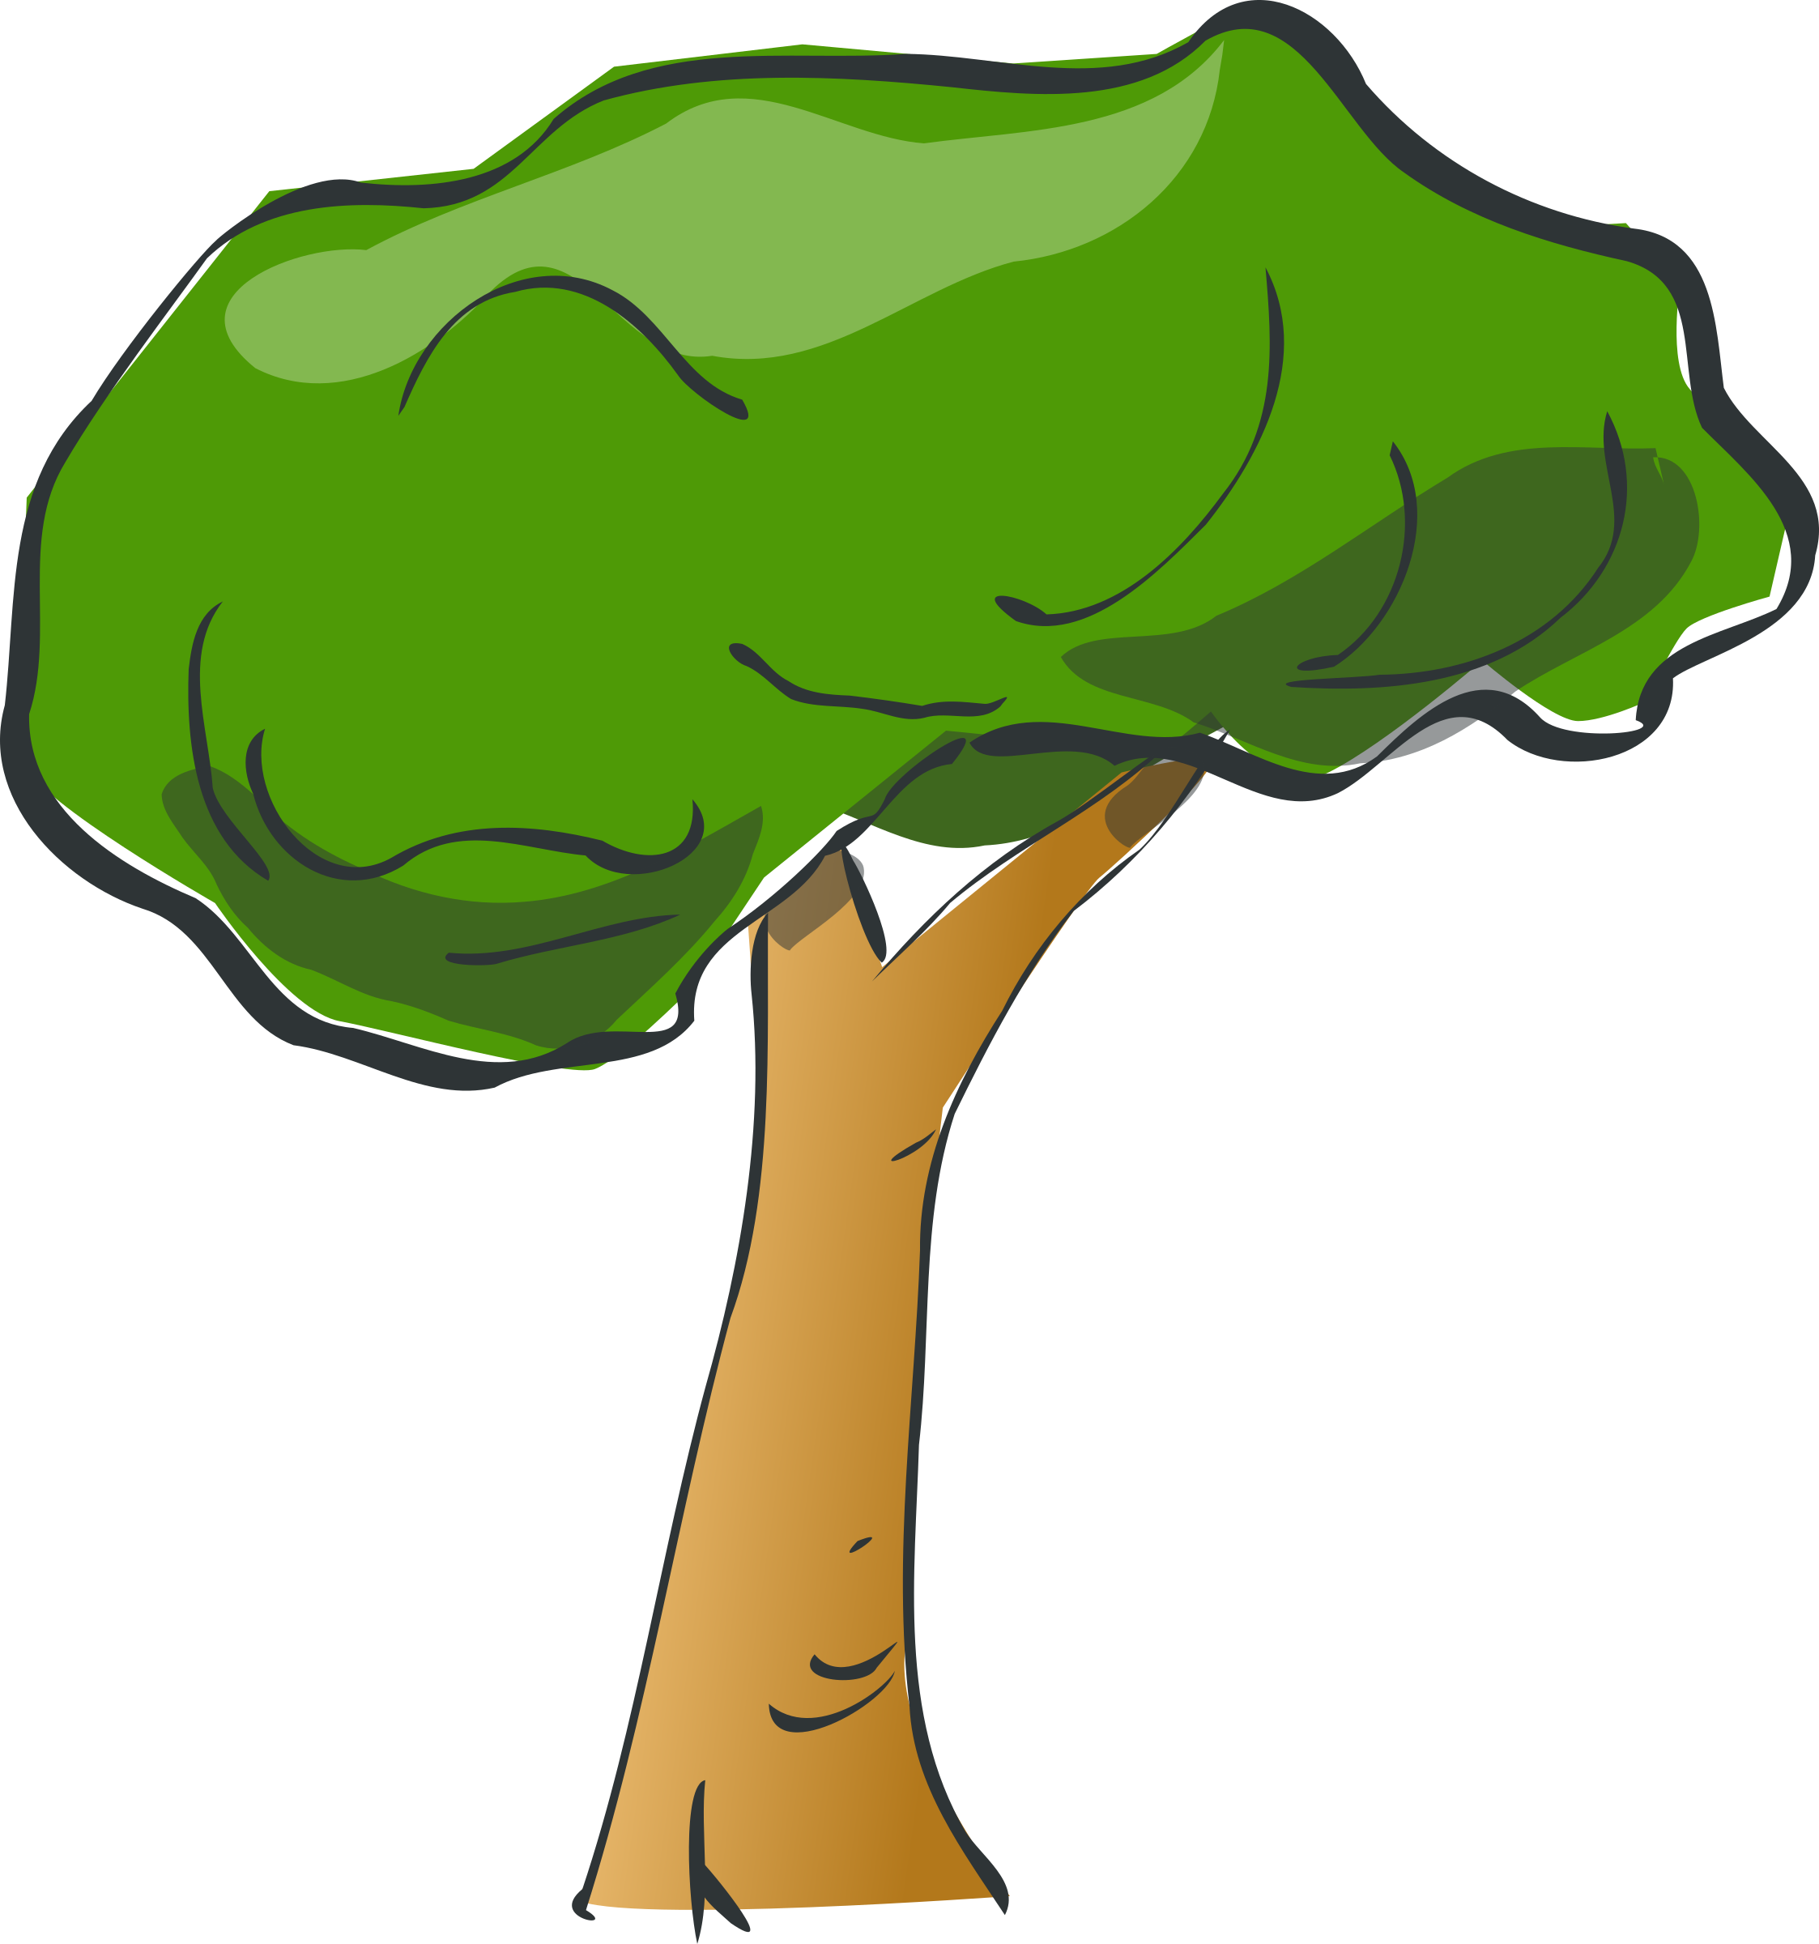
Trees in my Dera
_____________________
_______________________
________________________
_________________________
___________________________
_________________________
___________________________

Slide 4
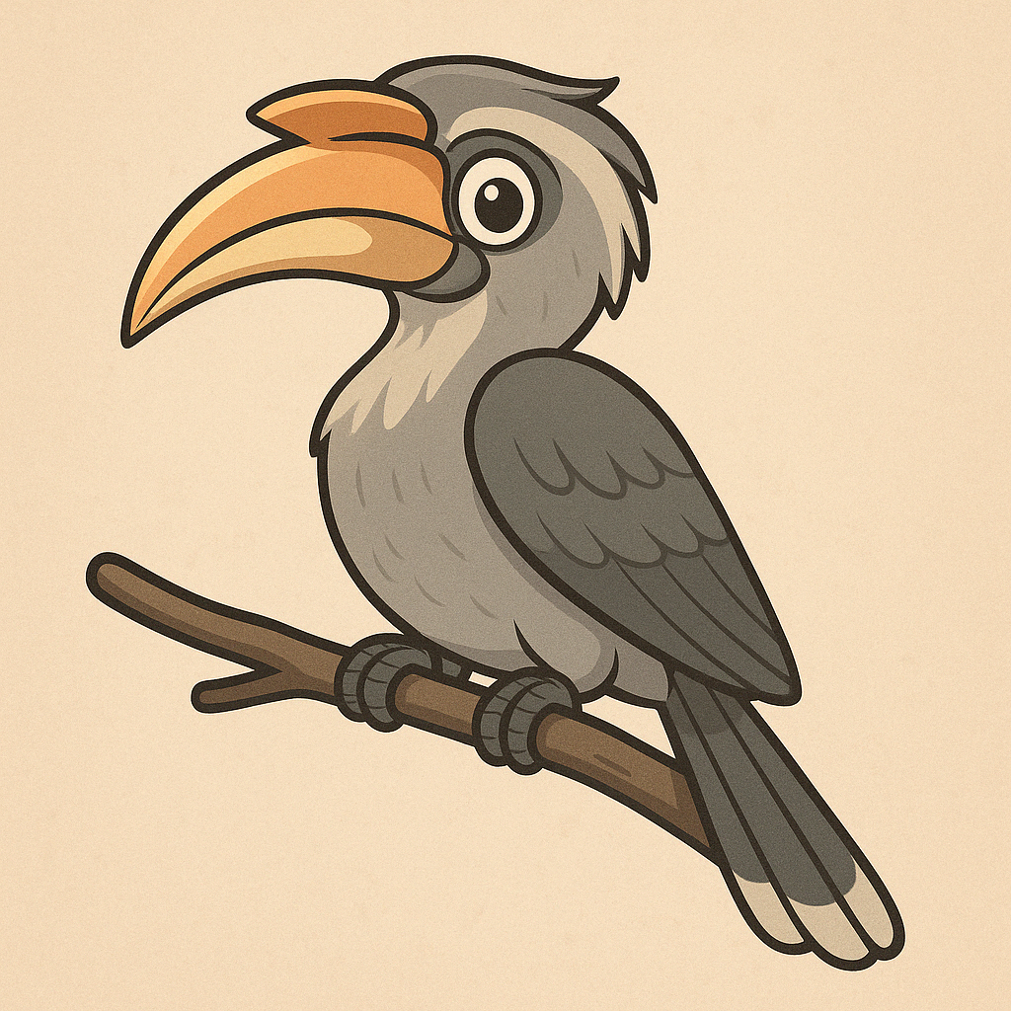
Birds in My Dera
_____________________
_______________________
________________________
_________________________
___________________________
_________________________
___________________________
_____

Slide 5
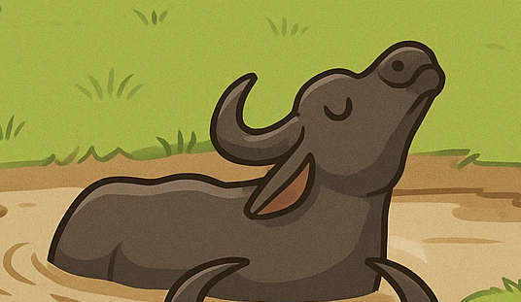
Animals in My Dera
_____________________
_______________________
________________________
_________________________
___________________________
_________________________
___________________________
____________________________
___________________________
___________________________
____________________________

Slide 6
My Buffalo
My buffalo gives _ litres of milk per day
In the morning she gives__________
In the evening she gives___________
She has given _______________ number of calves
Her first calf was born in ________
My Buffalos name is_________
She is ________years old

Slide 7
Animals in My Dera
_____Buffalo gives the most milk
She gives ____________litre per day
From 10 liters of milk we make _____Kg of ghee
From 10 liters of milk we make ____kg of khoa
We have _______ number of buffalos
They give us ______ and ________ and ________

Slide 8
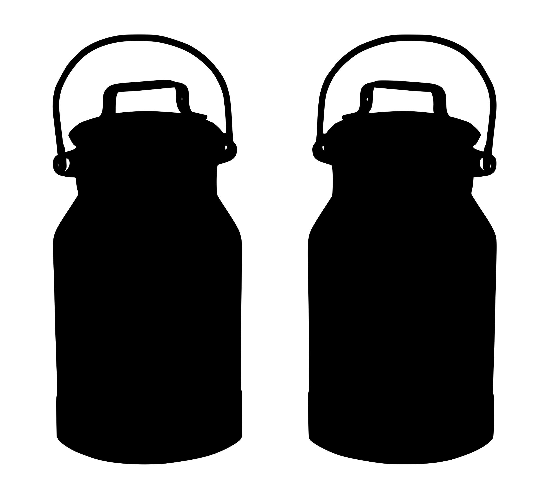
Milk
Good milk is
White in colour
It smells _
It does not have any _____
It tastes sweet / Sour
From the milk we make
1.
2.
3.

Slide 9
These plants help the buffalo make good milk
1.
2.
3.
4.
5.
6.
7.
8.

