Slide 1

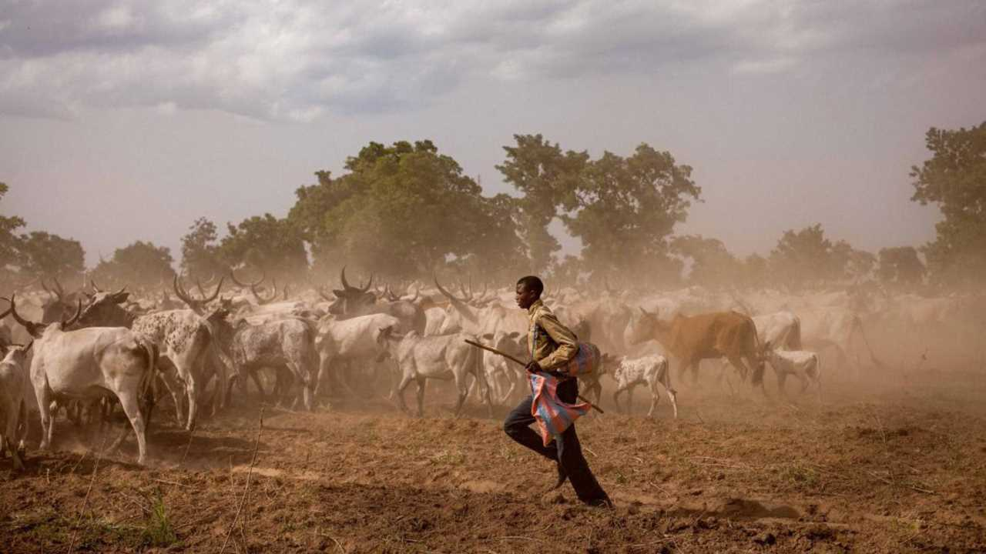


UN International Year of
Rangelands and Pastoralists
2026
April 2026 Theme: Climate change and resilience
www.iyrp.info Global Alliance for Rangelands and Pastoralists
Notes:
Welcome to the International Year of Rangelands and Pastoralists!
This month, we will focus on pastoralists’ mobility and flexibility as core adaptive strategies, why carbon accounting needs to change, which structural barriers must be removed, and how agendas for climate and security should be aligned.

Slide 2
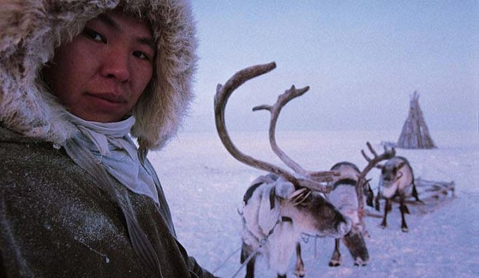
Pastoralism is a model of sustainable climate adaptation
Russia @ L. Monami
Notes:
Pastoral systems thrive on climate variability, managing its risks while converting unpredictable resources into productive use.
In arid and semi-arid lands, pastoralism is often the most productive and sustainable land use available.
Securing functional access to grazing opportunities and investing in rangeland-pastoralism systems unlocks climate resilience and adaptation, enhances biodiversity and strengthens livelihoods at scale.
For this reason, we can say that rangelands and pastoralism are climate assets, not marginal lands or land-use systems, and that climate policies must build on this adaptive intelligence, not suppress it.

Slide 3
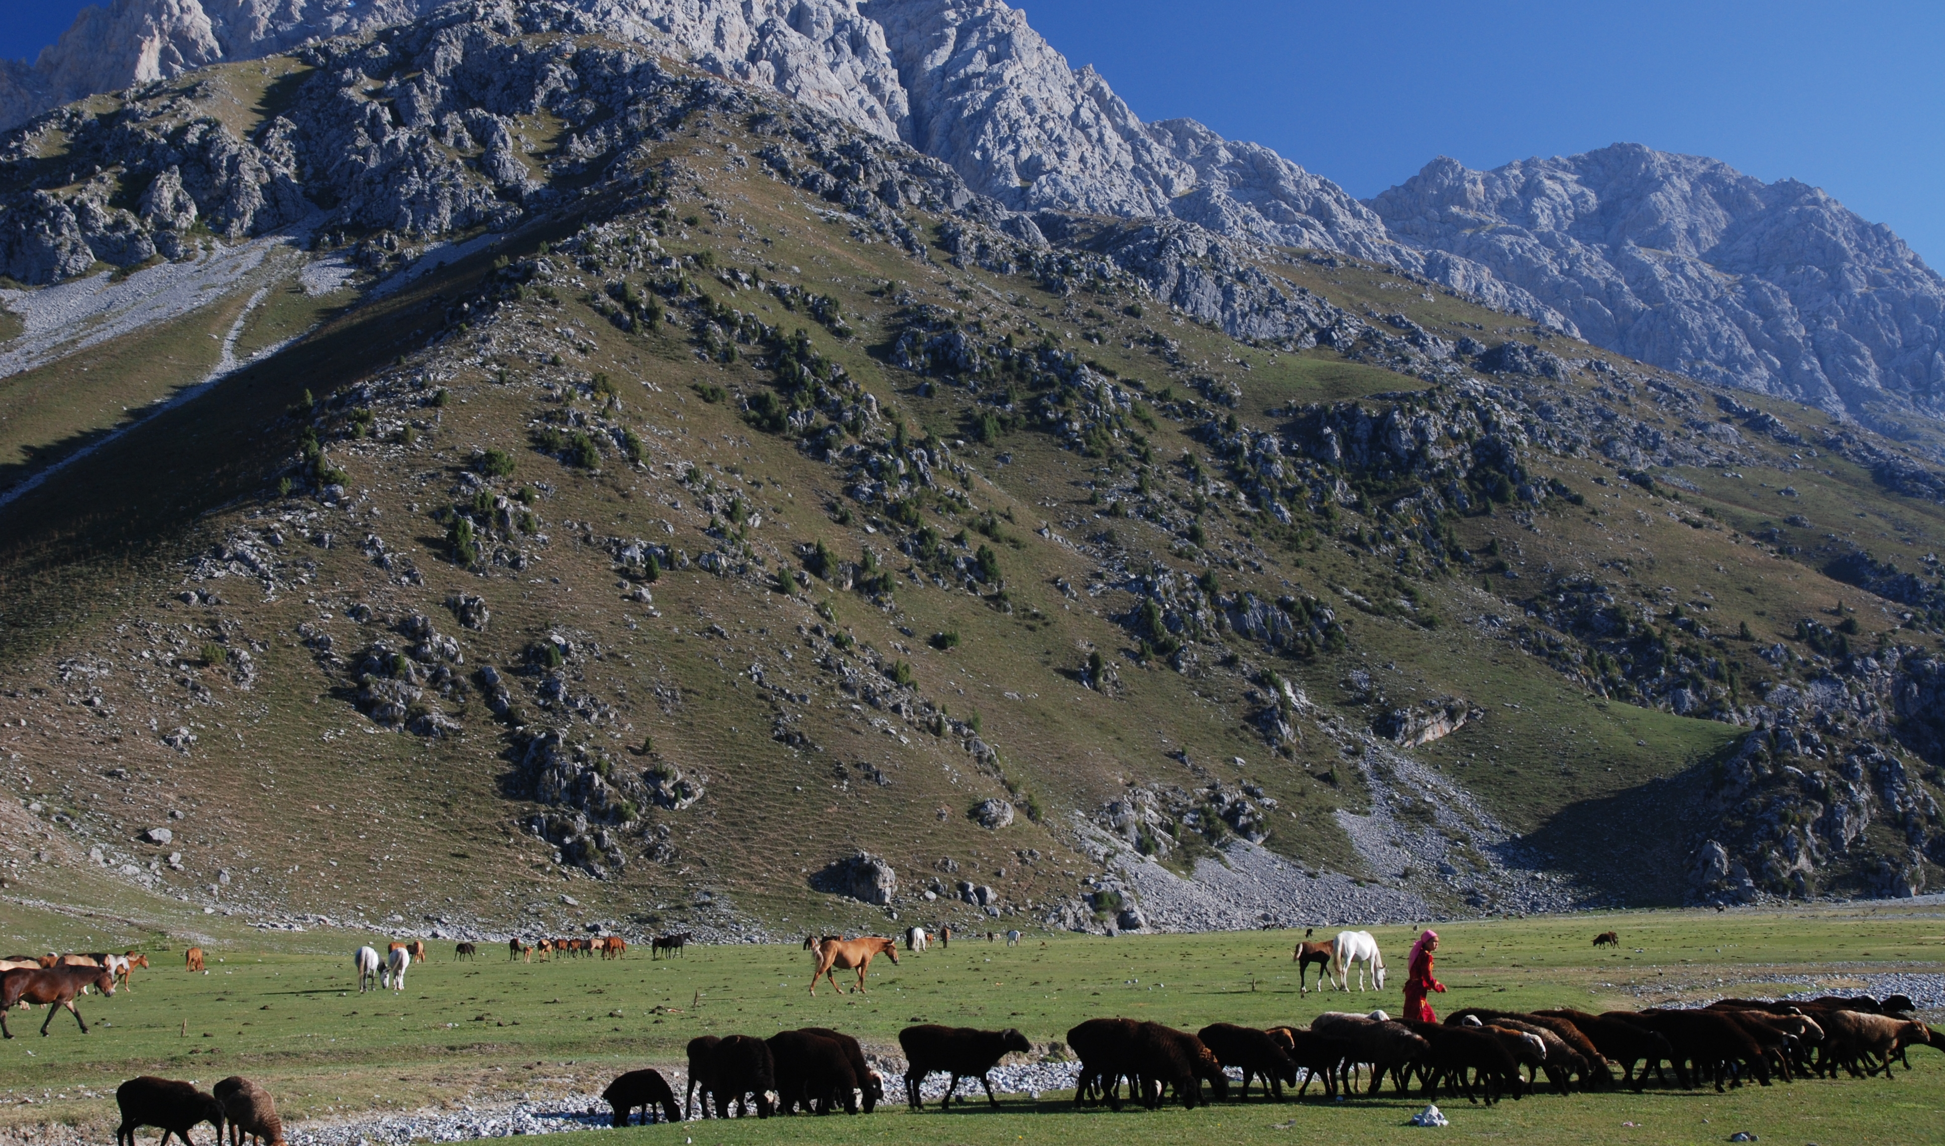
Mobility is climate adaptation in action
Kyrgyzstan @ C. Spurway
Notes:
Resilience in mobile livestock systems lies in using and managing climate variability, not in eliminating it.
Movement aligns herds with shifting ecological opportunities, regenerates rangelands and maintains biodiversity — all without dependence on fossil fuels.
Mobility allows herders to seize unpredictable and short-lived grazing opportunities while reducing pressure on the ecosystem.
Restricting mobility – through borders, fencing or sedentarisation – increases pastoralists’ exposure to climate risk.
The IYRP Global Alliance calls for support to pastoralists’ mobility and adaptability. Investment should be made in their core adaptive strategies — mobility, herd diversity, flexible land tenure and collective governance — instead of infrastructure that locks people in place.

Slide 4
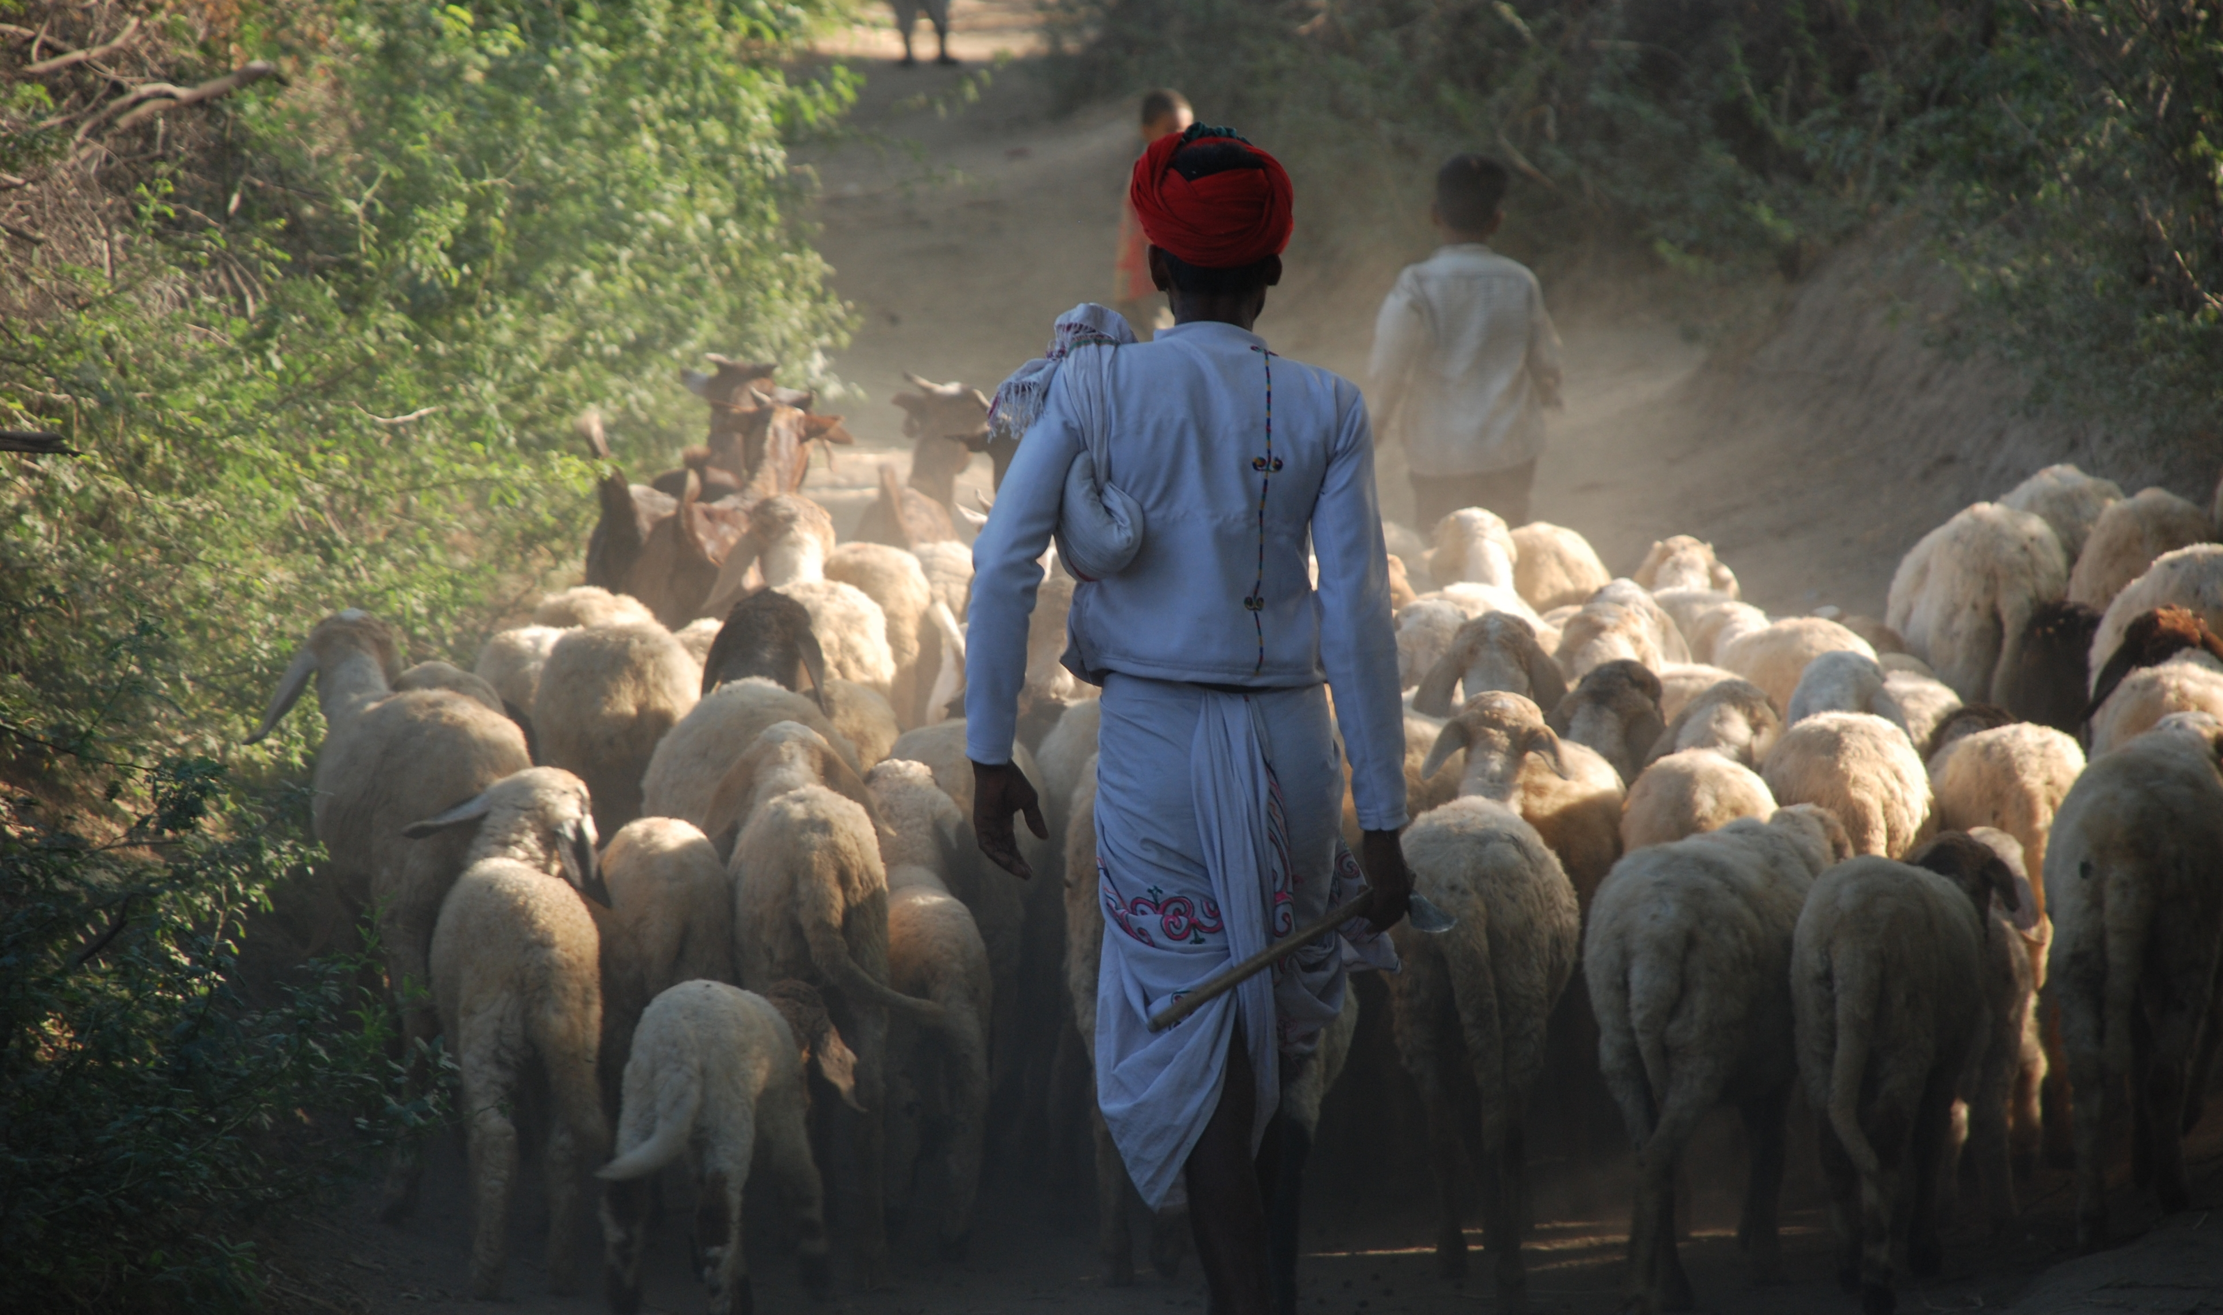
Degradation is driven by exclusion, not use
Rajasthan, India @ Ilse Koehler-Rollefson
Notes:
Most rangeland degradation occurs after loss of access, fragmentation, and use.
Most governance systems evolved to manage variability.
Policy implication: Securing access for pastoralism restores stewardship and rangelands

Slide 5
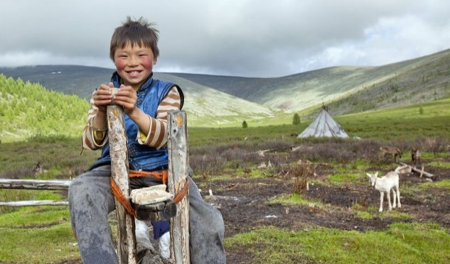

Climate change is a challenge—but pastoralists are failed by poor policy, not climate
Mongolia @ L. Hislop
Notes:
Climate change is reshaping rangeland variability, requiring pastoralists to adapt their specialisation accordingly. However, pastoralists’ climate adaptation is obstructed by policies that undermine flexibility.
Restrictions on mobility, combined with land-use conversion and fragmentation, and exclusion from governance—all trigger exposure to climate risk. Restrictions to mobility and land-use constraints in pastoral areas must be addressed as part of addressing climate risk.

Slide 6
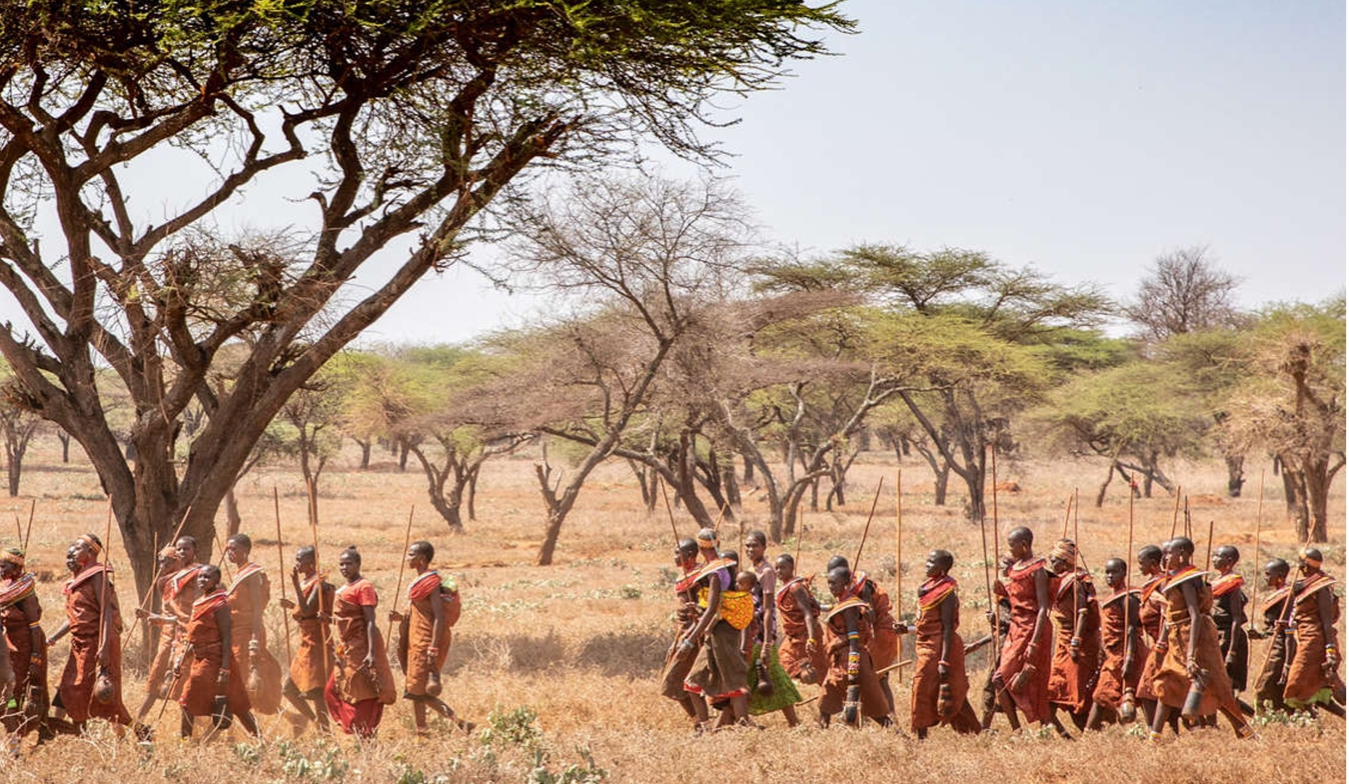
Indigenous knowledge is a climate resource
Samburu, Kenya @ E. Millstein
Notes:
Pastoralist climate expertise is embedded in daily practices, herd composition and breeding systems, and the institutional infrastructure of mobility, including collective governance. Knowledge is finely tuned reading of landscapes, animals, and skies.
Climate services should therefore be co-designed with pastoralist communities — strengthening the systems that already enable them to live productively with variability.
Indigenous knowledge systems and scientific knowledge systems are complementary, each offering distinct but overlapping insights into climate variability and risk.

Slide 7
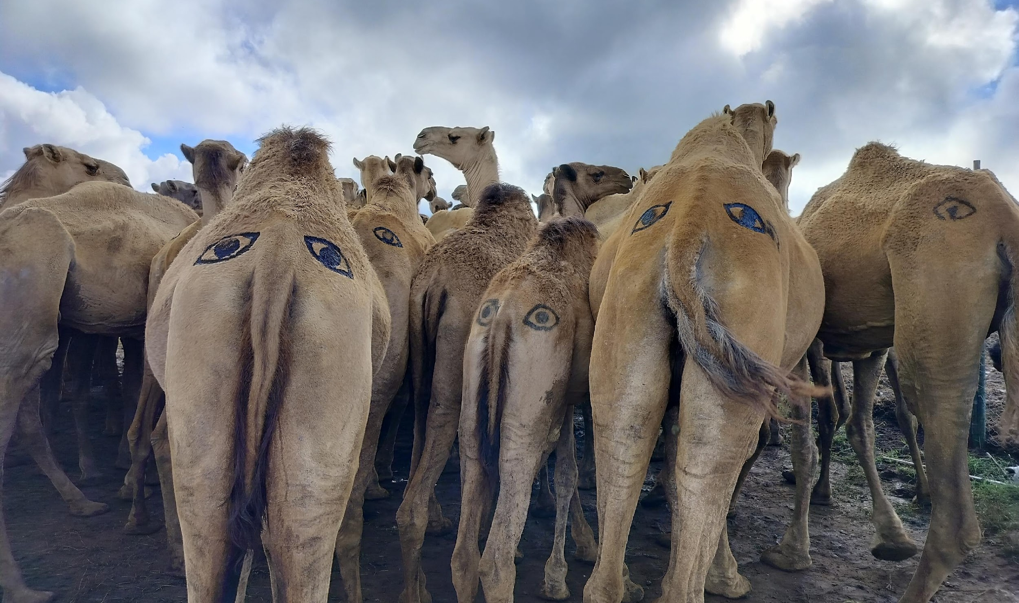
Conflict is often linked to stress and weak governance
Marsabit, Kenya @ P. Simpkin
Notes:
Climate change, with only little room left for adaptation, intensifies competition over water and pasture. Conflict is more likely where customary institutions are undermined and conflict-resolution mechanisms weak.
In pastoral areas, it’s essential to invest in local governance, cross-border agreements and peace-building efforts as part of climate adaptation.

Slide 8
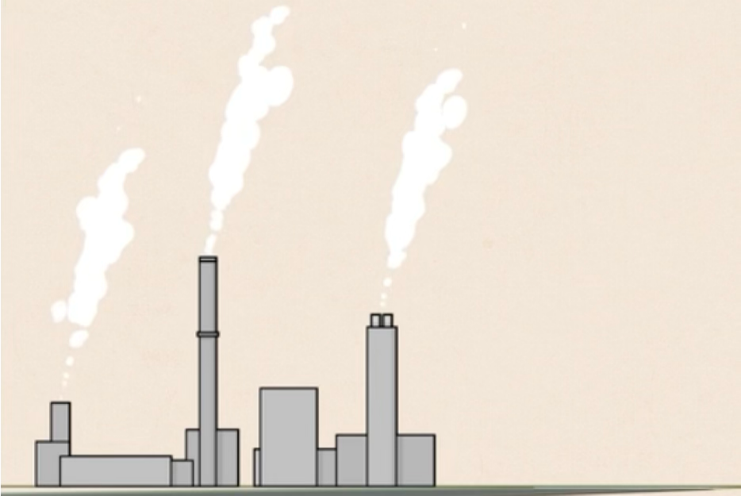
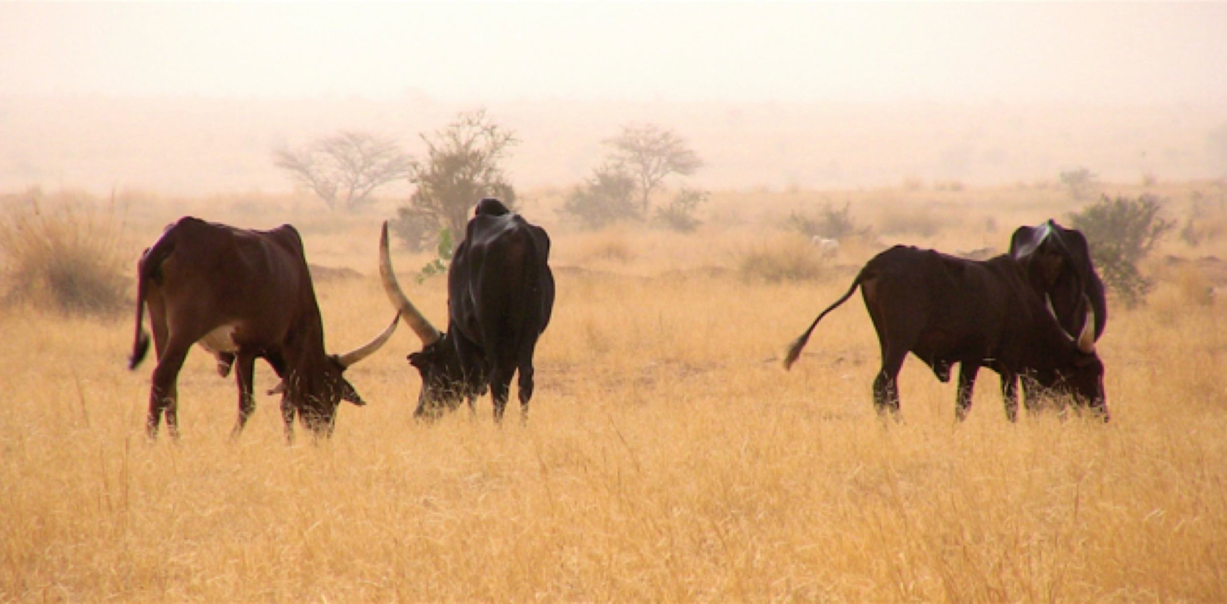
Not all emissions are equal
Niger @ S. Kratli
Pastoralism and Development MOOC @ IIED
Notes:
Carbon is life and carbon is climate change: whether or not carbon is a problem depends on its context and its role in Earth's natural systems.
Climate change is driven by fossil carbon, not by natural emissions from living systems like rangeland-pastoralism. Treating natural emissions as equivalent to fossil-fuel emissions undermines both science and justice.

Slide 9
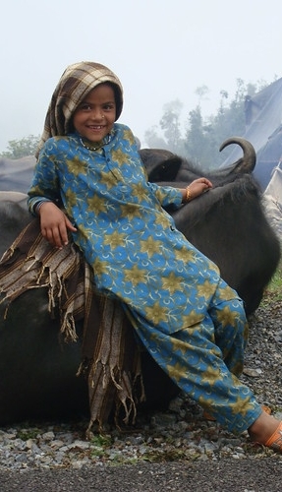
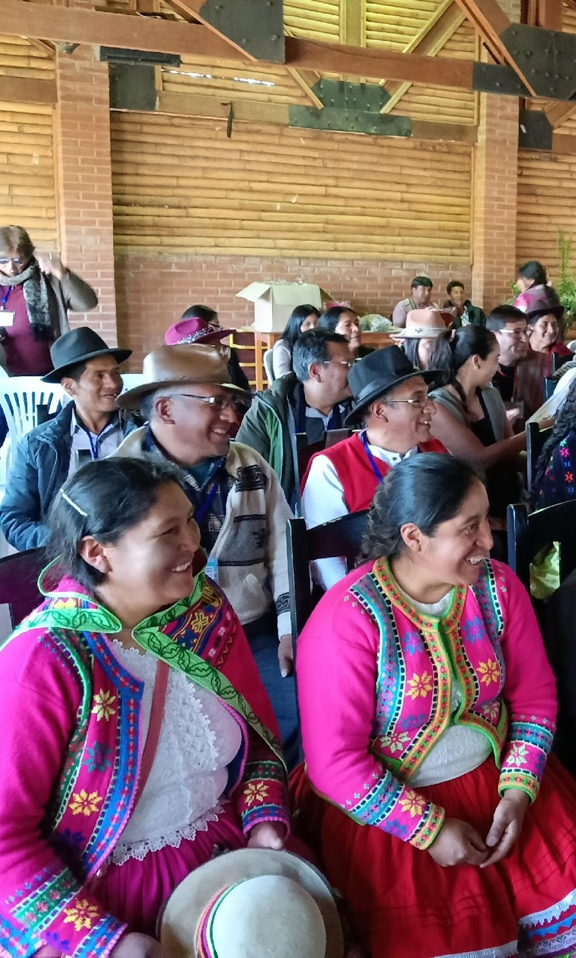
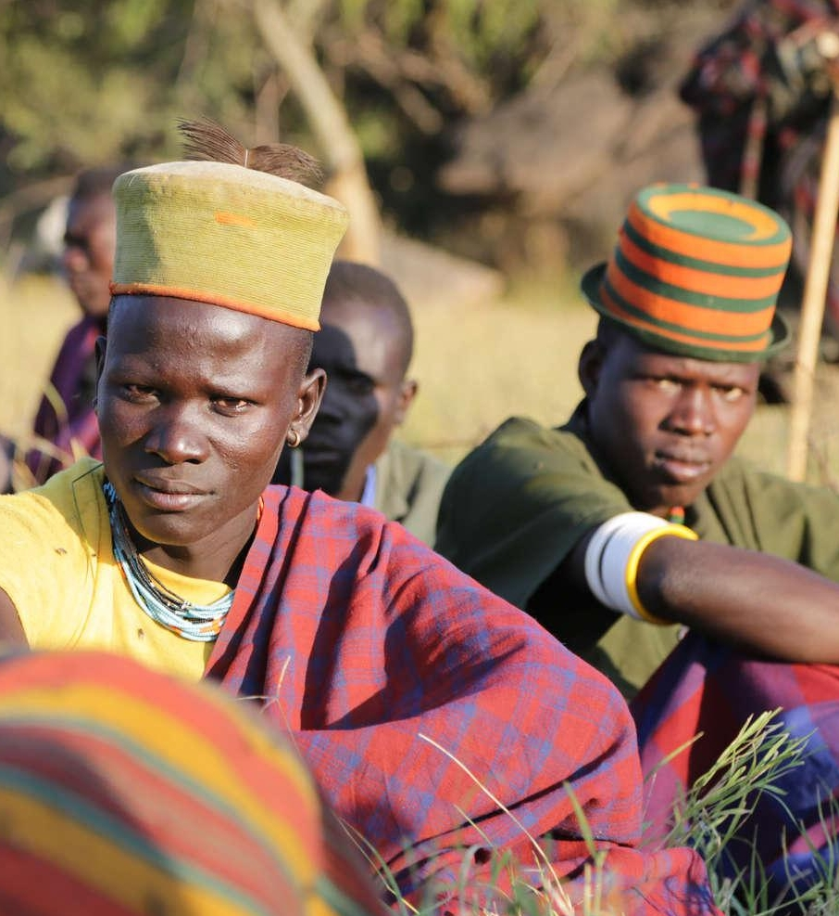
Women and youth are key to rangeland resilience
Uttarakhand, India @ S. MacMillan
Andean gathering @ E. Michaud
Karamoja Uganda @ E. Millstein
Notes:
Pastoralist women manage critical resources. The youth sustain mobility and innovation. Exclusion of women and youth from decision-making weakens pastoralist communities’ capacity to adapt.
Climate impacts are not gender-neutral: women often face increased workloads and reduced access to resources. Exclusion of youth from governance over land and livestock can lead to increased youth migration and greater risk of conflicts. Climate, land tenure and livestock policies should be designed in ways that explicitly include pastoralist women and youth, so as to ensure rangeland resilience.

Slide 10
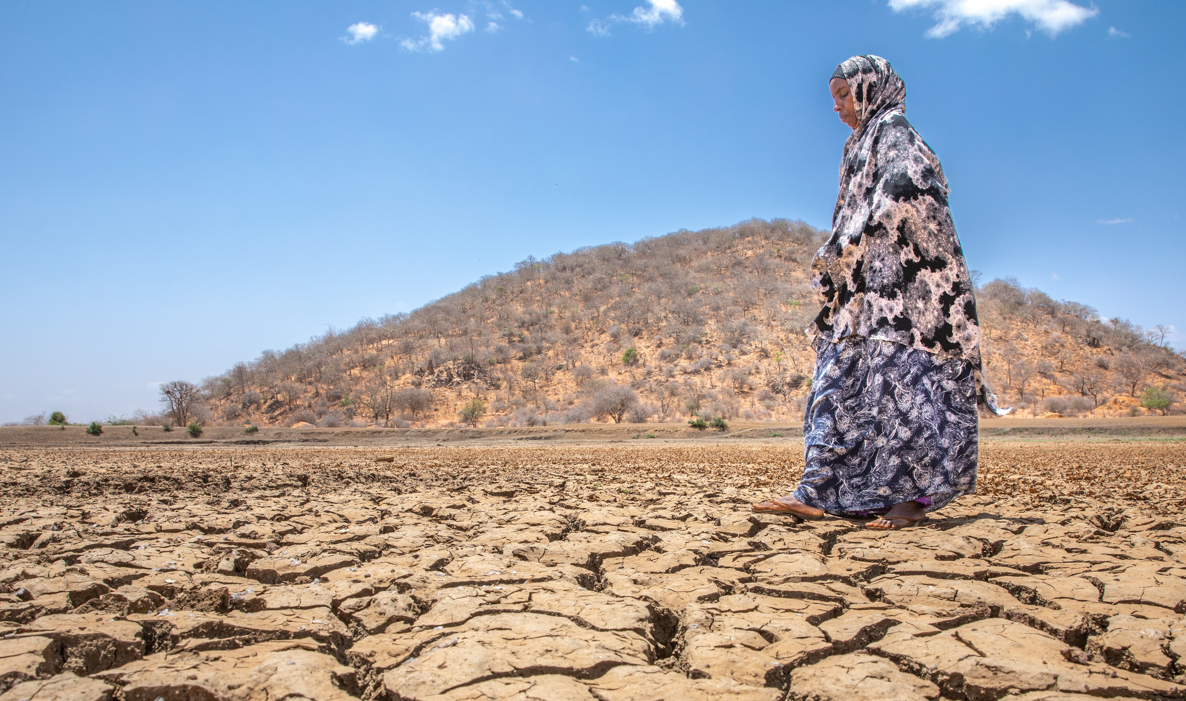

Investing early is cheaper than responding to crisis
Samburu, Kenya @ E. Millstein
Notes:
Proactive investments in rangeland-pastoralism systems cost far less than humanitarian aid, conflict response, or forced migration.
Every dollar invested in rangeland resilience reduces future disaster-related costs. Proactive investments in rangelands and pastoralism are among the most cost-effective climate solutions available. Laws and finance mechanisms that restrict pastoralists’ access to rangelands, criminalise their mobility or exclude them from decision-making must be reformed.

Slide 11
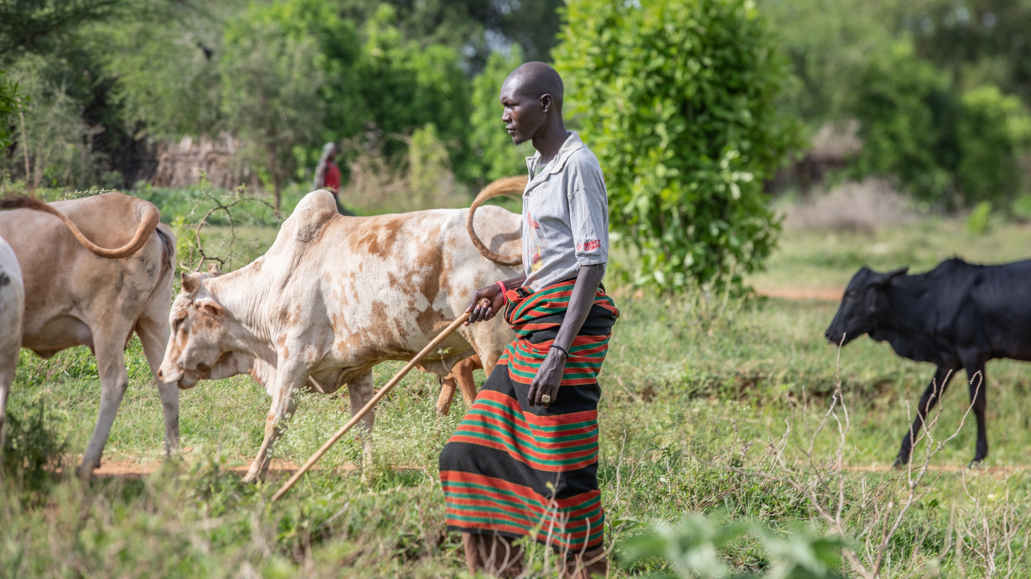
Investing in pastoralism & rangelands is cost-effective climate action
Karamoja, Uganda @ E. Millstein
Notes:
Investments in early-warning systems, mobile veterinary, health and education services, drought insurance, and secure access to grazing, costs less than than repeated emergency aid.
Supporting pastoralism—by strengthening mobility and flexibility—reduces humanitarian crises and displacement.
The IYRP Global Alliance calls for a shift in funding from reactive external aid to proactive support for pastoralist specialisation and resilience.

Slide 12
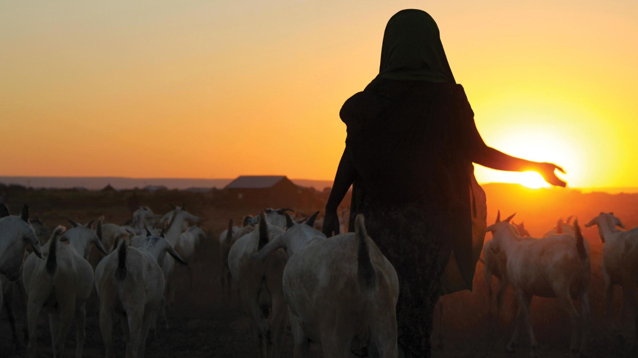
Pastoralism is already in the future
Ethiopia @ K. Lynch
Notes:
Pastoralism is not a problem to be fixed, but an agroecological system specialised to use climate variability while managing its risks —
it must be acknowledged, rewarded, and governed wisely as a global infrastructure/asset in the face of climate change.
Investing in rangeland-pastoralism systems is one of the most certain, fairest, and scalable paths to climate action.

Slide 13
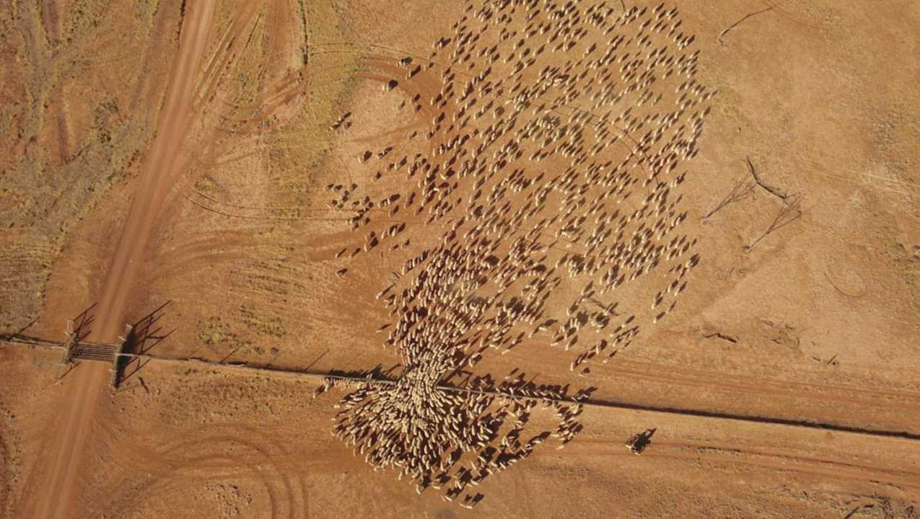

CELEBRATE IYRP 2026!
Contact us:
iyrp@iyrp.info
More information:
https://iyrp.info
Australia @ W. Sheehan
Notes:
Join us in celebrating the International Year of Rangelands and Pastoralists !

