Slide 1
Global Grasslands & Savannahs Dialogue Platform
Pastoralism – Challenges and opportunities
for biodiversity, climate and people
7 September 2021
Mobile Pastoralism, Game Changing Ideas, and IYRP
Maryam Niamir-Fuller, Vice Chair ISG of IYRP
Opening Film : https://www.youtube.com/watch?v=DeqITzac9Ac
Notes:
Opening video: https://www.youtube.com/watch?v=DeqITzac9Ac
I’ll be covering three related topics today:
1. Valuing mobile pastoralism
2. UNFSS Game Changing Solution
3. A quick update on the IYRP

Slide 2
Notes:
But first, lets be clear what we are talking about. We often speak at cross purposes because we don’t use the same terms to define “pastoralist” .
Typically, it conjures up a nomad in a desert on a camel. But it is so much more as you can see in this Word Cloud.
IYRP has adopted a broad definition for pastoralist, as this is a global campaign. Also a definition is being refined by a Working Group – and preliminary results are to be presented at IGC/IRC Joint Congress October 2021.
On a broader strategic level, I’d suggest that we work together, not necessarily to standardize, but to build a lexicon that allows cross-cultural communication while maintaining cultural diversity. Some of the IYRP Regional Support Groups are already making similar word clouds in their own languages.
…..
Going beyond definitions, we also have quite a few myths and misunderstandings to address.

Slide 3
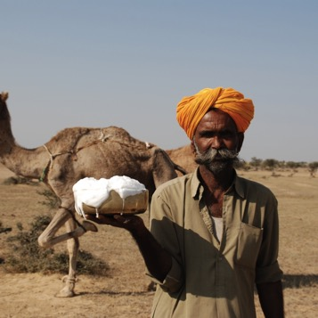
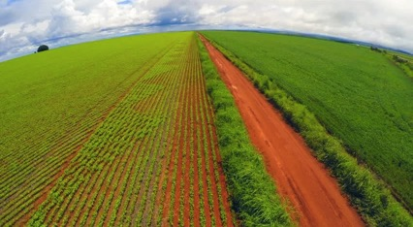
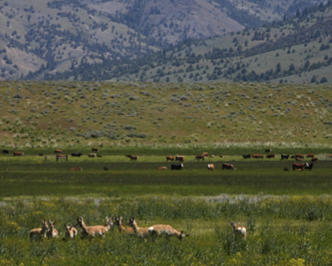
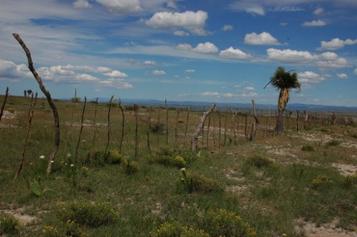
? Is livestock bad for ? ? humans and biodiversity ?
Bad for biodiversity AND bad for pastoralism
Nutrient dense food
Over-grazing vs under-grazing
Livestock wildlife compatibility
Notes:
Both the IYRP and the UNFSS Game Changing Solution are about busting myths. Let’s take the overall issue of the role of livestock.
Social media and some scientific circles are abuzz about how meat is bad for your health, and livestock are bad for the environment. But how true is that ? I’ll give you four examples.
1. While humans can exist on a plant-based diet, WHO concludes that animal protein has very high nutrient density, more polyunsaturated fatty acids, and better Omega 3/ Omega 6 ratios. [Meat and milk from pastoralism is largely chemical-free, unlike that from intensive, confined systems.]
2. Plowing up grasslands and savannas for soybean and other animal feed IS indeed bad for our ecosystems, but it is ALSO bad for pastoralists. Conversion of rangelands for food and feed crops is one of the most important drivers of rangeland degradation.
[An IFPRI study in 2012 predicted that by 2030, if high-income people reduced their meat intake, and low-income people increased theirs, then global consumption of meat products would fall by 19% and demand for coarse feed grains would drop by 14%. To my knowledge this study has not been replicated or updated to differentiate extensive from intensive production systems – does anyone know?]
3. Over-grazing has long been blamed on pastoralists – that they are bad managers, they don’t care about the environment. But correlation is not necessarily causation. That paradigm is thankfully now being replaced with a more nuanced approach that recognizes the root causes that have disrupted pastoral systems as being land use change, land expropriation, privatization, and also impacts of climate change.
And evidence shows that taking livestock off grasslands and rangelands does not necessarily bring back ecosystem health. Many of these systems, especially the grasslands, are grazing dependent – whether by wild or domesticated species. Studies show how under-grazing can result in bush encroachment, or increase in termite population that destroys trees, and decrease in plant diversity. So we can say with some confidence that under-grazing is just as bad as over-grazing.
4. Livestock and wildlife do compete with each other for grazing resources and space, transfer of disease, and loss of livestock from carnivores, etc.. However, there are many more instances of compatibility that we often do not hear about. For example carnivores keep the population of rabbits and small wild ruminants in check, thus benefiting livestock with more grazing resources.
[Grazing of invasive buffel grass in Australia has helped control the grass and enhance habitat diversity. ]
Mobile pastoralism is said to mimic wildlife movement and herbivory. Cattle appear to mimic zebras the most, and a study in Nairobi National Park shows that the population of gazelles fell when livestock were excluded, but rebounded when zebras were introduced.
These are just a sample of myths that how they can be addressed. Much more work needs to be done to find the evidence to bust more myths.

Slide 4
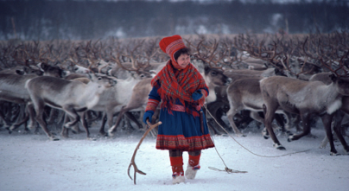
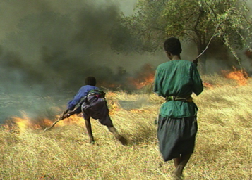
UNFSS Game Changing Solution: “Mobile Pastoralism Valuing Rangeland Variability”
Livestock mobility and ecosystem health
Seed & nutrient dispersal
Patch mosaics
Reduced fuel for fire
Notes:
If you’ve followed the UNFSS process, you will know that there are several Game Changing Solutions that address the issue of sustainable livestock production and consumption. The Mobile Pastoralism Game Changing Solution was submitted by a coalition of 20 organizations from the International Support Group for IYRP, and fills a glaring gap within the solutions offered. That gap is mobility.
Saverio will talk more about mobile pastoralism and how it has evolved to manage climate variability. The video prepared by CELEP and Partners you just saw elaborated on this. Here I will focus on the biodiversity and restoration aspects of the game changing idea.
Livestock mobility has specific benefits to ecosystems, for example :
> Increasing mobility of animals helps seed dispersal, nutrient dispersal, and even carcass dispersal that has been shown to help maintain populations of endangered vultures in Europe.
> Mobility helps reduce fuel for fires in the wider landscape.
> Seasonal transhumance provides rest and restoration for rangelands, especially sensitive areas such as wetlands or montane meadows, and enhances patch mosaics.
> Mobility is also beneficial for the animals themselves, helping to avoid build up of pests and disease – thus dramatically reducing the need for chemical inputs.
Mobile pastoralism has many forms all over the world – from long seasonal transhumance in Spain, to the relatively short rotations in Masai Mara.
There are signs of a return to transhumance in California’s foothills, we see professionalization of herders in Europe, a strong Basque community in Wyoming, and private ranchers in South Africa, often miles away, sharing grazing resources with each other.
[Recently it was reported by PASTRES that there are plans to train and hire herders as Park Rangers in East Africa. ]
My point is, that mobility of animals is not an archaic return to the past, but a technology suited to our times and environment.

Slide 5
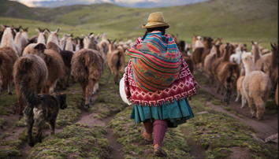
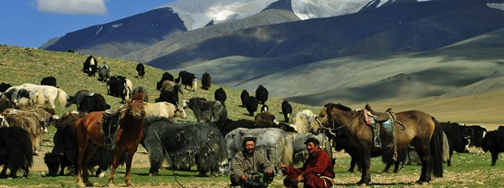
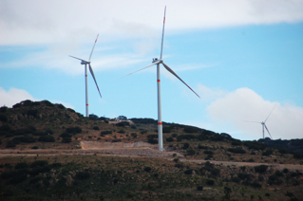
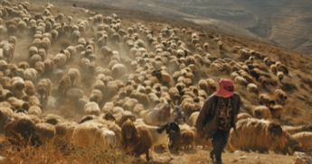
Examples of tested solutions to enhance mobility
Legal recognition of mobility of livestock
Decentralized electricity & mobile health and education services
True cost accounting
IPCC and IPBES methodology improvements
And more!
Notes:
The Game Changing Solution recognizes that not all livestock systems can be converted easily to mobile pastoralism, but provides specific solutions that can enhance mobility of livestock where possible, and where necessary for ecosystem health. For example:
Legal recognition of mobile pastoralism and common property – in fact is a prerequisite. An example is the transhumance passports of West Africa.
> Decentralized and mobile electricity is essential. But pastoralists should also get their fair share of royalties from large solar, wind and water power in their communal rangelands.
> But policies need to change too, and it will help to systematically apply true cost accounting to all livestock products AND differentiate the intensive from the extensive systems
> The proposal calls on IPCC to modify its methodology for calculating carbon footprint from rangeland and pastoral systems; the recent report is a step in the right direction
> It also calls on IPBES to comprehensively map ecosystems recognizing rangelands as a distinct category and the role of livestock in maintaining natural landscapes
> And many more practical and tested solutions! Please do read the full proposal.

Slide 6
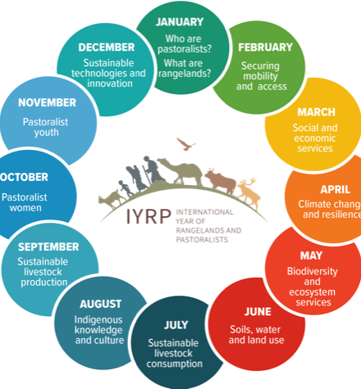
Momentum building up for IYRP 2026
2002: Dana Declaration on Mobile Peoples and Conservation
UNEA 2016 – 2018
FAO 2020-2021
IUCN WCC 2021
76th UNGA for IYRP 2026
IYRP International Support Group
Notes:
The IYRP campaign has a long history. From the Dana Declaration in 2002 which WWF supported (http://danadeclaration.org/main_declaration.html)
, to the Hohhot Declaration in 2008, and many other declarations from pastoralist gatherings in 2005 – 2015.
In 2016, we organized an IYRP Event at CBD COP 13, on 14th December 2016 in Cancun, Mexico. [ "World´s Grasslands and Rangelands at Risk: the Role of Pastoralists and Livestock to Conserve Global Biodiversity”] which resulted in a short declaration that you can find on the IYRP website.
And this week, we are hopeful that the WCC will consider a resolution to support IYRP.
UNEA resolutions provided the first foray into the UN system. Governments moved it to the FAO process and Government of Mongolia has moved it forward ever since.
We are now expecting the 76th UNGA to consider it and endorse it before the end of this year. At least 36 governments plus the EU and IGAD formally support it by now.
IYRP – ISG is an open coalition of 300+ organizations worldwide, including WWF International, that support the Government of Mongolia’s proposal. – I invite you to become members

Slide 7
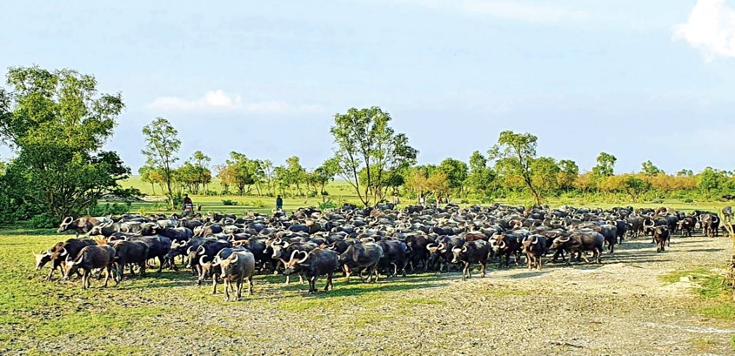
Why an IYRP and what can it achieve ?
Raise awareness
From: Presentation on Pastoralism in Bangladesh, July 2021, by Shah-I-Mobin Jinnah, Executive Director, Community Development Association(CDA) Dinajpur, Bangladesh
Notes:
IYRP has two work streams: raising awareness and filling knowledge gaps
And while we aim for IYRP in 2026, a lot has already been done.
For example, we can trace many awareness raising actions directly to the IYRP coalition: I’ve already mentioned:
Word Clouds
UNFSS Game Changing Idea,
Videos and media campaigns, such as the CELEP video you just saw
But also :
Revival of activism in South Asia
Just this year, Mongolia’s Annual Pastoralist Award has been extended to all of Central Asia.
A comprehensive East Africa policy review by the IYRP Regional Support Group
In late October of this year, the IGC/IRC Joint Congress has devoted two Concurrent Sessions to IYRP – which I hope you will join.

Slide 8
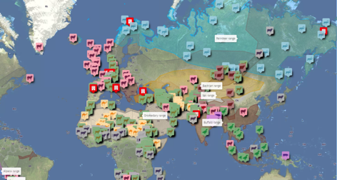
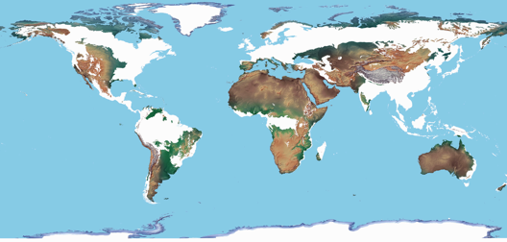
Fill knowledge gaps
UNEP Gap Analysis - 2018
Pastoralist Interactive map
www.pastoralpeoples.org/pastoralist-map
Rangeland Atlas, 2021 (ILRI + FAO, IUCN, WWF, UNEP, ILC )
Notes:
And there are plenty of knowledge gaps we need to fill.
UNEP’s Gap Analysis in 2018 recommended a global assessment that would be based on real, new, ground-truthed data – not just assessments of assessments. The UNEA 4 resolution L17 called for regional assessments to be funded and supported. Regional assessments if coordinated and using standardized methodology can lead to a global outlook. Can we work together to get the substantial increase in funding necessary to help governments do these assessments in a fully participatory way?
We very much welcome the Rangeland Atlas that ILRI and Partners have prepared, with a preliminary result that 54% of the earth’s land surface is rangeland. We know this is an under-estimate and more work is needed to improve this. Governments also need to accept and own this data. The IYRP ISG is ready to work with you to do so over the next few years and to launch a definitive and authoritative Atlas in 2026 together.
In addition, the League for Pastoral Peoples has launched an Interactive Pastoralist Mapping project, which is to be expanded globally through IYRP collaboration
And ILRI and UNEP have reported to UNEA that they will establish a global data base on rangeland use and change, including conversions and restorations
We need many more of such activities so that IYRP 2026 has the full impact we all hope for.

Slide 9
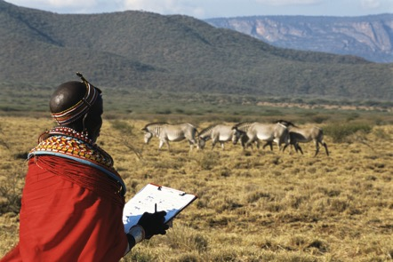
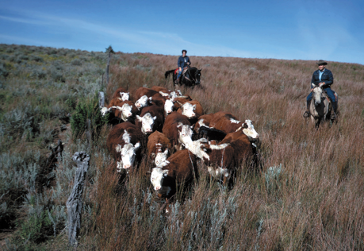
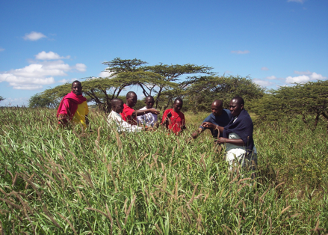
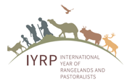
Final remarks
Notes:
Pastoralists and conservationists have had a fraught relationship historically (and it continues to today), but they have a lot more in common than they think.
We need to continue to break down the barriers of myths and misunderstanding and help bring the two communities together.
The IYRP 2026 gives the opportunity for better understanding, integration and multi-disciplinary and multi-stakeholder collaboration to fill knowledge gaps. Please join us.
I encourage you to support the Game Changer Idea : lets re-wild rangelands and enhance mobility of livestock. Even if we succeed in integrating this idea into the UNFSS, we will still need to work together to raise the funds and resources needed to implement it.
I also plead with you to initiate, support and contribute to participatory regional assessments of rangelands and pastoralists and other ways to fill knowledge gaps; without real data and knowledge we cannot break the myths that surround us.
Thank you for your attention.

