Slide 1


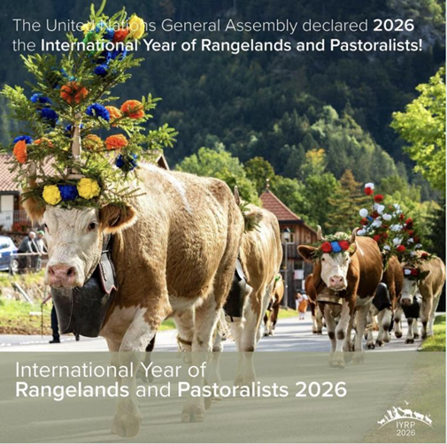
International Year of Rangelands & Pastoralists
Planning for IYRP 2026 in North America https://iyrp.info

Slide 2
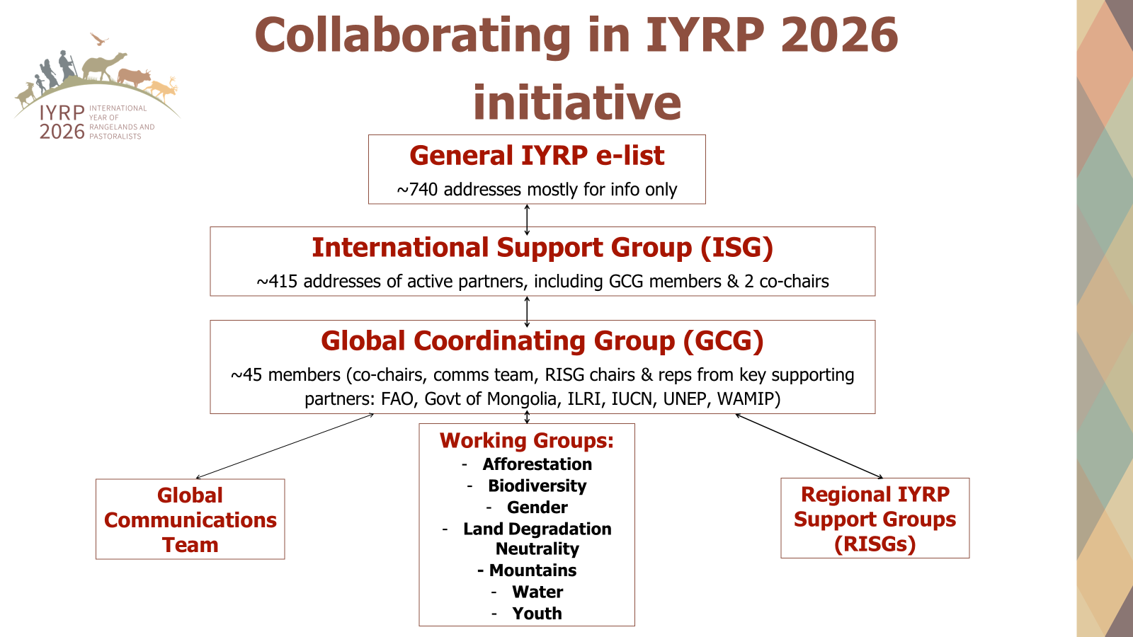

Slide 3
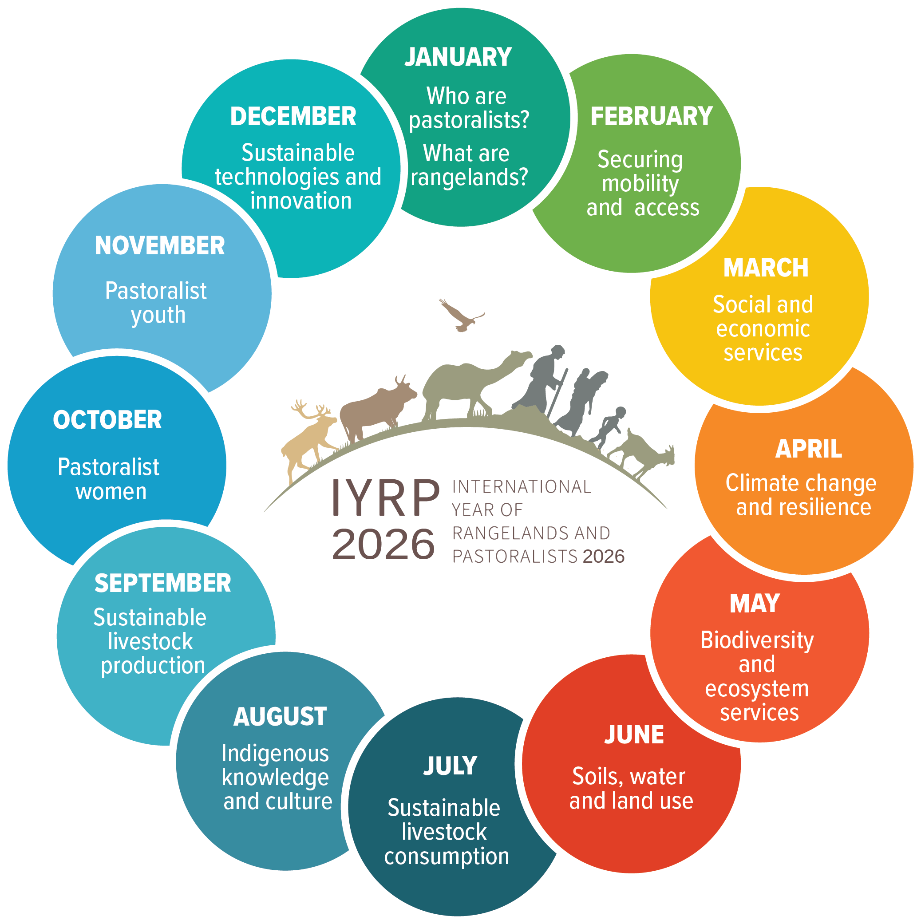
Action Planning for Outreach
Expected Outreach Outcomes (for example)
  Country and local levels: expos, awards, fairs, educational materials, video documentaries, social media campaigns…
  Global level: action statements, new partnerships, policy changes, increased development resources…
  International organizations: hosting a theme, articles in research journals and popular press
12 Monthly Themes expected to be adjusted to Regional Calendars
Notes:
Planning in preparation for IYRP 2026 is happening at many levels. Regional Support Groups have formed and are implementing many educational and informative events and activities including expos, film festivals, and social media campaigns. At the global level, new partnerships are being formed to promote enlightened policies that will conserve rangelands and document the contributions of pastoral communities. The graphic on the slide provides an overview of 12 monthly themes that will be a focus of activities in 2026.

Slide 4
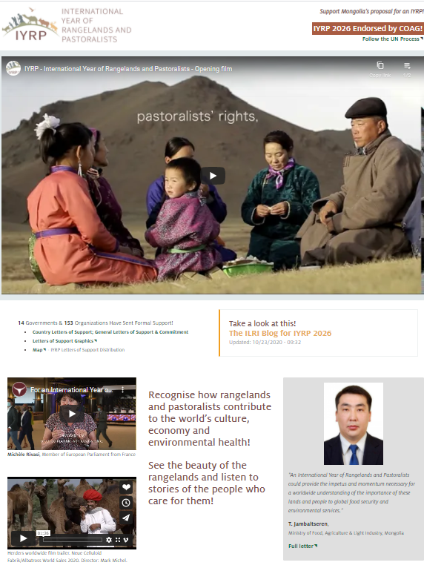
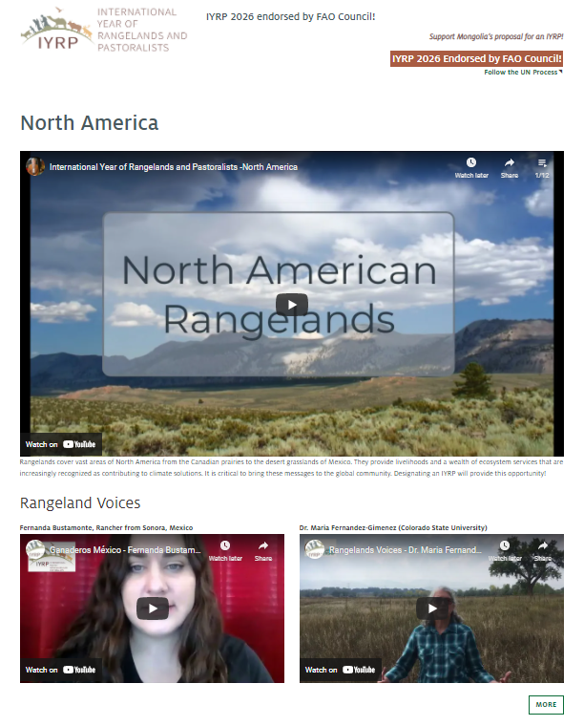
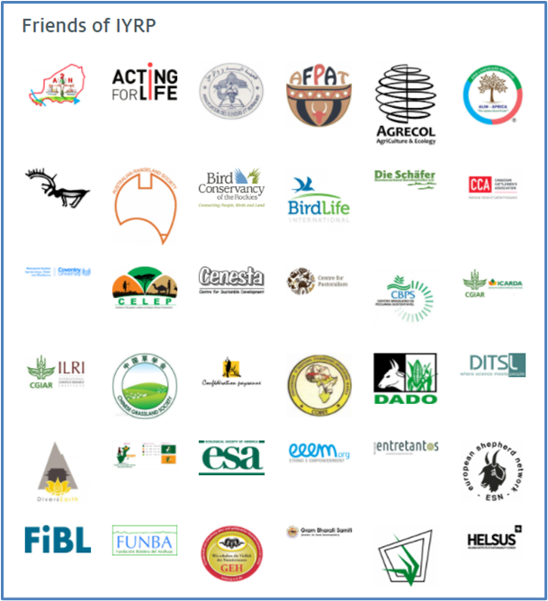
IYRP Communications Outlets
(Largely Supported by the University of Arizona, Yolda & CELEP)
IYRP.info Website “online booth” (outreach materials, videos, position papers etc.) https://iyrp.info
IYRP Archive on Rangelands Gateway https://globalrangelands.org/international-year-rangelands-and-pastoralists-initiative
Multiple listservs
Social Media (global & North America)
  Facebook - https://www.facebook.com/IYRP2026
  Twitter - https://twitter.com/IYRP2026
  Instagram - https://www.instagram.com/iyrp2026/

Slide 5


N.A. IYRP Communication Team-Led Initiatives
Feature-length documentary film
https://www.iyrp.info/north-america/film-projects
Film festival (3-6 minute videos)
Identifying and/or submitting short videos for the IYRP website
Educational materials (inc. K-12)
https://www.iyrp.info/outreach-materials/322
(logos, extension materials, wallpaper, etc.)
Conference events & presentations
Social media campaign

Slide 6
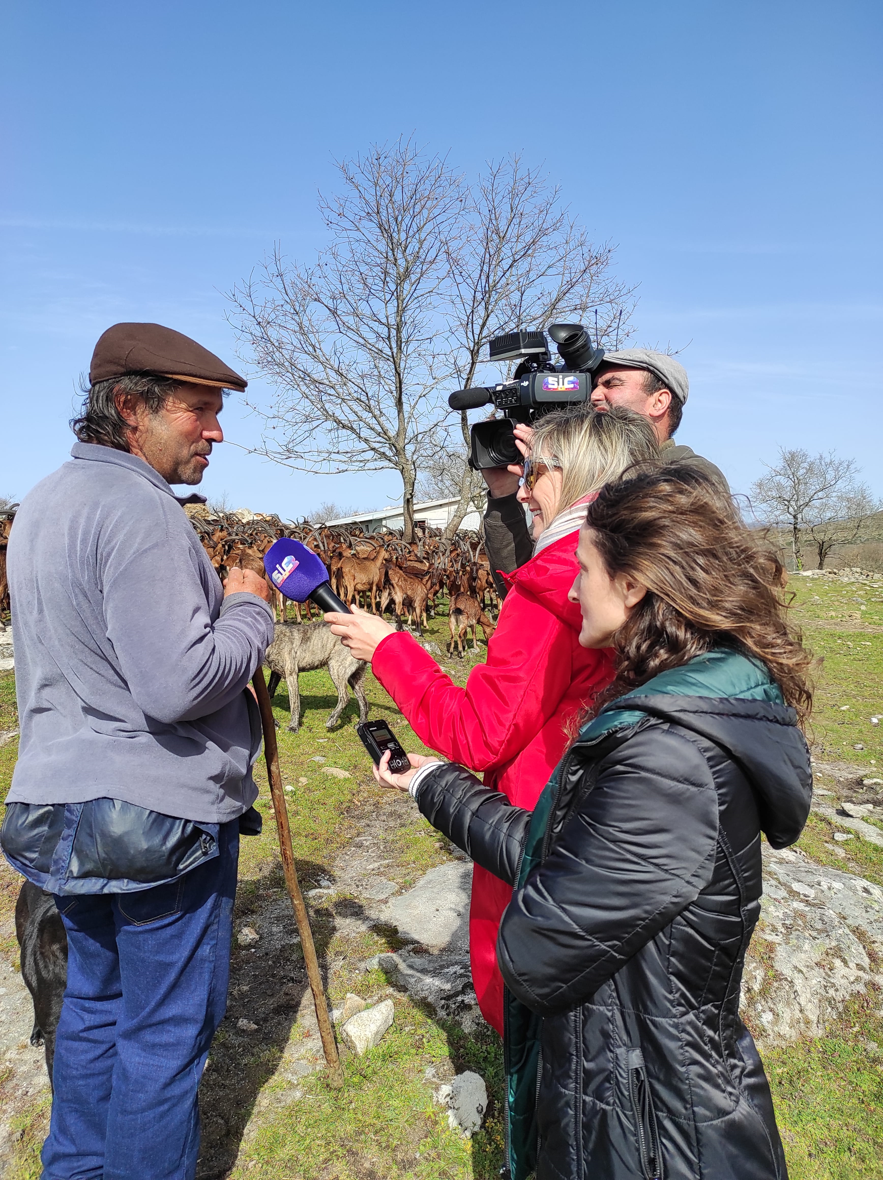
Example IYRP Programming Plans
Idaho: Home on the Idaho Range video series: Story told through two entwined narratives about both the sociocultural and natural history of Idaho’s range. A limited series of five one-hour episodes
Utah: also planning a statewide program
Canada: info-commercial - https://youtu.be/eKoRnA3ytW8
Portugal: The association Terra Maronesa hosted the launch of IYRP 2026 in Portugal on March 28th. The event was filled with activities in the Serra do Alvão and benefited from national media coverage.
Rangelands Partnership: How can we be a part of of this once in a lifetime opportunity?

Slide 7
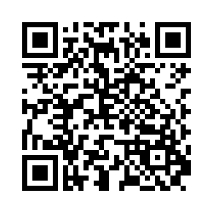
IYRP Qualtrics Survey:
https://tahr.qualtrics.com/jfe/form/SV_3w1YOzD2svP5UCa

