Slide 1

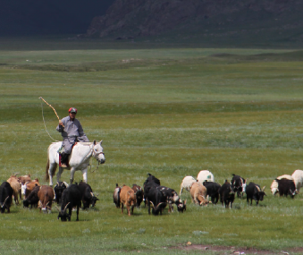
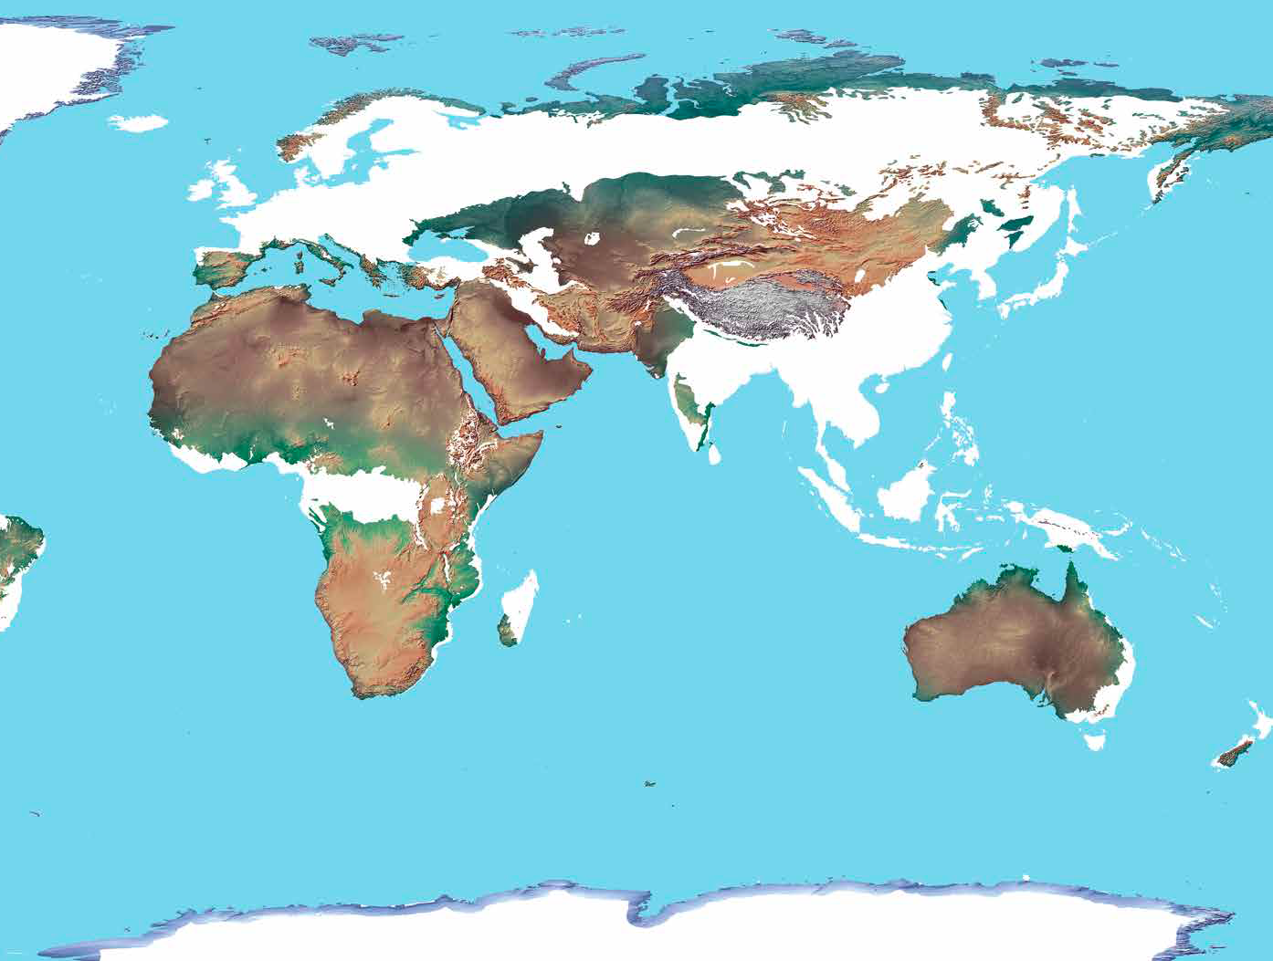
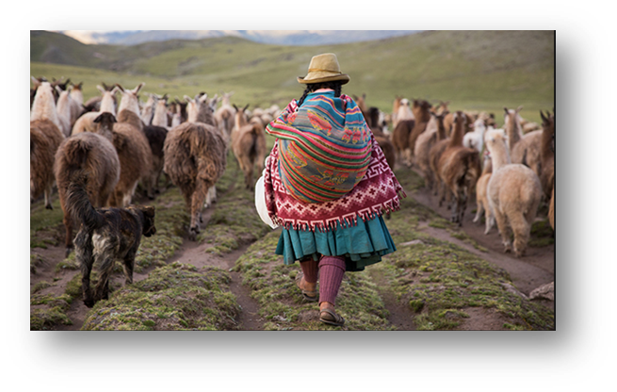
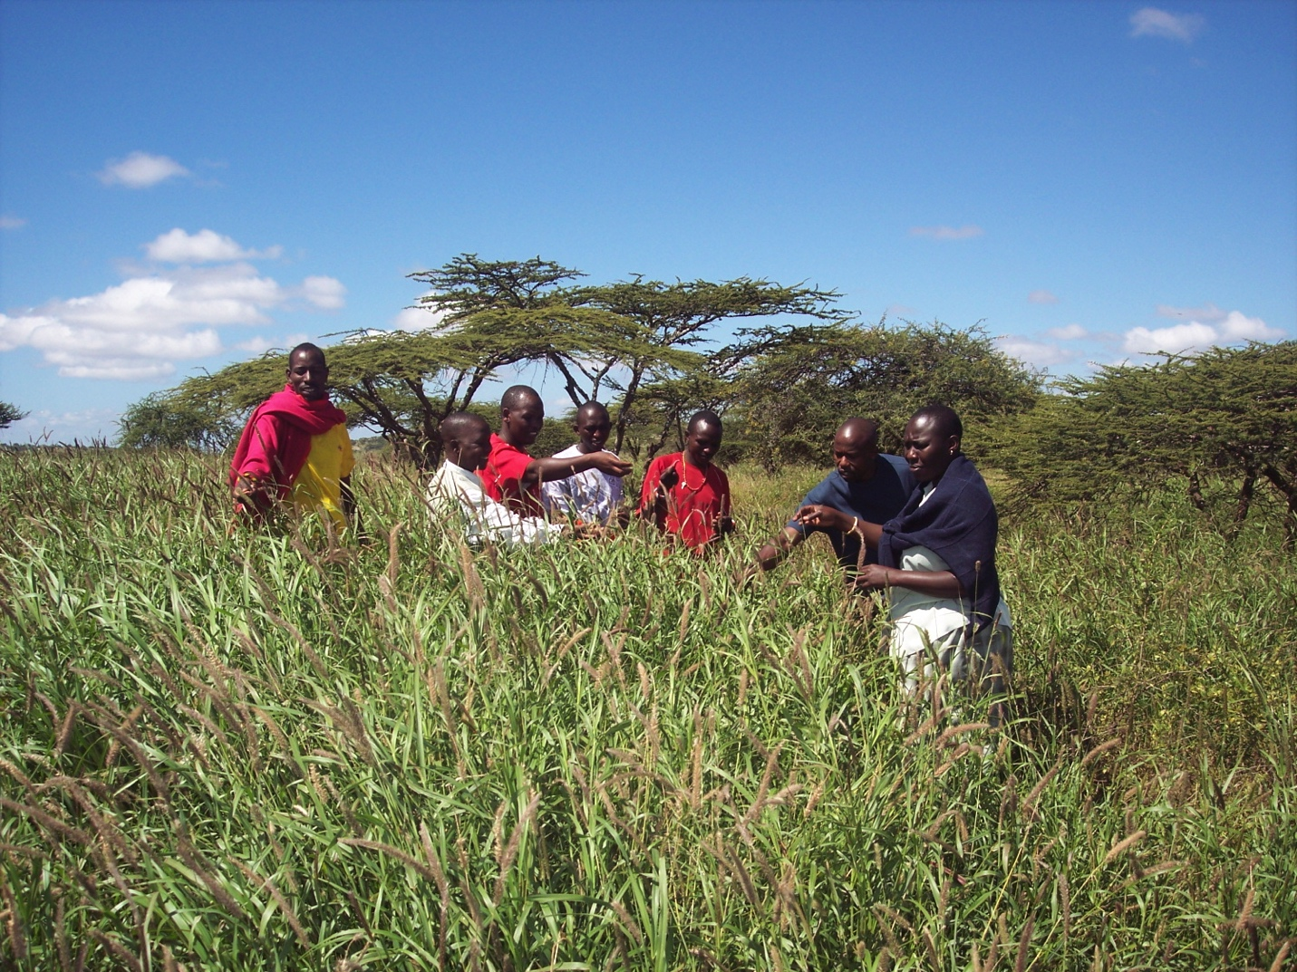
WELCOME TO THE IYRP BOOTH
Global effort to support the International Year of Rangelands and Pastoralists (IYRP) in 2026
WHY AN IYRP?
GETTING TO SUSTAINABILITY
WHO ARE PASTORALISTS ? WHAT ARE RANGELANDS?
YOUR ACTIONS MATTER

Slide 2
YOUR actions matter
Exert your influence, get involved, be part of the IYRP for 2026 !
JOIN NOW!
Contact your governmental officials (ministries of agriculture, environment, foreign affairs, etc.) and request support for the IYRP 2026.
Promote the IYRP 2026 on your organization’s website, social media & other communication outlets and forward its hashtags to your government representatives.
Join the IYRP International Support Group [email to iyrp@iyrp.info].
Learn more: https://www.iyrp.info

Slide 3
Why an IYRP 2026 ?
Reveal critical contributions of rangelands & pastoralists for food security, the economy and the environment
Break myths and misunderstandings
Fill knowledge gaps with more participatory research
Promote informed, science-based policies and legislation throughout the world
Increase sustainable and ethical investment in rangelands
IYRP 2026 global monthly themes
https://iyrp.info/sites/iyrp.org/files/IYRP%2012%20Global%20Themes%20graphic%20and%20text_0.pdf
IYRP global action plan
https://iyrp.info/sites/iyrp.org/files/DRAFT%20Action%20Plan%20for%20IYRP%20ver9april2021%20edited2.pdf

Slide 4
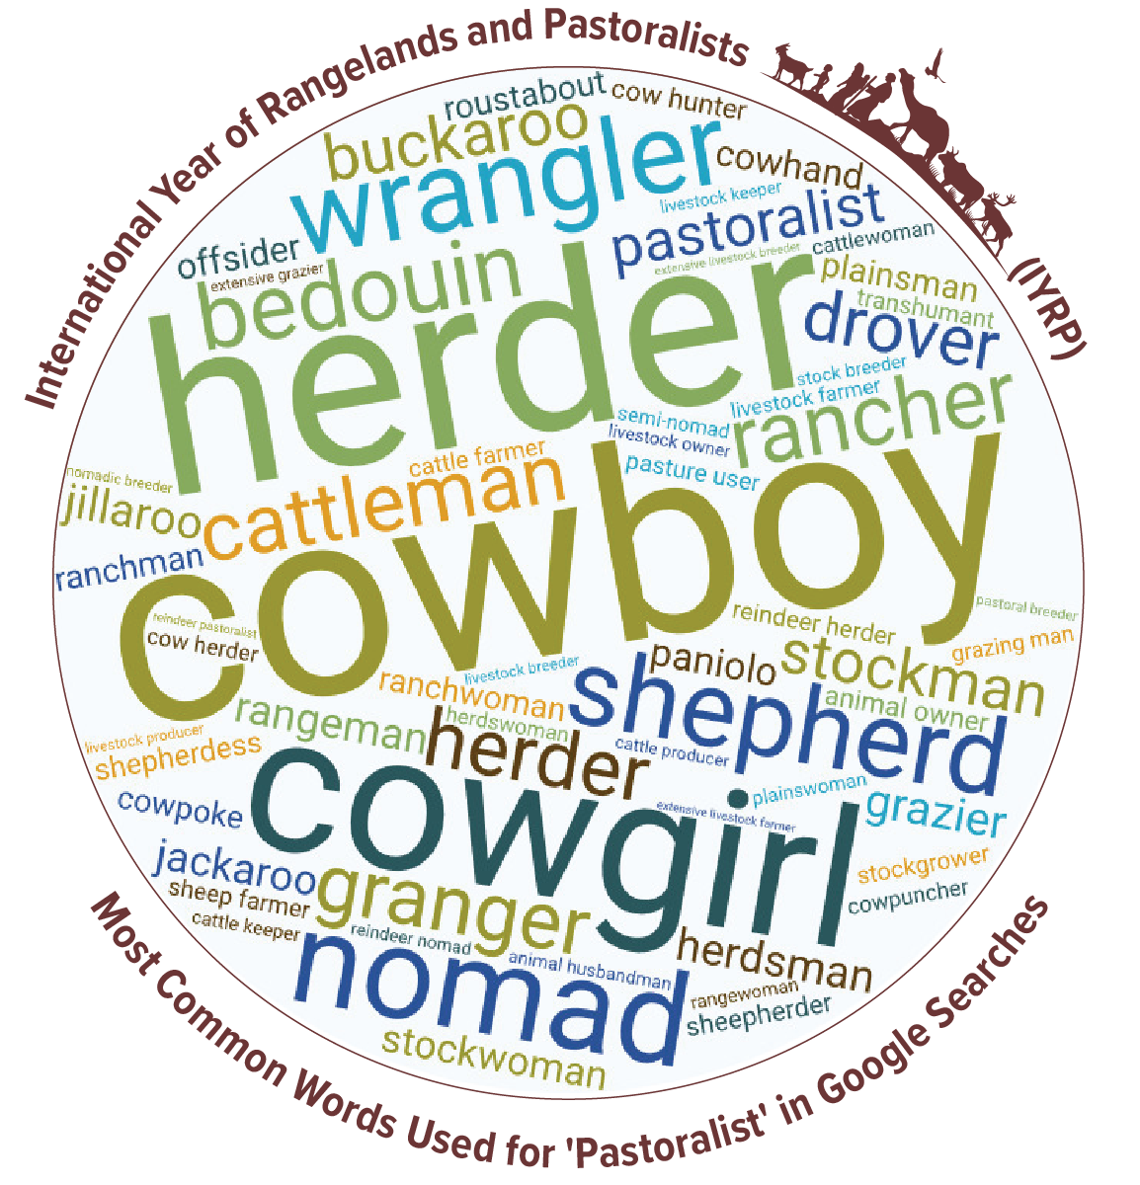
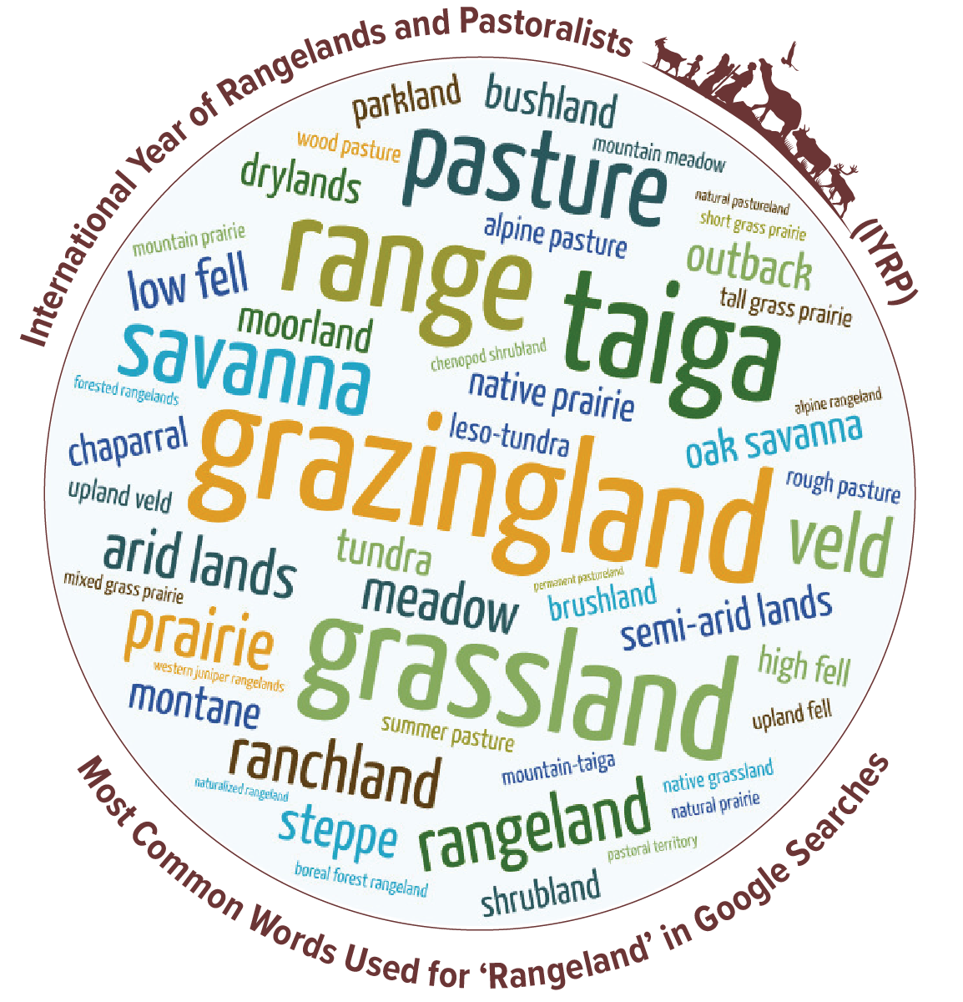
Who are pastoralists? What are rangelands?
We go by many different names:

Slide 5
Getting to sustainability
Rangelands support livelihoods of 500 million people
and another 2 billion people along the value chain.
Pastoral livestock products have high-value protein
and are rich in nutrients.
Carbon sinks can be significant in rangeland/pastoral
systems.
Rangelands are global biodiversity hotspots and
habitats for numerous endangered species and offer
valuable grazing land for both livestock & wildlife.
Rangelands cover at least 54% of Earth’s land.
Pastoralism is the Future !
WATCH THIS! https://www.youtube.com/watch?v=DeqITzac9Ac

