Slide 1
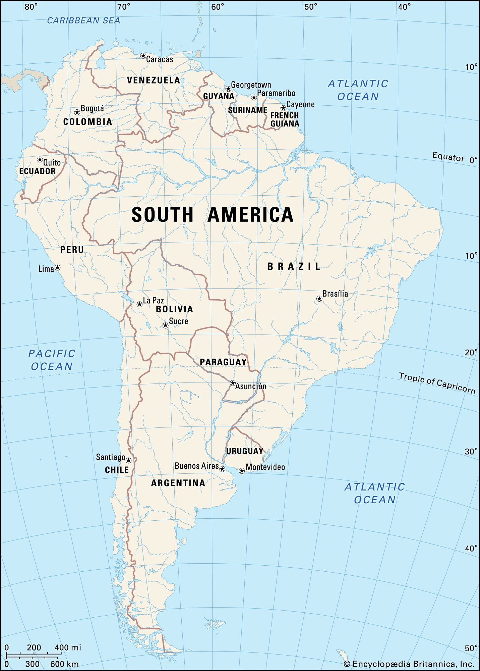
RISG South America
Report Action Plan
Virtual Symposium IYRP 2023 | 7 Feb 2023, SRM Boise Idaho
Co-chairs:
Cecilia Turin, Pablo Manzano and Pablo Frere
07 Feb 2023

Slide 2
Table 1: South America priorities IYRP 2026
 | 12 IYRP themes
1 | Increasing societal awareness of importance of rangelands and pastoralists
2 | Securing access to rangelands by pastoralists.
3 | Improving access to services and other resources for pastoralists
4 | Rangelands, pastoralism, climate change and resilience
5 | Preserving biodiversity and ecosystem services on rangelands
6 | Water, soils and land use: mitigating natural resource degradation and managing multiple uses on rangelands
7 | Promoting sustainable consumption of livestock products
8 | Promoting pastoralist knowledge, culture and innovation
9 | Promoting sustainable livestock production
10 | Promoting the well-being of pastoralist women
11 | Promoting the well-being of pastoralist youth
12 | Promoting sustainable technologies and innovations for rangelands and pastoralists

Slide 3
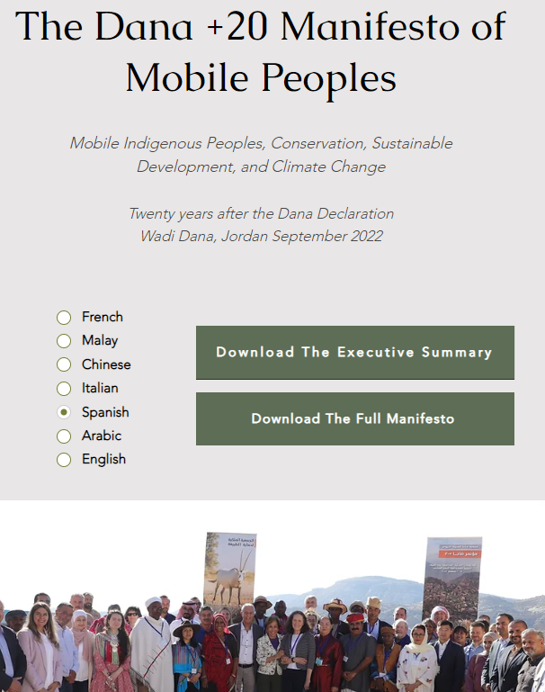
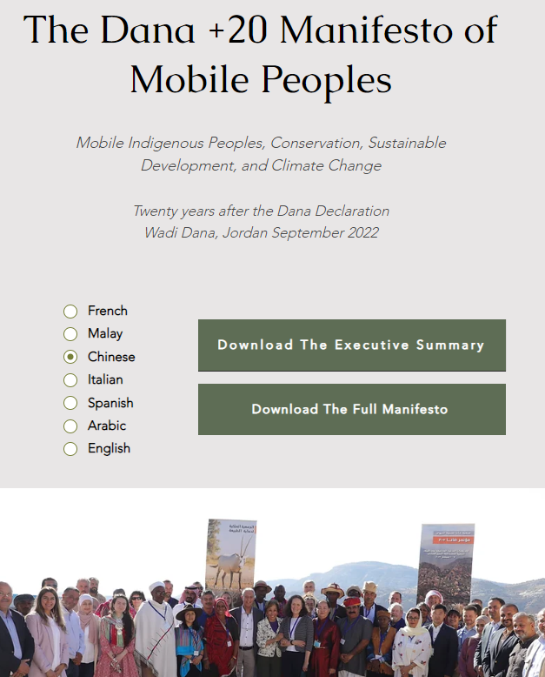
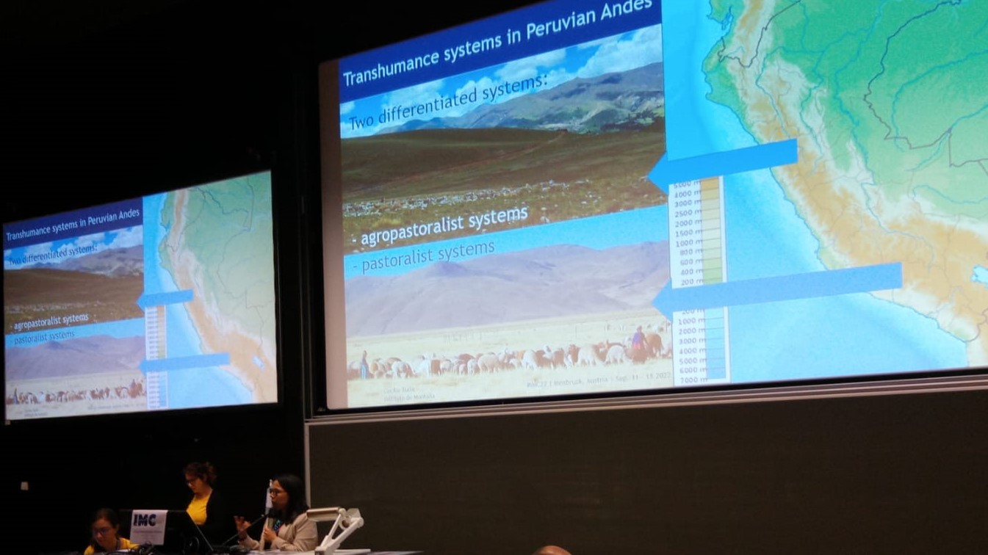
International events
Dana + 20 meeting, Jordan, September 2022. Technical delegate.
IMC 2022. Session “Past, Recent and Future Changes in Mountain Transhumance”. Innsbruck, Austria, September 2022. Presentation of Peruvian Andean pastoralism.
https://www.danadeclaration.org/dana-20-manifesto

Slide 4
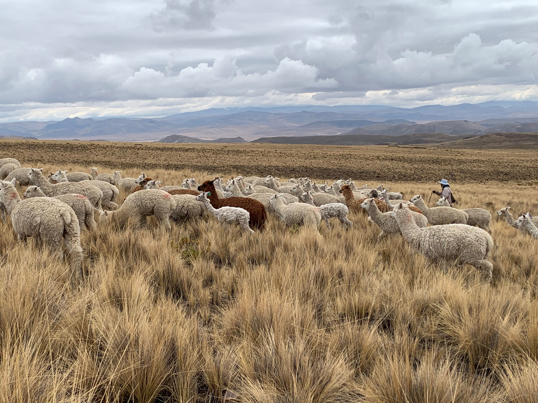
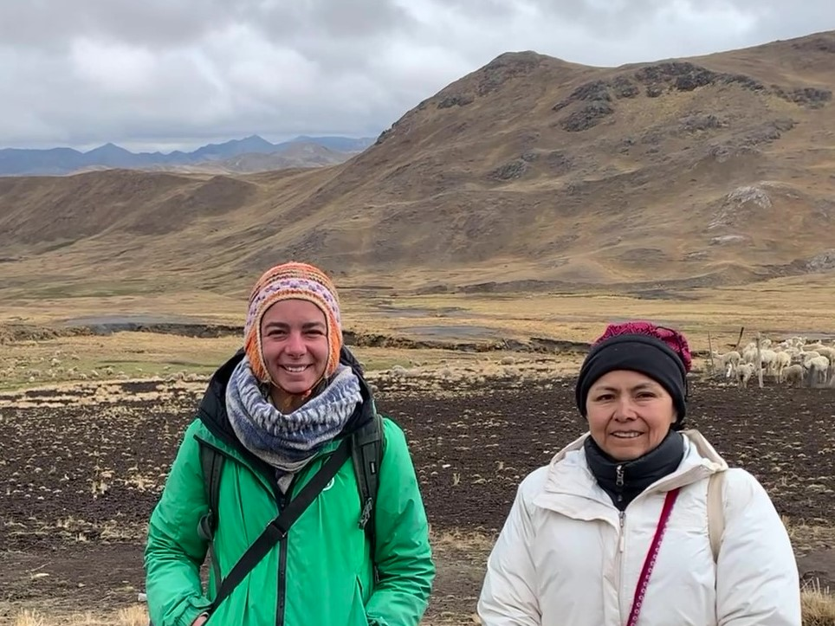
Explorative study to update information of pastoralist and transhumance systems in Latin America
Greta Semplici, post-doctoral fellow of PASTRES with support of RISG SA co-chair Pablo Manzano, started an explorative study of pastoralists systems in Latin-American countries (Mexico, Colombia, Peru and Argentina).

Slide 5
Support letters to IYRP 2026 and increase awareness
Coordination with Government of Peru. Ministry of Agriculture was informed about IYRP 2026 and now they are preparing the Letter of Support.
Coordination with IUCN Lantin America and FAO Peru. Both were informed and agreed to include IYRP 2026 in their agendas.
Andean Initiative – CGIAR, will provide platform to disseminate and promote IYRP 2026 in Peru and Andean region in general.
Universidad Nacional Agraria La Molina, Peru, School of Animal Husbandry is open to include a course on Andean Pastoralism (in Spanish).
Participation in the UNCCD/LDN Working Group, for the contribution of policy recommendations with examples or literature from SA.

Slide 6
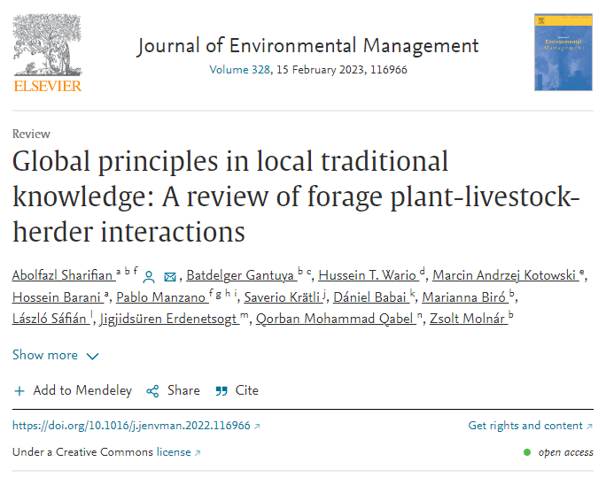
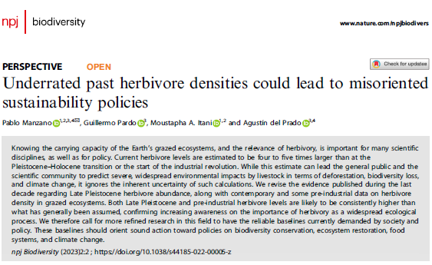
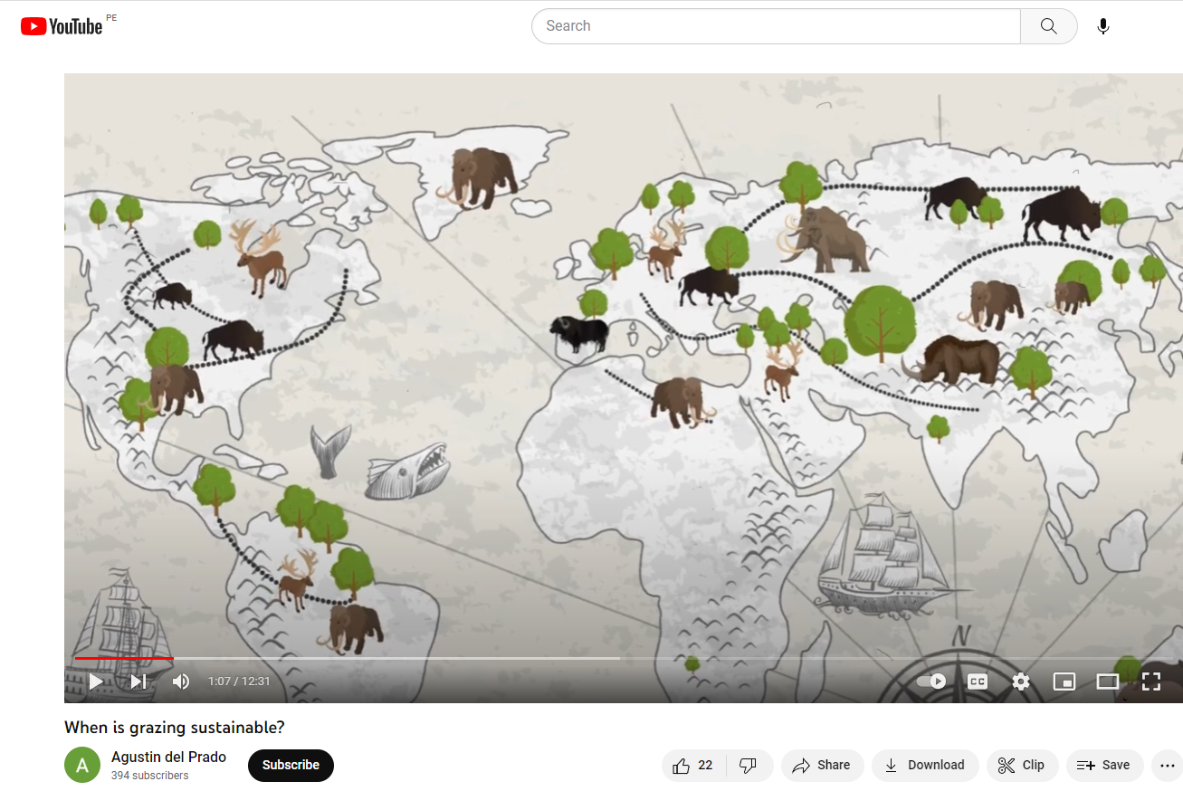
Published papers
Sharifian, A.*; Gantuya, B.; Wario, H.T.; Kotowski, M.A.; Barani, H.; Manzano, P.; Krätli, S.; Babai, D.; Biró, M.; Sáfián, L.; Erdenetsogt, J.; Qabel, Q.M.; Molnár, Z. (2023). Global principles in local traditional knowledge: a review of forage plant-livestock-herder interactions. Journal of Environmental Management 328 (15 Feb 2023), 116966. https://doi.org/10.1016/j.jenvman.2022.116966
Manzano, P.*; Pardo, G.; Itani, M.A.; del Prado, A. (2023). Underrated past herbivore densities could lead to misoriented sustainability policies. npj Biodiversity 2, 2. https://doi.org/10.1038/s44185-022-00005-z
A video: When is grazing sustainable? https://www.youtube.com/watch?v=-9ku3t9JesM&t=2s

